Slide 1
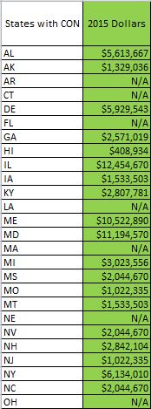
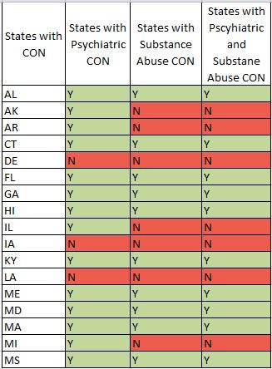
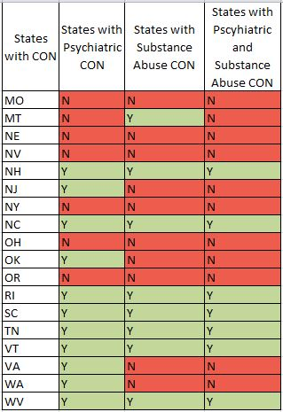
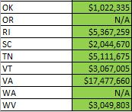
COLLEGE OF PUBLIC HEALTH AND HUMAN SCIENCES
The Current Status of Psychiatric Certificate of Need in the United States
Ashley Callahan, student; Karen Volmar, JD, MPH; Connie Wu, BA; Jangho Yoon, PhD, MSPH;
School of Social and Behavioral Health Sciences
Background
Certificate of Need (CON) laws provide state level review of the need for additional health care resources in a given community.
General CON regulations on medical services have been relatively well-documented.
Little attention has been paid to state CON regulations for psychiatric and substance abuse care and their impacts on the efficiency supply of services.
No effort has been made to document the current status of CON laws on psychiatric and substance abuse care and state characteristics influencing nationwide variation.
Surveyed the current status of CON using state CON websites and Lexis/Nexus (a legal databases of state statutes and regulations).
The research demonstrates the need for further exploration of the impact of CON on the availability of mental health and substance abuse services and subsequently relevant population health outcomes.
Purpose
The purpose of this project is to document the current status of CON for psychiatric and substance abuse services in the United States.
Certificate of Need (CON)
CON laws are one way by which state governments seek to reduce overall health and medical costs.
New York, in 1964, was the first state to enact a statute that granted the state government power to determine the need for a new hospital or nursing home before it was approved for construction.
Four years later in 1968, the AHA expressed an interest in CON laws and started a national campaign for states to generate their own laws.
In 1974 there was a federal mandate requiring all 50 states to structure a proposal approval system before beginning major capital projects.
Many states implemented CON programs because there was an incentive of receiving CON federal funds.
The federal mandate and federal funds were repealed in 1987 and in the following decade 14 states discontinued their CON programs.
Methods
CON status was determined using The National Conference of State Legislatures website with the CON Programs table
In order to determine the status of general, psychiatric, and substance abuse CON in the U.S., the Certificate of Need: State Health Laws and Programs page was accessed.
The American Health Planning Association (AHPA) CON Program Directory was then used to supplement and verify information on CON programs.
For further information state government websites were viewed along with online legal databases of state statues and regulations.
Findings
36 states currently have some form of CON program.
25 states have CON for psychiatric services
18 states have CON for substance abuse services
17 states have CON for both psychiatric and substance abuse services
The most common psychiatric service regulated under CON is inpatient psychiatric care beds in a licensed general hospital.
Lessons Learned
CON varies among many aspects such as:
States
Services
Facilities
Thresholds
There is very little consistency among CON in the United States.
CON creates variation in the supply of psychiatric and substance abuse services.
Direction for Future Research
To provide the historical account of psychiatric and substance abuse CON regulations in the United States.
Use preliminary data on state psychiatric CON regulations for subsequent quantitative analysis on the effect of psychiatric CON on population mental health outcomes.
Look to explore if there is a relationship between CON and psychiatric health between individuals and the community.
Look to see if the availability of psychiatric services varies according to the type and degree of CON.
References
American Health Planning Association (2013). National Directory of State Certificate of Need Programs Health Planning Agencies. (23rd Ed.). Falls Church, VA.
Cauchi, R., Hanson, K., Thangasamy, A., & Victoroff, A. (2013). Certificate of Need: State Health Laws and Programs. Retrieved May 5, 2015, from http://www.ncsl.org/research/health/con-certificate-of-need-state-laws.aspx
State Government Health Planning or Certificate of Need websites
The Current Status
Thresholds are used in CON programs to determine what point must be exceeded before CON review is necessary. It is important to recognize what expenditures are regulated by CON to further compare state CON programs. The table above shows the capital expenditure thresholds for states with psychiatric CON. Capital threshold amounts have been rounded to the nearest dollar and reflect 2012 figures adjusted for inflation.
The chart above illustrates the current status of psychiatric and substance abuse CON in the United States. The three categories used to describe the current status of CON include states with psychiatric CON, states with substance abuse CON, and states with psychiatric and substance abuse CON. A state with the specified CON program is indicated by the letter “Y” and colored green. A state without the specified CON program is labeled with the letter “N” and colored red.

