Slide 1
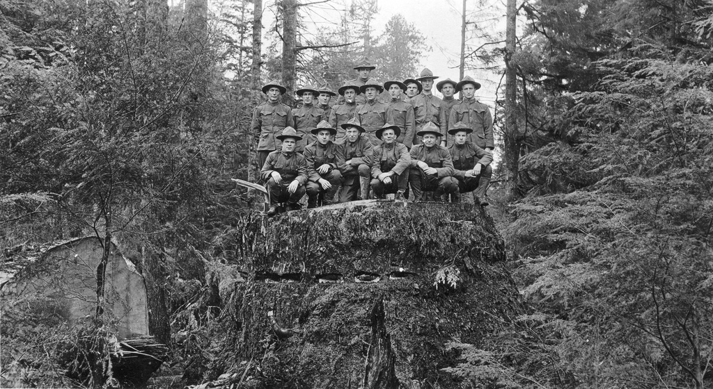
Labor Relations – Authorized by the Secretary of War: The Loyal Legion of Loggers and Lumbermen and its Unique Contribution to the Great War Effort 1916-1918 Mike Dicianna

Slide 2
Spruce for the Air Fir for the Sea
Spruce – Strong, light and does not splinter when hit with bullets
Spruce production from Pacific Northwest – Strategic resource
United States enters WWI – April 1917

Slide 3
Industrial Workers of the World “Wobblies”
Founded Chicago -June 1905
"an injury to one is the concern of all."
Preamble to the
IWW Constitution
The working class and the employing class have nothing in common.
There can be no peace so long as hunger and want are found among millions of the working people
we must inscribe on our banner the revolutionary watchword, "Abolition of the wage system.

Slide 4
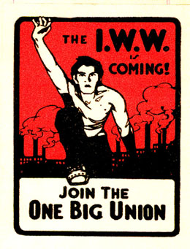
Wobblies attempt to organize Timber Workers in Northwest
Call for general strike 1917
8 Hour workday
Pay increases
Better food & living conditions in camps

Slide 5
Formation of Loyal Legion of Loggers and Lumbermen to break the Wobblies
“Legion” terminology chosen to set the 4L apart from IWW
Lt. Colonel Brice P. Disque

Slide 6
LLLL pledge draws on patriotic fervor after U.S. enters the Great War
11,000 members take pledge to “stamp out sedition”
Membership pin worn

Slide 7
U.S. Army/LLLL publications Patriotic and anti-wobblie themes
Monthly Bulletin used to promote patriotism and anti-Wobblie articles
Publications were produced by US Army Signal Corps in Portland

Slide 8
I.W.W. Propaganda of WWI era

Slide 9
“The Northwest woods had become a field of honor…They fought, these lumberjacks in khaki.”
The Loyal Legion would continue after WWI , closing during the depression.
143,008,961 board feet of spruce was shipped from the Northwest forests
$12 ,000,000 of equipment sold to the NW Timber industry

