Slide 1
Oxytocin-dependent MARCKS protein phosphorylation in the ovine endometrium
By: Kyle Ireton
Dr. Fredrick Stormshak

Slide 2
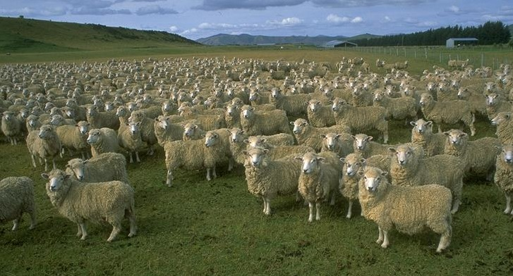
USDA National Agricultural Statistics Service
(2011)
5,530,000 sheep in USA
(2010)
$563,202,000 gross income

Slide 3
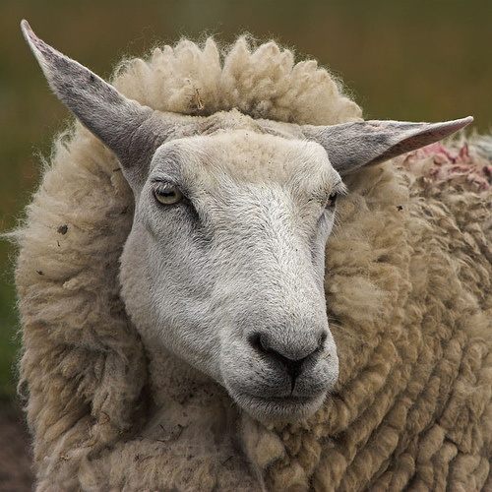
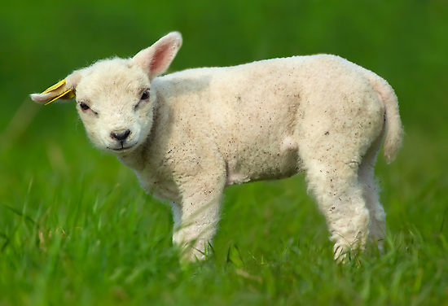
Reproductive biology fundamentals
How do we go from this…
To this?
Similarities between ovine and human anatomy make them a compelling subject for scientific study, for what they may reveal about our own bodies.

Slide 4
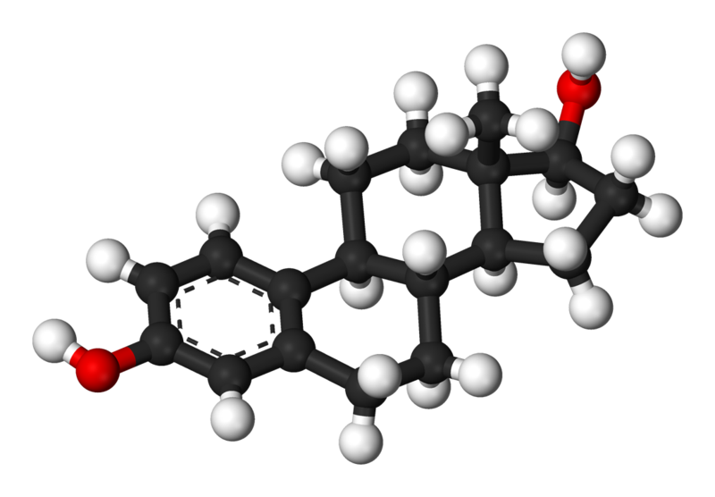
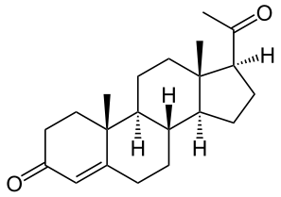
Estrous cycle steroid hormones
Estradiol-17β (E₂) and
Progesterone (P₄)
prepare uterus to be receptive to fertilized embryos
Estradiol-17β (E₂)
Progesterone (P₄)

Slide 5
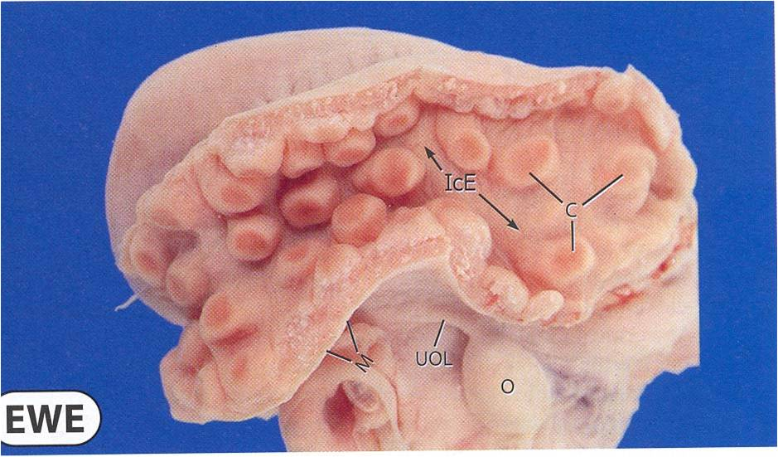
Fetus develops in uterus
Interior lining of uterus is endometrium
Caruncles are endometrial “hooks”
Caruncles

Slide 6
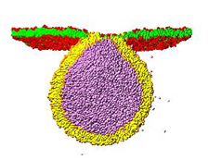
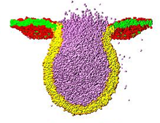
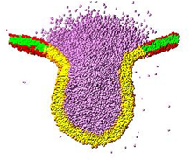
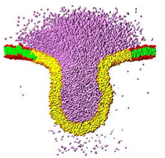
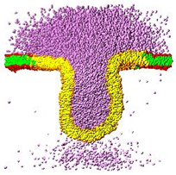
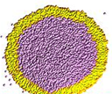
Regulation of fetal development
Exocytosis (cell secretion) delivers cellular products across endometrium, into uterine environment
Exiting cell
Vesicle integrates self into PM, expels products outside cell

Slide 7
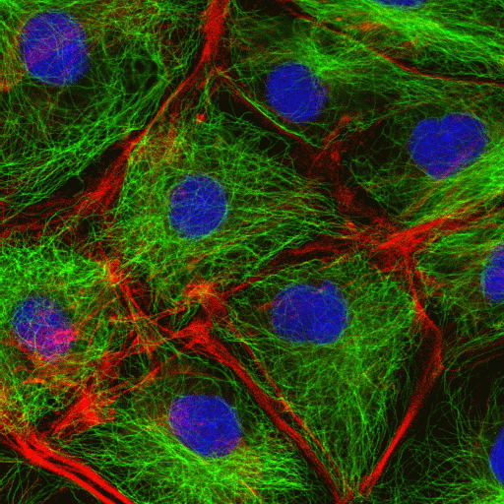
Context: Actin cortex barrier
Actin cortex prevents vesicles from reaching PM
BLUE = Nuclei
RED = Actin
GREEN = Microtubules
http://www.bscb.org/softcell/images/mp_tripple.gif

Slide 8
Context: Actin cortex barrier
Actin cortex filaments
Plasma membrane
Vesicle is unable to cross actin cortex to access PM
Actin cortex must unravel to allow vesicle passage
Notes:
Add entrance effects to MARCKS, Myristic acid bit, electrostatic interaction, actin cortex binding to MARCKS
***Make sure each component of diagram is broken down and explained before animations begin***

Slide 9
Context: Actin cortex disassembly
A mechanism for disassembly has been observed in the ovine corpus luteum.

Slide 10
Context: Actin cortex disassembly
Myristoylated alanine-rich C kinase substrate
(MARCKS) coordinates actin cortex, tethers to PM
Actin cortex filaments
Introduce PO₄³⁻
MARCKS protein
Plasma membrane
Vesicle is able to access PM
Myristic acid
Notes:
Add entrance effects to MARCKS, Myristic acid bit, electrostatic interaction, actin cortex binding to MARCKS
***Make sure each component of diagram is broken down and explained before animations begin***

Slide 11
Context: Actin cortex disassembly
This mechanism is hypothesized to play a role in ovine endometrial cellular secretion.

Slide 12
Context: MARCKS phosphorylation
Steroid hormone
Steroid hormone receptor
Plasma membrane
DAG
Protein kinase C
Activated PKC phosphorylates MARCKS
IP3
ER releases Ca²⁺
MARCKS protein

Slide 13
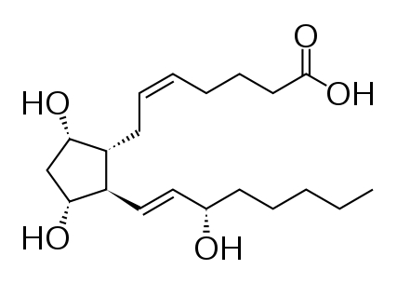
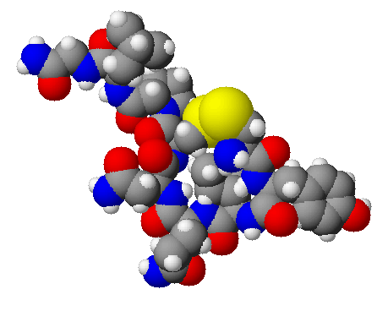
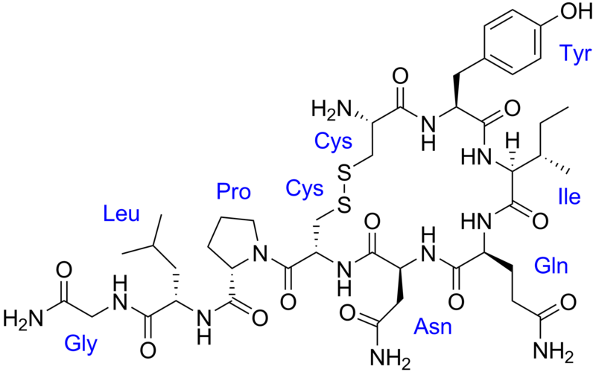
Context: OT & PGF_{2α}
Prostaglandin F_{2α} (PGF_{2α})
PGF_{2α} secreted in response to OT
Oxytocin (aka OT)
OT acts as steroid hormone

Slide 14
Context: MARCKS phosphorylation
Steroid hormone (e.g. OT)
Steroid hormone receptor
Plasma membrane
DAG
Protein kinase C
Activated PKC phosphorylates MARCKS
IP3
ER releases Ca²⁺
MARCKS protein

Slide 15
Research focus:
Will Oxytocin (OT) induce MARCKS protein phosphorylation in the ovine endometrium?

Slide 16
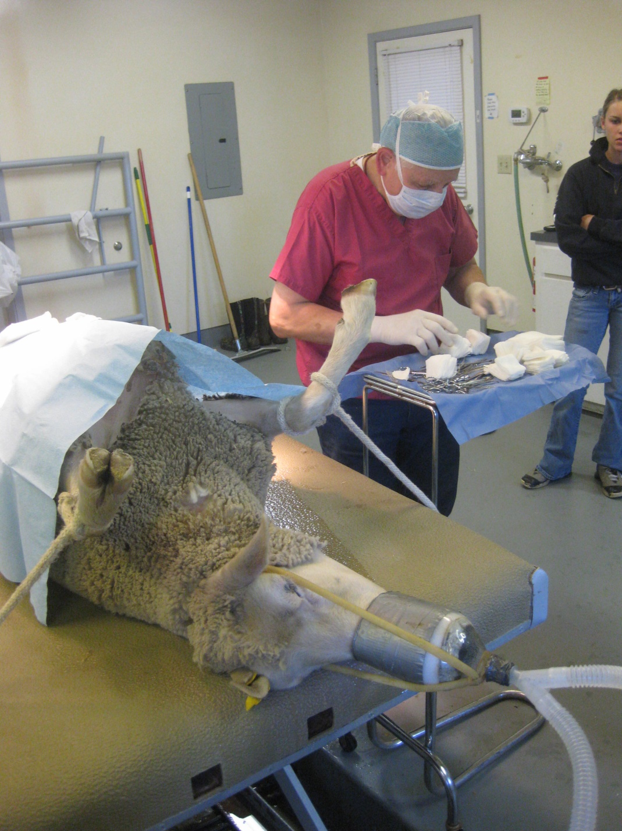
Methodology: Ovariectomization
10 ewes for study were prepared by removing ovaries – removing source of E₂ & P₄

Slide 17
Methodology: Hormone treatment
Ewes were injected with E2 & P4 to simulate estrous cycle.

Slide 18
Methodology: Injection Protocol
Group 1:
Group 2:
E₂ = Estradiol 17β
P₄ = Progesterone
Lap. = “Laparotomy” surgery

Slide 19
Methodology: OT receptor by group
Group 1 has significantly more OT receptor
Group 2 has significantly less OT receptor

Slide 20
Methodology: Tissue recovery
Tissue was recovered by laparotomy
(making incision into abdomen).

Slide 21
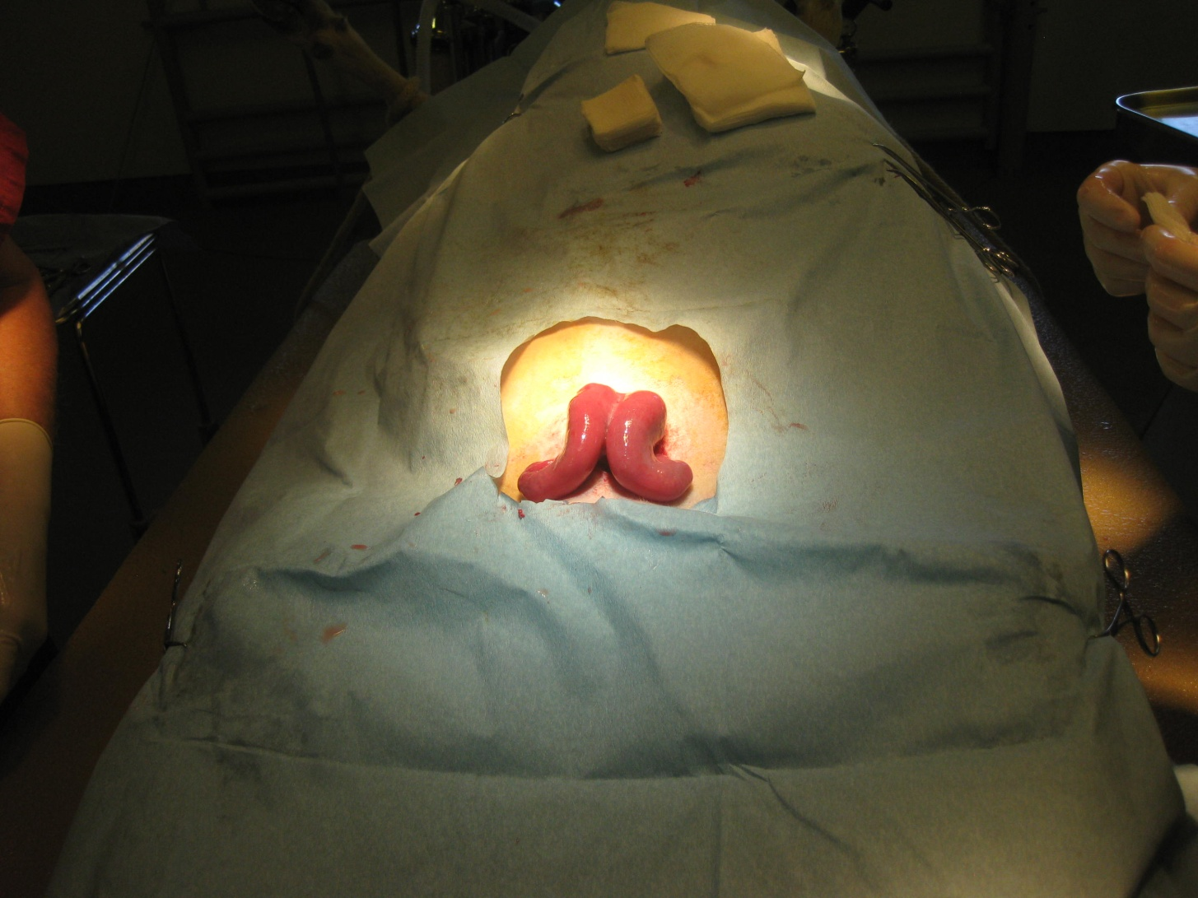
Methodology: Tissue recovery
Uterus is exposed,
then opened to reveal endometrial lining.

Slide 22
Methodology: Collect tissue samples
Tissue harvested from inter-caruncular areas
After recovery, tissue samples are transported to laboratory on ice for processing.

Slide 23
Methodology: ³²P incubation & OT
Incubate in ³²P
Only ³²P-labeled MARCKS remains
Add Oxytocin
MARCKS Protein

Slide 24
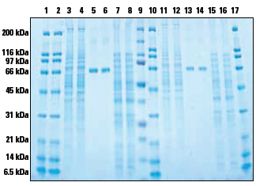
Methodology: SDS-PAGE
Polyacrylamide gel electrophoresis (PAGE)
Various proteins separate by size (measured in kilodaltons, kDa)

Slide 25
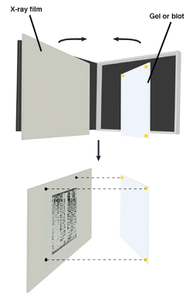
Methodology: Autoradiography
Autoradiography shows ³²P-labeled proteins

Slide 26
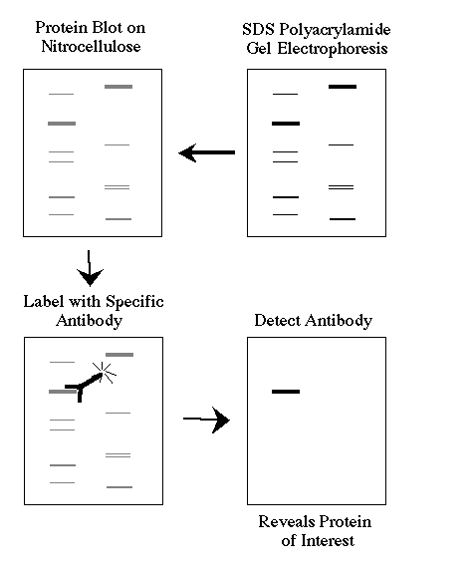
Methodology: Laboratory analysis
Western blotting specifically labels MARCKS protein for visualization
Transfer SDS-PAGE to PVDF

Slide 27
Methodology: Interpretation of results
Significantly higher levels of phosphorylation in Group 1 would indicate the OT receptor is playing a role in mediating the process.
Compare relative quantity of phosphorylated MARCKS between Group 1 & Group 2 ewes

Slide 28
Results:

Slide 29
Online references
http://www.awesomefarmny.com/uploaded_images/DSC_0264-793114.JPG
http://www.greenewave.com/wp-content/uploads/2011/04/domestic-sheep-herd-full.jpg
http://www.nass.usda.gov/Statistics_by_State/South_Dakota/Publications/Annual_Statistical_Bulletin/2011/ab11037c.pdf
http://ocw.usu.edu/University_Extension/sheep-and-lambing-management/sheep.jpg
http://1.bp.blogspot.com/_iQB-2Y_Kzwk/S-8f5gmNQnI/AAAAAAAADDQ/PWV6at5pVo8/s1600/cute-baby-sheep.jpg
http://en.wikipedia.org/wiki/File:Oestradiol-3D-balls.png
http://en.wikipedia.org/wiki/File:Progesteron.svg
http://complex.upf.es/~josep/collage9725.jpg
http://en.wikipedia.org/wiki/File:Oxytocin3d.png
http://www.scienceprogress.org/wp-content/uploads/2007/12/radioactive_symbol_250.jpg
http://www.nationaldiagnostics.com/images/4_1_3a.gif
http://www.bio.davidson.edu/courses/genomics/method/westernblot.gif
http://en.wikipedia.org/wiki/File:Oestradiol-3D-balls.png
http://en.wikipedia.org/wiki/File:Oxytocin3d.png
http://en.wikipedia.org/wiki/File:Oxytocin_with_labels.png
http://en.wikipedia.org/wiki/File:Dinoprost.svg
http://www.piercenet.com/media/Pierce-Precast-PAGE-Gel-Fig1x324v2.jpg

Slide 30
Acknowledgments
HHMI 2011 Program
Dr. Kevin Ahern
Dr. Fredrick Stormshak
Mary Meaker
Dr. Cecily Bishop
Dr. Nathan Lopez
Dr. Viola Manning
Dr. Caprice Rosato
Dr. Dan Arp
Ellie Murray
Lane Mellor
Mark & Shelley Ireton

