Slide 1

Spectroscopic and Structural Characterization of FXR Agonists and Antagonists
Xiao Lan Chang
Mentor: Victor Hsu
Department of Biochemistry and Biophysics

Slide 2
Farnesoid X Receptor (FXR)
Metabolic Syndrome
Central Obesity
High blood pressure
High triglycerides
Low HDL-cholesterol
Insulin resistance
FXR
Glucose homeostasis
Lipoprotein metabolism
Bile acid homeostasis
Liver regeneration
Notes:
FXR is currently being studied by many researchers for its pharmaceutical effect on metabolic syndrome. Therefore I would like to study the molecular binding properties of ligands and fxr so that I could possibly establish a larger variety of drugs that are capable of activating or deactivating fxr activity.

Slide 3
FXR Gene Regulations
Organ | Function | Gene Product | Regulatory Effect
Liver | Bile Acid Metabolism | BSEP MRP2 MDR3 SHP BAT BACS NTCP CYP7A1 CYP8B1 Mrp4 | Induced Induced Induced Induced Induced Induced Repressed Regulated Repressed Induced
 | Lipid Metabolism | SREBP-1c ApoAI ApoB ApoCII ApoCIII PDK4 | Repressed Repressed Repressed Repressed Repressed Induced
 | Glucose Metabolism | PEPCK Glucose-6-phosphatase | Induced or Repressed Induced
Small Intestine | Bile Acid Transport | IBABP FGF15 ASBT | Induced Induced Induced
Kidney | Bile Acid Transport | OST MRP2 ASBT | Induced Induced Repressed
Heart and Blood Vessels | Vascular Function | Endothelin1 ICAM1 VCAM1 DDAH1 | Repressed Induced Induced Induced
Notes:
FXR is found mainly in the liver, intestine, kidney, and heart. It is a nuclear hormone receptor that is capable of regulating various types of genes, therefore, taking part if numerous cellular functions. When FXR is activated, it can either induce or repress the production of a gene product; therefore, it has both beneficial or detrimental effects.

Slide 4
Notes:
This is an example of something negative that could occur from the activation of FXR. So cholesterol is a natural ligand for liver x receptors and the binding of those two will activate the transcription of CYP7A1 therefore starting the production of bile acids. When the concentration of bile acids is high enough it will eventually bind to fxr to start the transcription and production of small heterodimer partners. They can then go back and bind to liver x receptors to inhibit the transcription of CYP7A1. This is a feedback loop for bile acids to control its own concentration. The end result would be a low concentration of bile acids and high concentration of cholesterols.

Slide 5
Purpose
Development of a biophysical assay that can be used to facilitate the direct identification of agonist and antagonist ligands of FXR
Notes:
So the purpose of our experiment is to develop a biophysical assay that can be use to determine if a ligand would have agonist or antagonist property when exposed to FXR. By doing so, we can regulate FXR to express only certain genes so that we can target specific complications but still maintain many of the body’s general homeostasis.

Slide 6
Hypothesis
Ligands will have spectroscopic characteristics consistent with whether they exhibit agonist or antagonist properties
Notes:
So the hypothesis is that the assay will be developed by analzying the traits of the small group of known agonist and antagonist ligands; therefore, we can use the assay against unknown ligands of FXR and see that it would either have the characterizing properties of agonist or antagonist ligands.

Slide 7
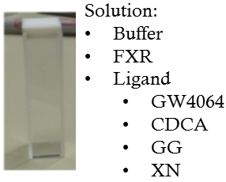
Method: Fluorescence Spectroscopy
Notes:
So the method is to use fluorescence spectroscopy to analyze the binding of a ligand and FXR. The cuvette that I use contains a solution of buffer, fxr, and a ligand. Four is currently being used: GW4064 and CDCA are agonists, GG is antagonist, and XN is hypothesized to be either. The cuvette is placed into this area of the flurometer and a total of 14 runs will occur. In each run, the solution will be titrated with a difference concentration of acrylamide. So what the machine does is that it shoots a bean of light to the solution to excite the electrons to go from ground stage to excited stage. When the electrons want to go back to ground state, it will emit a source of light which the machine will read as an intensity of fluroscences.

Slide 8
Acrylamide Titration
Acrylamide is a quenching molecule
FXR is made up of 227 amino acids, two of which are tryptophan (Trp)
Notes:
Acrylamide acts as a small molecule that can absorb the energy of nearby excited electrons. Thus, when the electrons want to go back to ground stage, it will release a lower intensity of fluorescence that it would without acrylamide.
Acrylamide titrations are done to analyze the solvent exposure of tryptophan. Tryptophan is a fluorescence amino acid that makes up 2 of the 227 amino acids that compose the protein. The locations of the trp are unknown; however, these are the three possible locations. So if the trp is in the core of the protein and we add acrylamide to it, the fluorescence without acrylamide and the fluorescence with acrylamide will be exactly the same because the protein structure protects the amino acid from the solvent. However, if the trp is on the surface of the protein, the acrylamide will dramatic reduce the fluorescence since the trp is unprotected. When a ligand is added to the solution, it will either protect or increase the exposure of the trp.
Overall, the acrylamide titration is not meant to help determine where the trp is or how the various ligands bind to the protein, but rather to provide us with a method to distinguish the difference between agonist and antagonist activities on the protein. Thus, we can use this information to create an assay.

Slide 9
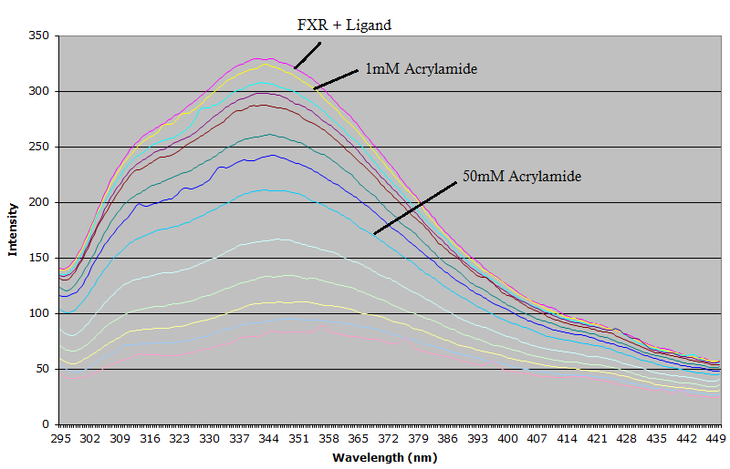
Fluorescence Spectroscopy
Notes:
So this is an example of a dataset from the flurometer.

Slide 10
Method: Stern-Volmer Relationship
F0 is the fluorescence without quenching
F is the fluorescence after quenching with given amounts of acrylamide
Ksv is the Stern-Volmer quenching constant
[Q] is the concentration of the quenching molecule
Notes:
After our data is collected and the dilution factors are counted in, we will use the stern-volmer relationship to analyze the rest of our date. This is the general equation for the stern-volmer relationship. Acrylamide is a quenching molecule.

Slide 11
Prediction: Stern-Volmer Plot
Notes:
Once we analyze our date, we will observed an obvious difference between agonist and antagonist ligands and similarities between the same ligands

Slide 12
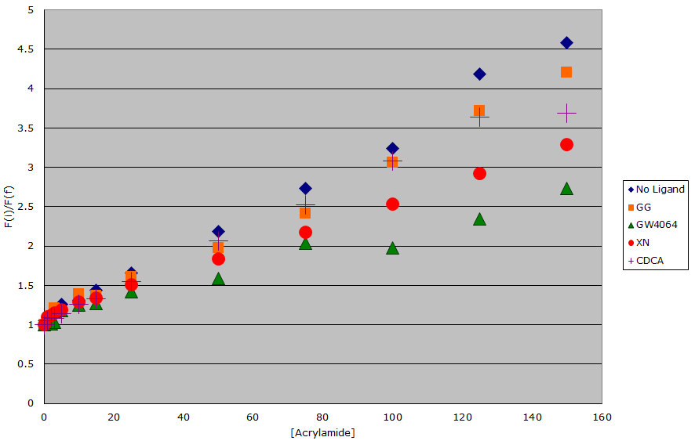
Stern-Volmer Relationship of Ligands and FXR
Notes:
Four titration were done: FXR without any binding ligands, GG, GW4064, and XN. This graph shows that the trp are not in the core of the protein because none of the slopes are 1. If we look at the slope for GW4064, we can see that it is relatively small and the individual points range from 1 to 2.25. This proposes that GW4064 is somehow protecting the trp because even as the acrylamide concentration increased, the resulting fluorescence levels are not that different than the initial fluorescence of no acrylamide. The slope for GG suggest that it did not bind to the trp because its slope is very similar to the slope of FXR without ligand. Therefore, trp is not protected and the acrylamide is dramatically decreasing the energies from the electron, thus resulting to a lower fluorescence and a larger slope.
This graph shows the averages for five titrations

Slide 13
Further Research
Additional acrylamide titrations to better confirm the observed data
Experiment with other known agonist and antagonist ligands to refine our assay
Analyzing the structure of known FXR ligands to predict the general chemical and structural property of possible agonist vs. antagonist ligands to later test the assay

Slide 14
Acknowledgment
Dr. Victor Hsu
Dr. Kevin Ahern
Liping Yang
Stefan Lucchini
The Howard Hughes Medical Institute
Undergraduate Research, Innovation, Scholarship Creativity (URISC)
Cripps scholarships

