Slide 1



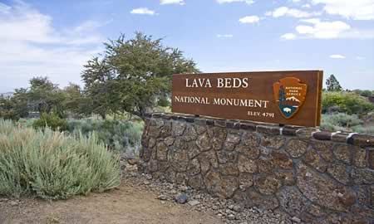
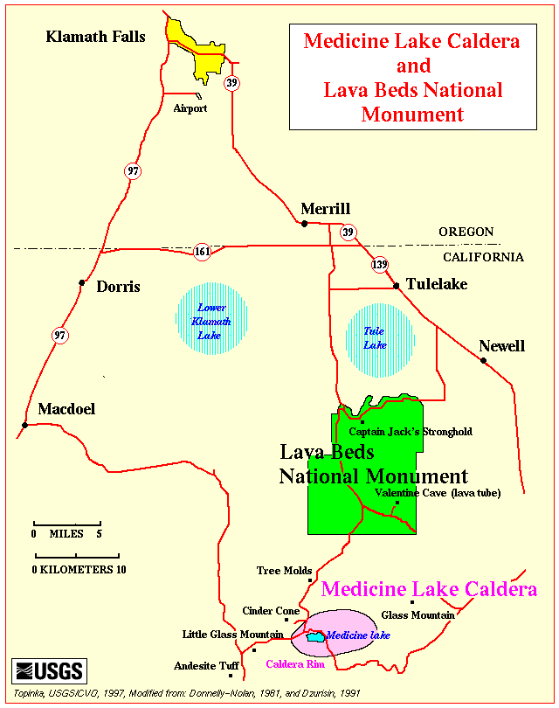
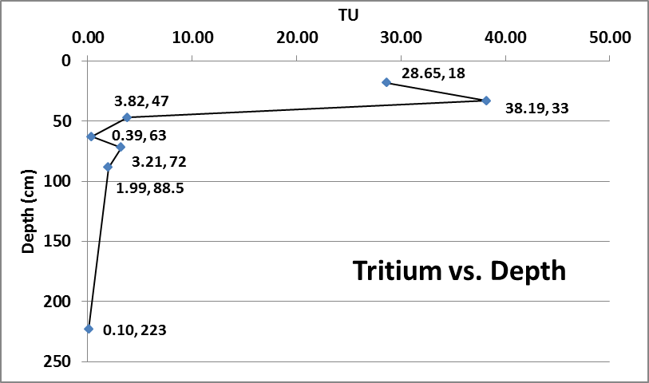
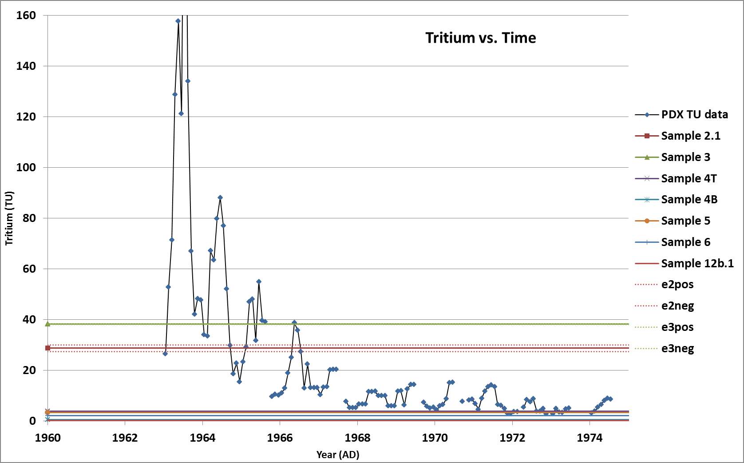
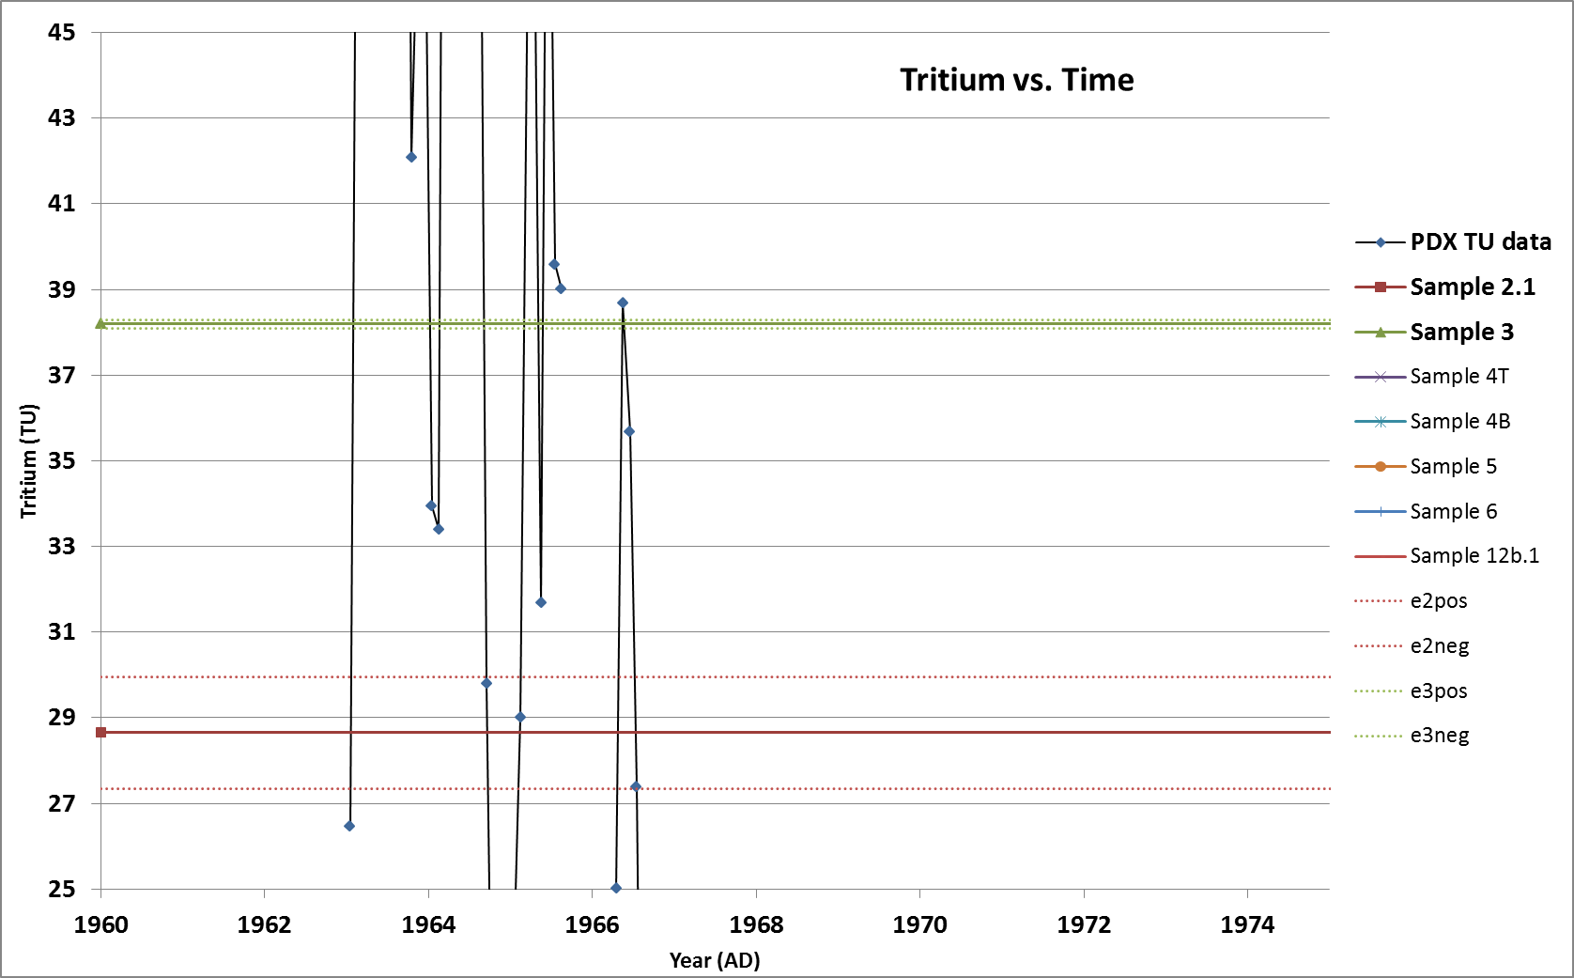
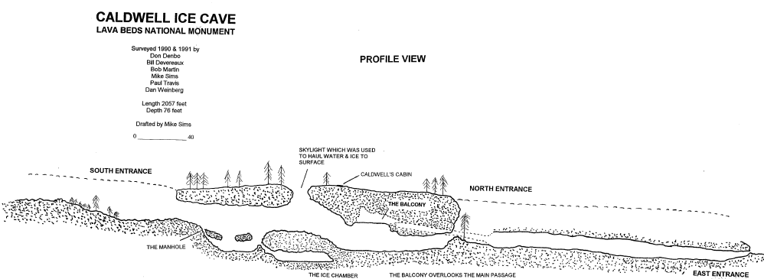
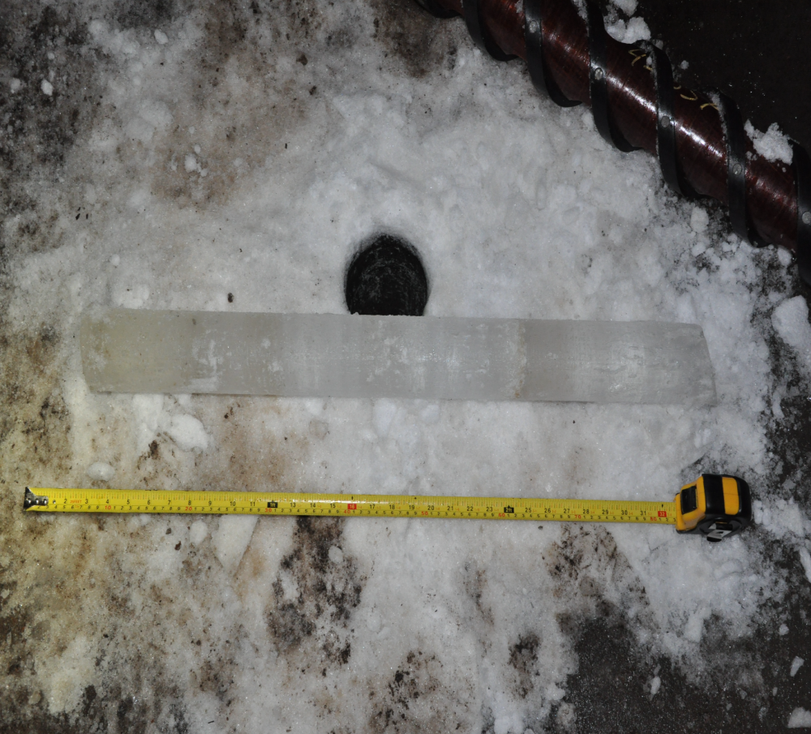
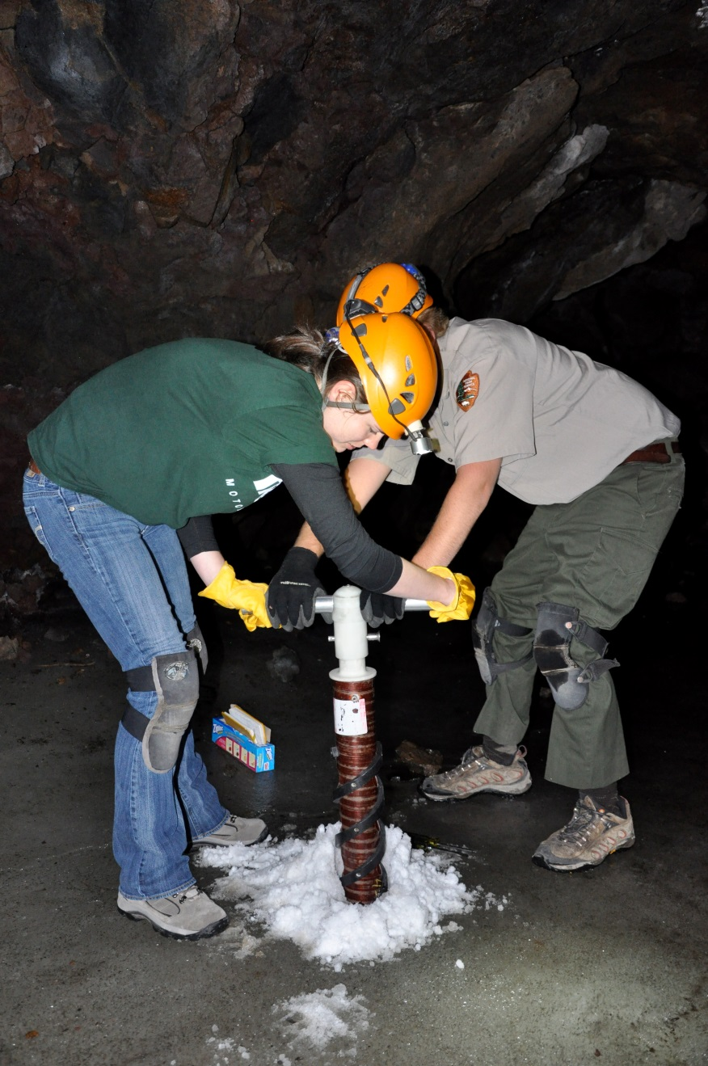
Investigation of Perennial Cave Ice in Lava Beds National Monument
Nicole Rocco, Geology undergraduate & Dr. Ed Brook, Project Advisor, CEOAS
Introduction
For many years, scientists worldwide have been using glacial ice to reconstruct and study Earth’s past climates. While the most continuous records we have are from sites near both poles, there is also mid-latitude perennial ice in the form of mountain glaciers and cave ice. Very little is known about the potential for cave ice to provide information about past climates, particularly in the United States. This study reports initial work on cave ice at Lava Beds National Monument in Tulelake, California (Fig. 1). The objective was to determine how old the ice is to establish how valuable it may be as a resource for paleoclimate studies.
Data
Tritium and radiocarbon data:
Figure 4 (left). Tritium levels versus depth for each core sample from Caldwell Cave. Points are labeled (TU, depth).
Figure 5 (lower left). Portland rain water and Caldwell Cave samples’ tritium levels versus time. Sample numbers are in order of depth.
Figure 6 (lower right). The two core samples, +/- error, with the highest tritium levels as compared to the Portland data.
Figure 1. Map of LBNM (NPS).
Methods
Ice cores were collected in 2010-2011 by OSU and scientists at LBNM. Tritium measurements and radiocarbon dating were the methods utilized in the preliminary work. Core samples were melted at OSU and sent to the University of Miami RSMAS Tritium Laboratory (http://www.rsmas.miami.edu/groups/tritium/) for analysis, while organic matter was carbon dated at UC Irvine Keck Carbon Cycle Facility. Multiple samples were melted and filtered for more potential organic matter to radio-carbon date; however, nothing dateable was found.
Figure 2. Profile of Caldwell Cave (NPS).
Background
LBNM was created by basaltic eruptions of the Medicine Lake shield volcano over the last 500,000 years. The park has one of the world’s largest collections of different volcanic features, including more than 700 lava tubes – some of which contain meters thick layers of ice. Caldwell Cave (Fig. 2) was chosen as a site of interest because of the amount of ice and possible radiocarbon dateable material.
Figure 7. Radiocarbon data from Ponderosa Pine bark in Caldwell Cave. (Brook et al, 2013)
ª2-sigma range.
Discussion
Tritium was measured in seven samples from Caldwell Cave. The samples were calibrated to May 1, 2011, as were the Portland rainwater data, and plotted together for comparison (Fig. 5). The two core samples that showed the highest levels were at depths of between 18 – 47 cm. According to the data, the ice at these depths was deposited between 1963 and late 1966 (Fig. 6). According to the law of superposition, the shallower ice must have been deposited sometime after the deeper ice. Since the other samples are deeper in the core, they were deposited pre-nuclear testing.
The age of the much deeper ice (~200 cm) was discovered through the radiocarbon dating of the bark from Caldwell Cave (Fig. 3). The bark had a ¹⁴C age of 685 +/- 20 years BP (Fig. 7). Calibration of this age yields age ranges of 1274-1304 AD and 1365-1384 AD; the ice at this depth was at least 629 years old as reported in 2013 (Brook et al, 2013).
Figure 3. Ponderosa Pine bark in Caldwell Cave ice at approximately 2 m depth (left). Close up of bark (middle left). Uncut core from Caldwell Cave (middle right). Drilling in the ice (right) (Brook et al, 2013).
Sample Collection & Analysis
Ice cores were collected by using hand coring drills (Fig. 3). Each core was then cut into segments for further data collection including radiocarbon dating and tritium analysis.
Tritium analysis
Before mid-century nuclear weapons testing began, tritium (half-life, 12.32 years) was essentially nonexistent in the atmosphere. There was a significant spike in concentrations during nuclear testing, and since then levels have been decreasing due to decay and uptake by the hydrosphere and biosphere (NRC). Melt water from the Caldwell core was analyzed and compared with tritium records from Portland, Oregon rain water (Fig. 5, Eastoe et al, 2012) to discern whether the samples were deposited before or after the mid-century testing.
Conclusion and Future
These early investigations show that ice over 600 years old is preserved two meters from the surface of Caldwell Cave and that the ice near the surface dates back to the mid-1960s. At this point, the total depth of the ice in Caldwell is unknown, and there has been discussion and collaboration with the National Park Service (NPS) as to potential methods for measuring that depth. The preliminary data show great potential for recovering information about the environmental conditions of the area over at least the last 600 years. Continued monitoring and collaboration with the NPS is underway.
References
Brook, E., Little, L., Fryer, S. (2013), A Preliminary Investigation of Cave Ice at Lava Beds National Monument, northern California, unpublished manuscript, Oregon State University, Corvallis, OR.
Eastoe, C., C. Watts, M. Ploughe, and W. Wright (2012), Future Use of Tritium in Mapping Pre‐Bomb Groundwater Volumes, Ground Water, 50 (1), 87--‐93.
Office of Public Affairs. Tritium Production. U.S. Nuclear Regulatory Commission. Washington, D.C., June 2005. Retrieved from www.nrc.gov on November 15, 2014.
U.S. Department of the Interior, National Park Service (2014), Retrieved from http://www.nps.gov/labe/index.htm on May 10, 2014.
Special thanks to Ed Brook, NSF, IDES, U of M Tritium Laboratory, Nancy Nordensten, Megan Mason and Katrina Smith (NPS) and Lava Beds National Monument.

