Slide 1
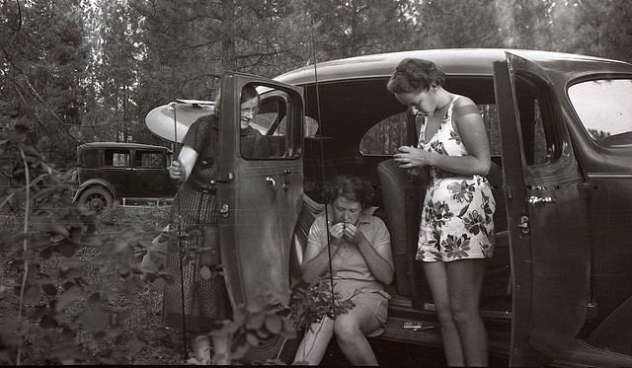
Old Habits Are Hard to Break: Lessons Learned from a Qualitative Research Study
Stefanie Buck
Anne-Marie Deitering
Hannah Gascho Rempel
Online NW 2012

Slide 2
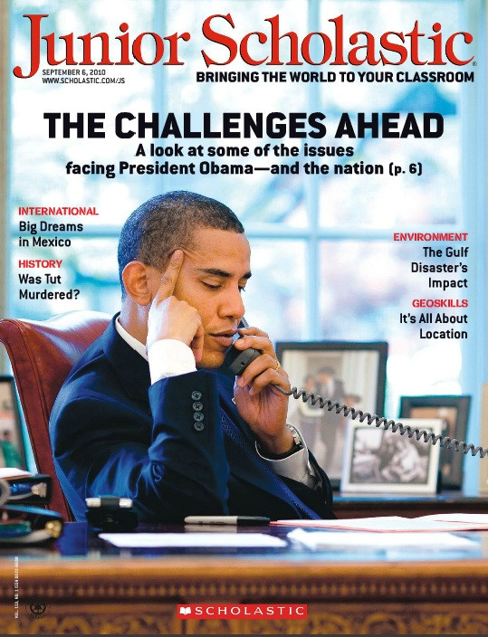
Background & Rationale

Slide 3
What do our users expect when they use library databases or the library webpage to search for sources?
When given a research assignment, what do our users typically do? What’s their process?
When pushed to use new source types or new research tools, how do our users adjust?

Slide 4
n = 20

Slide 5
Statistical

Slide 6
Analytic

Slide 7
transferability
Notes:
http://www.flickr.com/photos/rabi/2760388453/
http://www.flickr.com/photos/collylogic/3653490189/
http://www.flickr.com/photos/naturalkinds/1424751281/
http://www.flickr.com/photos/hyperbolation/310060405/

Slide 8
Thick description
Notes:
http://www.flickr.com/photos/killabea/3351194990/

Slide 9
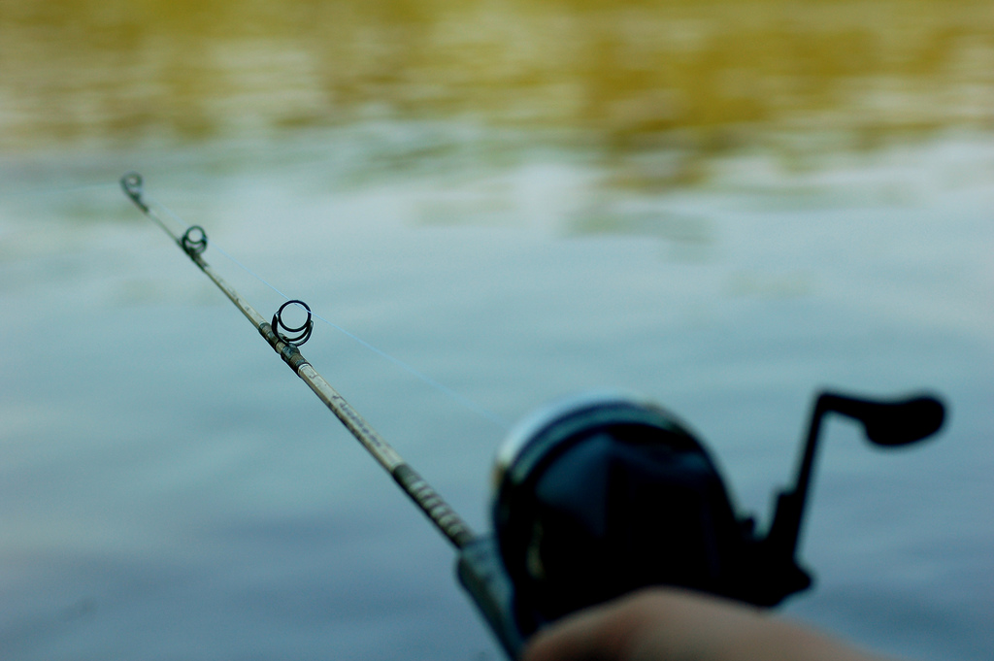
Study Methods
Some rights reserved by Justin Shearer

Slide 10
Task
You are an OSU student, enrolled in COMM 111. You have two weeks to prepare a speech that meets the following requirements:
You must use evidence from outside sources in your speech.
You should use sources that an academic audience would find convincing and authoritative.
You must use at least 3 different sources.
You may choose one of these 5 topics:
Tsunami early warning
Medical school admissions
Solar development
Traffic congestion
Urban woodlands
Notes:
Point to familiarity with COMM 111, include when it was in the term, thick description – limitations of study

Slide 11
Notes:
How the databases were displayed.
Asked them to start at this screen (although some did not want to) and if they strayed we directed them back to this screen.
Created 3 different versions of this website so that it rotated the order.
Did not find any noticeable difference based on order of web site.
Gave about half of them a sheet of paper at the beginning of the process with additional information about each source.
Other half did not have a detailed description, only what saw on screen
Only one student who referred back to this so no noticeable impact from the additional descriptions.
Most looked at the screen and made their determination based on the title.

Slide 12
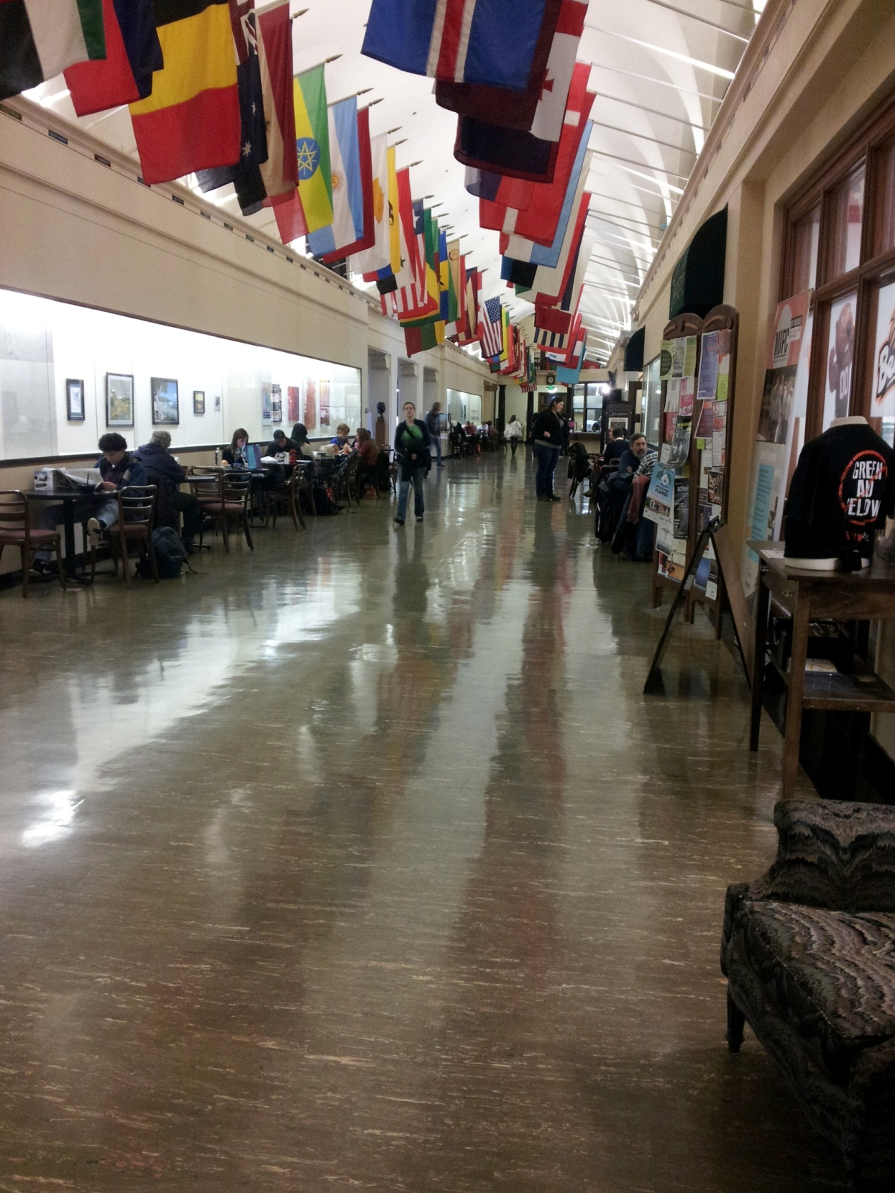
Don’t
fish here

Slide 13
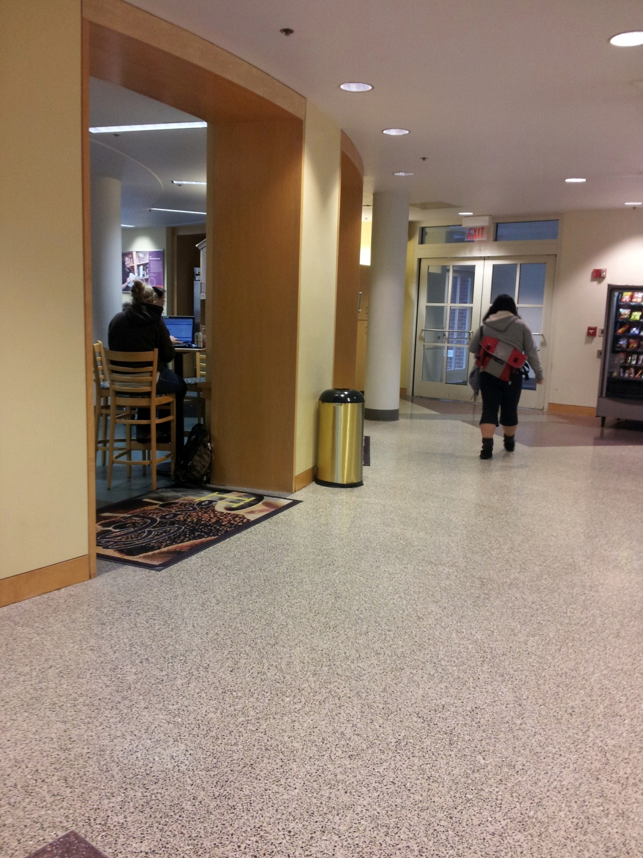
Or here

Slide 14
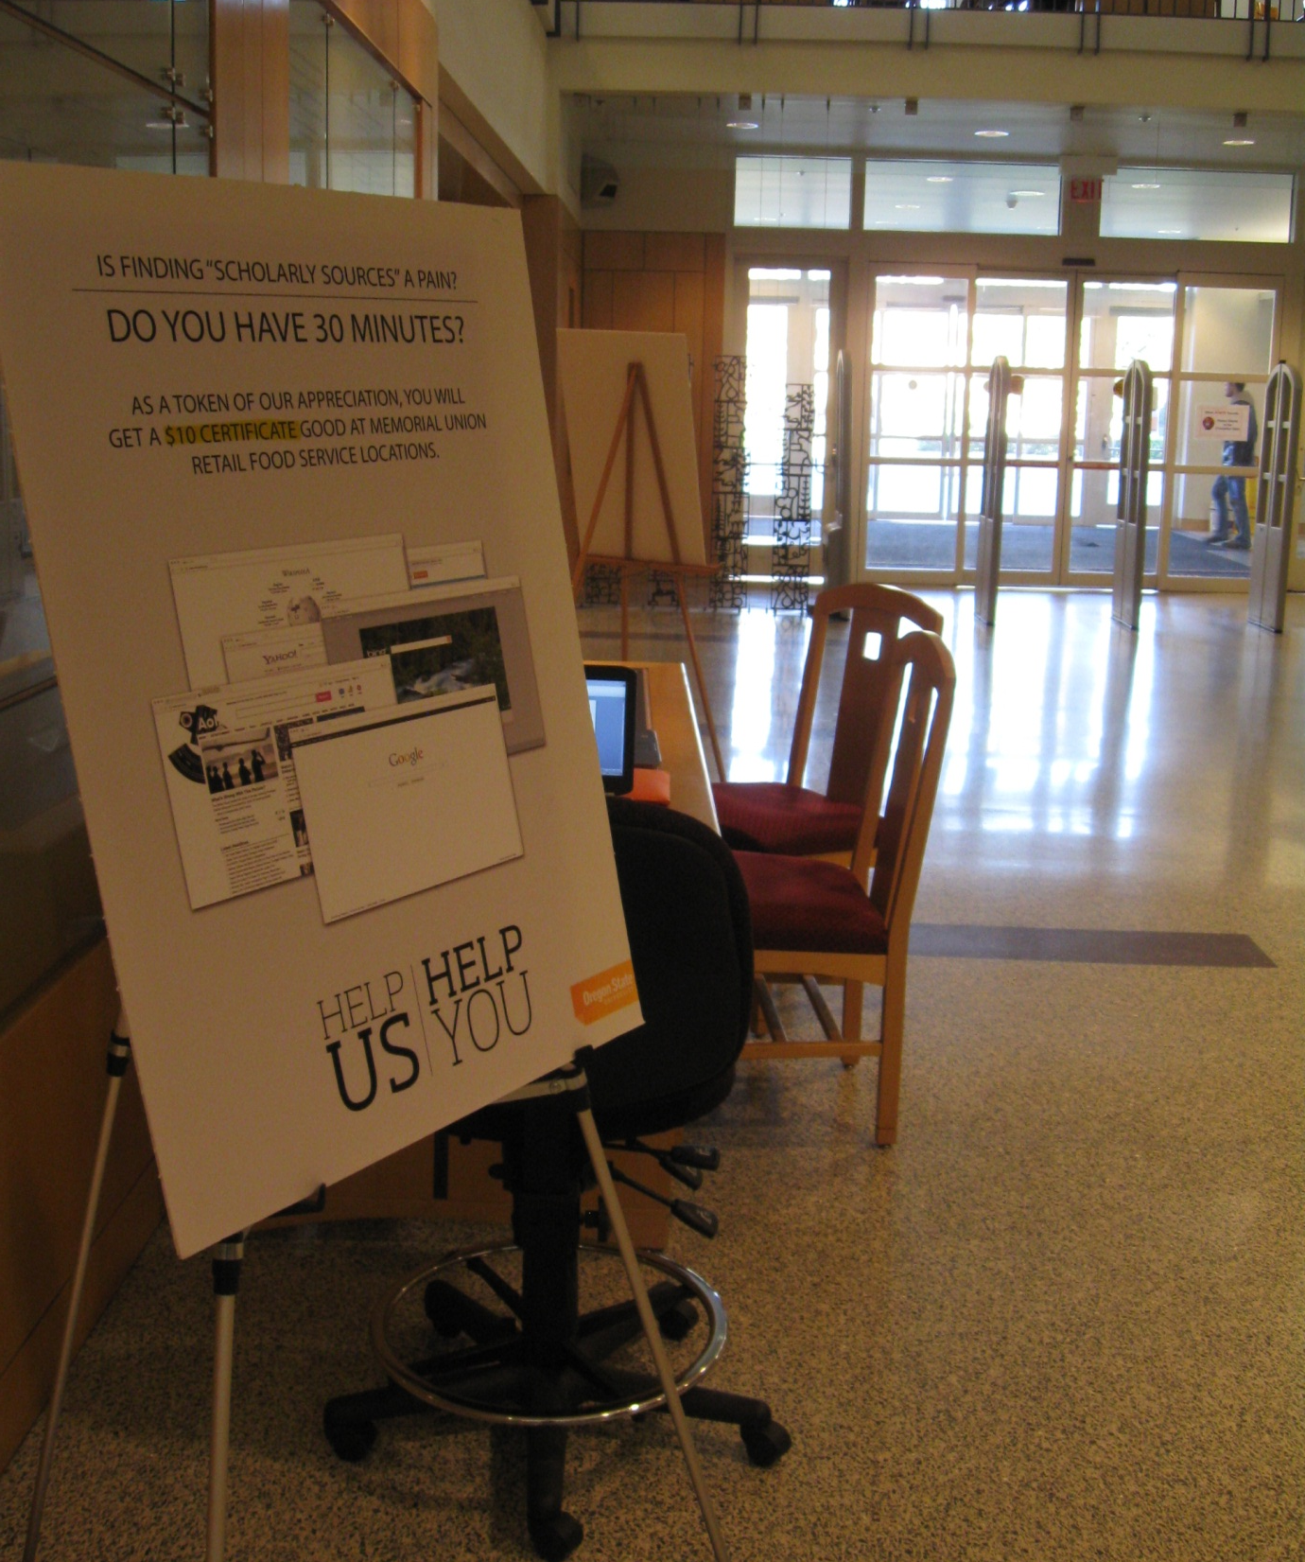
Fish HERE
Notes:
Description –
Limitations – time of term

Slide 15
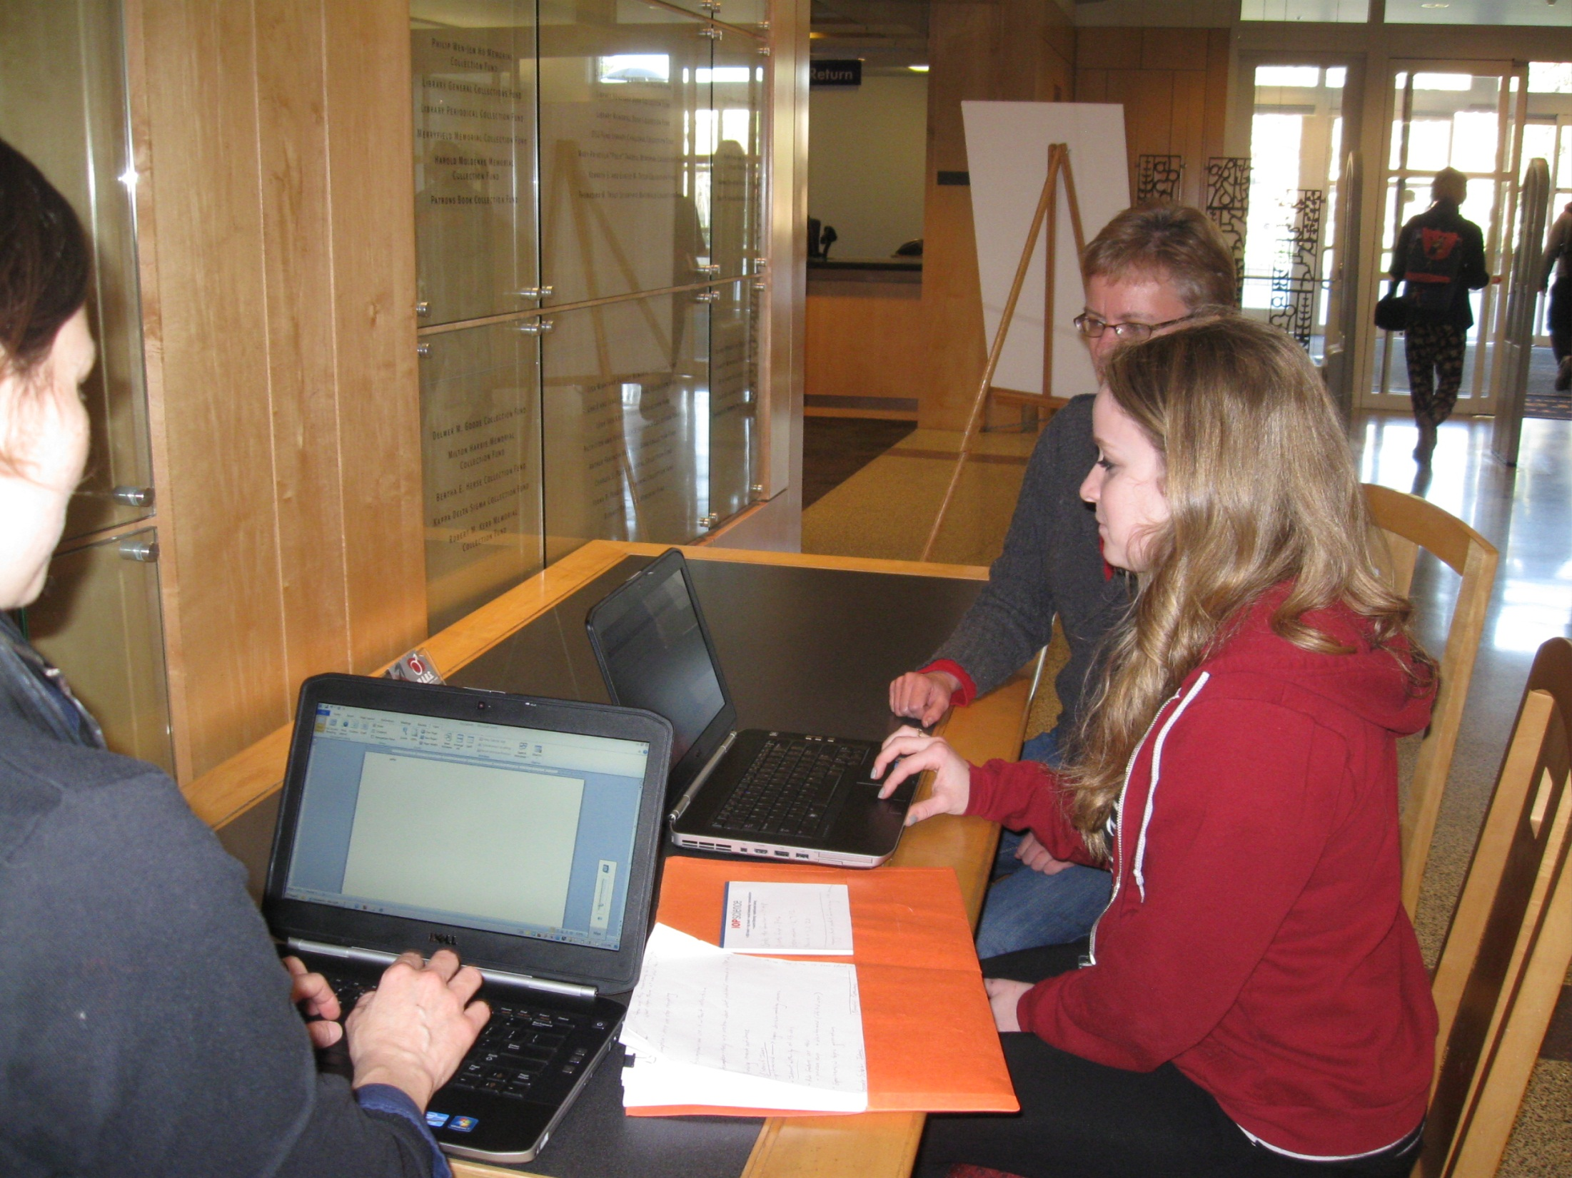
Notes:
Description –
Limitations -

Slide 16
20 Undergrads: Gender
Notes:
Description –
Limitations -

Slide 17
Academic Standing
Notes:
Description –
Limitations -

Slide 18
College Affiliation*
*Some participants belonged to more than one college.
Notes:
Description –
Limitations -

Slide 19
Notes:
Description –
Limitations -

Slide 20
Notes:
Description –
Limitations -

Slide 21
What Databases did they use?

Slide 22
Notes:
How the databases were displayed.
Asked them to start at this screen (although some did not want to) and if they strayed we directed them back to this screen.
Created 3 different versions of this website so that it rotated the order.
Did not find any noticeable difference based on order of web site.
Gave about half of them a sheet of paper at the beginning of the process with additional information about each source.
Other half did not have a detailed description, only what saw on screen
Only one student who referred back to this so no noticeable impact from the additional descriptions.
Most looked at the screen and made their determination based on the title.

Slide 23
What Did We Learn About Database Selection?
Notes:
Which databases previously used?
Divided between 1Search and Google Scholar (although a few saw Google Scholar and thought Google)
1Search is right on our home page so it’s easy to get to.
Have to go to our database list to get to WOS
Web of Science was new to most of our participants. (hgr – and I was not at all convinced by the one person who said she had used it before that she had actually used it)

Slide 24
What Did We Learn About Database Selection?
Notes:
Even though WOS very new to most participants, still one they chose most frequently.
19 said they had not heard of it and 8/20 of them chose as their first database.

Slide 25
What Did We Learn About Database Selection?
Notes:
Participants had the opportunity to use one or all of the databases on the web page. We did not limit them on this.
Fairly evenly distributed.

Slide 26
Analysis using personas
Notes:
So while Stefanie just gave you some quantitative data (because charts make people like Stefanie and me happy), this really was a qualitative study. Anne-Marie talked earlier about the ideas of transferability and how you can make meaning out of qualitative research. One way that you can do that is through things like case studies. In our case, we have used the term personas, a term that those of you with a background in usability will recognize, because like case studies, personas helped us to find commonalities between our searches, as well as pull out their differences and helped us to get a better picture of how to we move forward with things like instructional opportunities
We developed our personas by looking at the demographic or descriptive codes for our participants and seeing what differences there were. One of the clearest differences was academic standing. When we divided our participants by lower division undergrads (freshman & sophs) and upper-division undergrads (juniors & seniors), and then looked at some of the search behaviors and analytical codes we had assigned when analyzing the transcripts, we began to see some clear patterns in the way that they approached the search process, the way that they chose particular databases, and the strategies they used to address the task at hand. Four searcher types emerged from this analysis and in order to help us all visualize these groups better we have given each of these types a persona, or a fictional life, that is based on an amalgamation of the data we gathered about each of the 4 groups but does not directly correlate to one particular individual that we interviewed.
Before I show you our four searcher types, I want to emphasize that we are not placing these personas on a continuum (which is what I am trying to illustrate with the mess of arrows on this slide). While the freshman searcher will be clearly separated out from the upper-division searchers in many of his behaviors, none of these searchers has reached some sort of research process nirvana or demonstrates the only way to go about the research process. So, let me introduce you to our four fictional searchers.
http://www.flickr.com/photos/rabi/2760388453/
http://www.flickr.com/photos/collylogic/3653490189/
http://www.flickr.com/photos/naturalkinds/1424751281/
http://www.flickr.com/photos/hyperbolation/310060405/

Slide 27
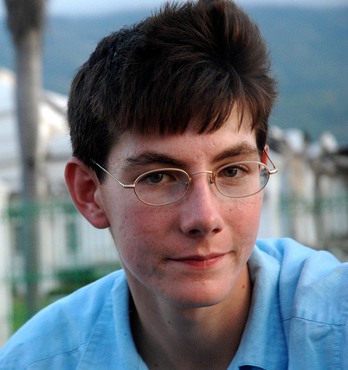
Novice
Anthony
Freshman
Engineering major
Google Scholar
Doesn’t know what peer review is
Wants credible sources, but nothing too scientific
Notes:
Anthony represents the novice searcher type. Novice is only one of the labels we thought of for this searcher who represents the lower division undergrads. Part of why the term novice for this persona feels a bit misleading is because it is not that Anthony has never searched before or approaches the process in a hesitant manner, in fact he tended to be very confident and had a very exact plan for neatly fitting the research he found into an outline he generated before delving into the search process. However, in terms of researching at the academic level, Anthony is a novice, he uses Google Scholar because of the brand name of Google, he doesn’t know what peer review means or what looking for that type of article entails, but he has only vague ideas about credibility and authority, and hopes that he won’t have to read anything too scientific.

Slide 28
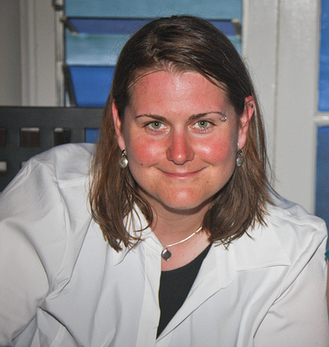
Seeks the Familiar
Megan
Junior
Sociology major
1Search
Chooses known databases (from H.S. or college classes) finding peer reviewed articles
Moderately important to find scholarly articles, but other access issues are more important
Notes:
The rest of the three searcher types are all upper-division undergrads. The first of these personas that I will describe is someone who seeks out the familiar throughout her search process. Megan always goes to a database that she has used before rather than trying something new. She likes to use 1Search because she has used it before for another class and remembers some of the tips she was given for using this database. She knows about peer reviewed articles and has a couple of databases up her sleeve that she trusts will give her those types of articles.

Slide 29
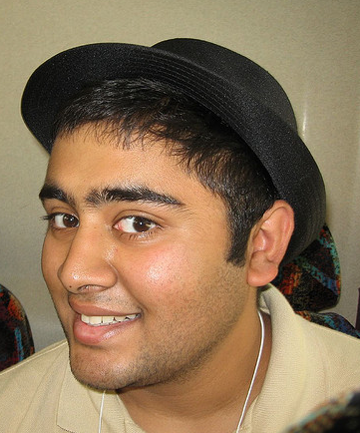
Orients First
Ryan
Senior
Economics major
Google Scholar
Relies on the database to return scholarly articles
Tries to be conscientious about selecting scholarly items from the outset
Notes:
Ryan is similar to Megan in that he likes to try a familiar database first, but then he is willing to switch databases, go back and forth or leave a search that isn’t working behind.

Slide 30
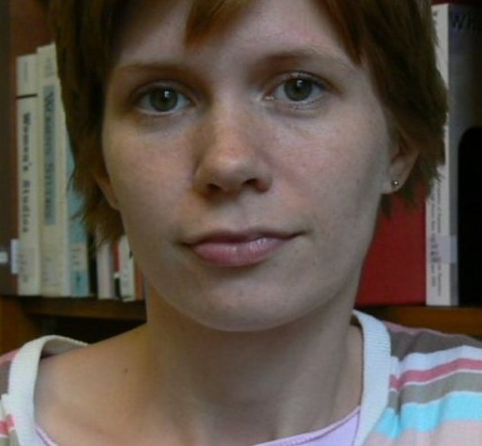
Experimenter
Sophie
Junior
Biology major
Web of Science
Wants a database with only peer-reviewed options
Will evaluate the articles she finds to see if they are scholarly
Notes:
Sophie differs from the other two upper-division undergrads in that she is willing to try something new. She was not previously aware of the Web of Science database, but based on the task at hand and her comfort with her searching abilities she feels that she could try out a different search environment.
So I’ve given you this brief overview of these personas because we are now going to go into a bit more depth in our analysis using these four searcher types to see what behaviors they demonstrate throughout the task we gave them.

Slide 31
Using Personas to think about Database Selection
Notes:
Our personas all had different reasons for why they selected a specific database so here we are going to investigate their process.

Slide 32
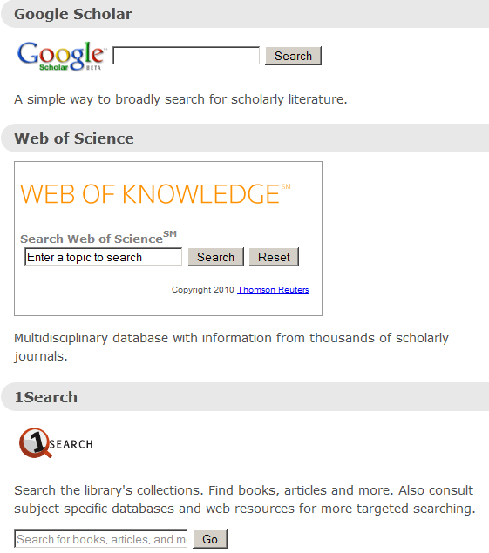
Role of Database Descriptions
Description played no role: “I know Google…I’d stick with Google because I won’t feel comfortable using something I’m not used to using””
Description played no role: “I’d start with 1Search for the earlier stuff”
Used description to explore other territory: “I’ve never actually heard of Google Scholar that seems pretty useful.” “Web of Science looks nicer than 1Search based on the description.”
Words in description played a role in initial selection: “This one (Web of Science) looks like it would be good. Because of the web of knowledge. “ “I like that [WOS] says articles here from the description”
Notes:
DO NOT SAY IT WAS FAMILIAR!!!! HANNAH WILL KILL YOU!
For Ryan and Megan (our novice and seeks the familiar user), the description does not really play a role. Description is the short one on the screen
Nor does it seem to make them want to try something new.
For the Ryan (who likes to orient himself first) the description (on the screen) does play a small role when he is exploring other options.
The experimenter (Sophie) gravitates towards WOS because she sees something in the description makes her think it has the right content.
<screenshot>
The terms science and knowledge in the description of WOS are attractive to Sophie and Ryan. The description of Google Scholar (scholarly literature) is also attractive. Conversely the description of 1Search (OSU’s implementation of Summon) some of our users off. They do not like that it says “books” and “and more”. What does “and more” mean? Nothing in the description clues them in to the type of content Summon has.
Since a more detailed description does not appear to play much of a role, it appears that people go for words in title or brief description.

Slide 33
Criteria for Database Selection Based on Content
Prefers a broad overview or background experience. “[I prefer] Wikipedia because it has everything.”
“I chose solar development because it sounds doable with databases like these.”
“[Web of Science] seems a little bit more – mostly articles, a lot of teachers require more scholarly based articles.” “I’d most likely choose Web of Science, because it’s scientific in nature, so I’d use Web of Science first.”
You may choose one of these 5 topics:
Tsunami early warning
Medical school admissions
Solar development
Traffic congestion
Urban woodlands
Notes:
For the most part, our personas are thinking about articles or sources that will answer their question; a few think about it more specifically – will the database get me what I want rather than I know this database and I’m going to hope it works.
Emphasize that this was a few.
For Anthony, something that gives him a broad overview is vital. He is unlikely to think about “appropriate database”
Megan chooses her database specifically because she thinks her topic will work in this database. She is starting to make the connection between database type and content.
Content plays bigger role with Sophie and Ryan than with others. In other words, Sophie and Ryan’s database selection is about what they know or think a database will contain.
Most of the topics we gave them were somewhat science related (urban woodlands, solar development) which may have drawn them to that in the title.

Slide 34
Database Content -Satisfaction
Access (Snippets, an abstract and full-text). “I’d take snippets, and put those snippets together and make a speech out of that.”
Guidance. “Now I’m looking at these tags at the end and seeing what’s interesting in those to me. So like this one I really like because it has a lot of tags that are broad enough, so I think I can assume that the author is talking about things that are interesting or relevant to me.” “The highlighting helps me out a lot.”
Content. “This one [this database and the results it returned] has a lot more, this has solar development and then the green stuff and using solar and wind power, yeah I would definitely use this [the database]”
Credibility. “Something else is looking if it’s been cited before, that means that it probably has good information, that’s something I usually look at.”
Notes:
Satisfaction with database based on four things – access, guidance, content, credibility.
All of these things are important to some degree for all of our personas
For novice like Anthony, seeing snippets or abstracts, is really important and helpful
Mega likes the guidance the database gives her – tags or subject headings, highlighting key terms
Ryan is happy when he gets the content he wants whereas Sophie is satisfied when she finds something credible (that then also meets the assignment criteria).
Again all of these apply in some degree to all of our personas. This is what makes them happy and want to continue to use the database.

Slide 35
Database Dissatisfaction – Content, Lack of Generality
But I am not getting the stuff. I know what I am looking for, but not finding it [1search]. “Well, since I saw so many newspapers, I want to exclude stuff like that - newspaper articles, patents, videos (I don’t want to watch those), I don’t want to read government documents either.” “It’s hard to get general information (from the databases when you’re required to look for scholarly sources). It’s kind of intimidating. I’m kind of put off.” “That’s a bit daunting sounding, I’d maybe come back to that later .”
Notes:
What does not make them happy is a perceived mismatch between what they want (general, background) and what they are finding (scientific, hard to understand) or they are not seeing the kind of sources they expect to find. Anthony , Megan and even Ryan find it frustrating not to find general articles. They are concerned with quality but are turned off by scientific sounding titles where they don’t know what all the words meant or they don’t see their keywords highlighted in the title.
Ryan and Sophie have a higher tolerance for finding scholarly materials but they can still be easily turned off when the sources they find are too schoallry or “duanting”

Slide 36
Database Switching
No switch or only 1 switch.
Works with current tool before switching: “I tend to exhaust one avenue before I go onto another one” “I’ve done the 1Search one before, so I’ll start there, and I’ll see what the others have to offer if I can’t find anything there.”
“Before I’d do that [change keywords] I’d go to another database. [Web of Science].”
Notes:
Participants could use one or more of the databases and could switch at any time.
Speech topics were pretty general and we chose them so they would work in any of these databases.
Anthony doesn’t really want to switch databases (actually, he’d rather be in Google) In our study, it might have been the environment – the students felt like they needed to use the databases whereas in “real life” might have just used Google or Wikipedia otherwise.
Ryan, Megan and Sophie are more willing to switch databases than Anthony. Ryan and Megan prefer to start in a known database before moving on.
Sophie is more prepared to move around and try different things.

Slide 37
Database Selection & Authority
Notes:
Given that the assignment did not ask them to look for peer-reviewed journal articles but just sources appropriate to an academic audience, we wanted to know if their process would have changed any had they been told to use peer-reviewed sources.
About 1/3 of our participants did not know what PR means.
The rest divided between changing the process/tool they would use and being satisfied that their process met the criteria.
Interesting to note that of those who used 1Search, none used the checkbox to limit to PR. Not an option in other 2 databases.

Slide 38
Peer-Review
Only a vague understanding of peer-review: “I would first research what peer-reviewed journals are, I have an idea but, and then I would do it depending on how the different web sites tell me to do it.”
Would have used a different tool: “EBSCO; I would expect peer-reviewed stuff there. I feel like EBSCO has more of a guarantee that there will be PR journals.”
Selection process would be more rigorous: “I think it would have been more intense, I would take more time if it was the peer-reviewed requirement” or “I’d find search terms that have more specific information, sources that have that.”
Already thinking peer-reviewed in their search or relies on database: “Most likely not [wouldn’t have changed her search tactics], because I try and find peer reviewed journals, because at this stage I think that’s what’s required of me.”
Notes:
Those who said they would change their process
Anthony is one of those with a vague understanding of peer-review. He has to figure out what p.r. is before deciding if he wants to change his process.
Megan will probably choose a different tool, one that she knows. She specifically likes EBSCO. (Several participants mentioned EBSCO but only one mentioned using the peer-review checkbox).
Ryan might take more time evaluating what he finds in whatever database he is using. He might try different terms.
Sophie, who is likely to use WOS, also feels confident that what she is finding is peer-reviewed or at least scholarly although if you asked her ask she might say “I assume that these are p.r. but honestly I’m not sure.”
All of our personas have a similar attitude that “since these are library databases, content must be acceptable.” No one in our study actually checked to see if what they were finding is peer-reviewed.

Slide 39
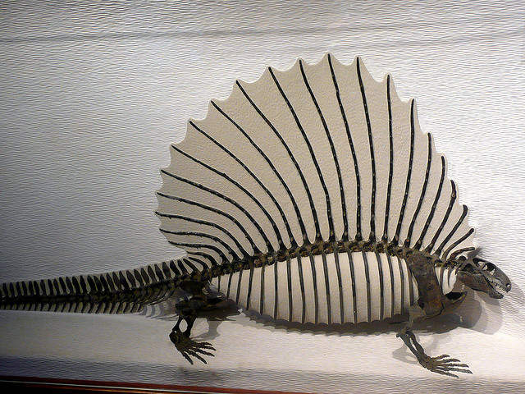
Impact of Prior History & Experience
Some rights reserved by roncaglia
Notes:
Stefanie told you about what our searchers actually did in terms of selecting tools. I’m going to talk a little bit about some potential reasons for why they did what they did. In analyzing our participants’ comments it became apparent that their past searching experiences played a large role in how they approached a variety of elements of this searching task. This of course makes a lot of sense because our past experiences establish our habits as well as our willingness or ability to try new things.
http://www.flickr.com/photos/roncaglia/2482651036/sizes/z/in/photostream/

Slide 40
Experiences Create Context for Research
Impact on databases selected
Source of academic authority
Sense of flexibility
Tools in their toolbox
Notes:
The four ways that emerged from our data in which past experiences created a context for these researchers were: the impacts their past experiences had on the databases they selected, where they perceived academic authority coming from, how flexible they were, and what tools they had in their searching toolbox. Let me walk through how our personas approached these four elements of the research process.

Slide 41
Approach to Database Selection
Lacks a starting point: “I’m not familiar with Google Scholar or any of these search tools. I’m not used to finding individual articles and how to cite them.”
Uses Tried & True Tools: “I usually go with Google Scholar because that is what I am used to.”
Orients First: “So I’m not familiar with Google Scholar, but I’ve done the 1Search one, so I’ll start there and I’ll see what the others have to offer if I can’t find anything there.” Searching is Random: “I’ve seen OSU has this 1Search screen so I’ll give it a shot – sometimes it works, sometimes it doesn’t.”
Tries new things (if on topic and authoritative): “I’d most likely choose Web of Science, because it’s scientific in nature, so I’d use Web of Science first.”
Notes:
Stefanie covered several aspects of how our personas approached database selection. I just want to tease out the part of the database selection process that was impacted by their past experiences. The defining thing here is the emphasis on the familiar. Anthony, our novice, lacks familiarity with any of the database tools or this style of academic research, and so chooses Google Scholar as a result of his past experiences with Google. Both Megan, who seeks the familiar, and Ryan who orients first, needs to start with a known database in order to settle into their searching routine. Megan feels most comfortable staying with a known database for the whole search process. Ryan, the orienter, is open to moving on, either as a part of a fall-back plan or because he had a sense that he can’t expect to find success with just one database. Sophie, our experimenter, gains her title primarily because of her willingness to try a brand-new database, in part because as a science major, she sees benefits to using a database that seems to match pretty well with her intended topic, but also because she demonstrates that she knows enough about searching from previous database experiences that she can transfer those skills to a new environment.

Slide 42
Source of Authority
Books: “I would go to Google or use a book from the library.” “I’m guessing that most of the books in the library are academically written.” Reference Sources: “my old high school had a page of reference sites that were really good – Annals of American history, Britannica”
Databases provide authority: “I usually use EbscoHost, I’ve used that quite a bit, that’s usually where I start if it needs to be accredited or something like that.”
Notes:
Stefanie talked about our personas’ knowledge of the peer review process. Another angle on that question appeared when examining where these personas saw the authority or quality of a source coming from, particularly within the context of searching for sources appropriate for an academic audience.
Anthony, our novice searcher, stands in stark contrast to the other searchers in that he sees authority as coming from two types of sources – books and reference sources. Much of this authority comes from the print nature of these sources and Anthony’s perception that print is more authoritative. (Although he does use online reference sources). The library also bestows a lot of this authority – surely the library would only collect resources that were always appropriate for an academic audience.
For the upper-division personas, authority was provided for all three of these searchers at the database level. These searchers understand what the peer-review requirement means, and feel that the most reliable way to make sure they get to the right types of sources is by using specific databases they have learned about that provide either a peer-review checkbox or simply that overall stamp of quality. Just a brief side note – I think that even these upper-division folks weren’t always comfortable with deciding if an article or journal itself was peer-reviewed and so were still more comfortable passing that decision off to the database.

Slide 43
Sense of Flexibility
Not Flexible: “and since speech writing is a five paragraph thing…”
Comfortable with a known process: “Generally with a speech you have a similar structure to a simple high school paper, 3 points, 3 sources makes sense.”
Highly Flexible: “A lot of times, I’ll start with an idea, and when I start doing the research it turns into something totally different.”
Notes:
Students’ ability to adjust their approach to a task or process - their ability to try new things pointed to some differences in our personas sense of flexibility. Anthony, our novice searcher, has arrived from his high school experience with a solid set of rules and procedures for completing tasks like researching for a speech. These procedures have served him well, and he makes no attempts to try new tools or look beyond the outline first-fill in with sources later approach that has worked for him before.
Megan, who seeks the familiar, is similar in this regard in that she is also comfortable with known processes. Even though she has been in college for awhile, she still remembers some of the guidelines she learned in high school and refers back to them when approaching a familiar task.
These two searchers are in contrast to Ryan and Sophie who are highly flexible and are open to trying new databases and adjusting their ideas about their topic along the way.

Slide 44
Role of Information
Utilitarian: “Generally I skim the abstract, or use the control search to search within the paper to search for the highlighted words for my topic…Then I’d read the paragraph to see if it’s something I can use.”
Willing to Explore: “I could read the articles that I’ve opened more thoroughly, take notes about what I could expand on, maybe filter through different types of content to find more things in that way.”
Utilitarian: “I look for useful information, and finds some information that would work.” “I scan over the article and later when the deadline approaches is when I actually read them.”
Willing to explore: “I type in the topic and see where it will take me, and usually go through all of them and see which ones I like.” Even if it’s scary: “That’s a bit daunting sounding, I’d maybe come back to that later…Like I said, it’s a bit daunting all of this.”
Notes:
Maybe delete?

Slide 45
Tools In Their Toolbox – Familiarity with the OSU Libraries
Unfamiliar: “So to be quite honest, when I do research to begin with, I’m not very familiar with the library website because I haven’t had any classes where the library has come to talk to us about using the library.”
Use the space, but refer back to H.S. access: “I still have access to EBSCO from my high school. I don’t know how to get to it here.”
Some (but not great) experience: “I quickly remove myself from the library page, because it’s not easy to use and not everything is readily available. So I’ll start there, but move out quickly.”
Familiar with library resources and how to use them: “the paper was from 1968, I did that I read all their articles, I had to go downstairs to all the old ones.”
Notes:
There were three types of tools that I considered these personas to have in their toolboxes (in varying amounts). The first was their familiarity with the OSU Libraries. Anthony, our novice, of course had little to no orientation to OSUL yet. It was the beginning of the term and he didn’t know much about our web space, how to find things that may have been familiar to him, or who to ask for help.
The upper-division searches varied in their level of familiarity with the OSUL.
Megan, who craved the familiar, still refers back to h.s. experiences and uses that h.s. library and doesn’t know how to find things on our website;
Ryan, the Orienter – our tool agnostic – hasn’t had great experiences with the library’s website and tools, and so as a result he jumps around to different tools; Sophie, the Experimenter is more deeply familiar with both the libraries tools and spaces and is willing to push the boundaries of what she currently knows to find what she needs.

Slide 46
Tools In Their Toolbox – Advanced Database Features
Unaware of advanced features
Recognizes some advanced features: “Now I’m looking at these tags at the end and seeing what’s interesting in those to me. So like this one I really like because it has a lot of tags that are broad enough .”
Knows how to use them: “I use the OSU tools a lot, and they usually say that it’s cited, or those [cited papers] are linked higher up.”
Notes:
The second tool in their toolbox was a knowledge of or demonstration of use of advanced database features.
Anthony, the Novice – doesn’t look for any advanced tools or try to use them. In fairness, he primarily uses Google Scholar, which doesn’t have a lot of advanced features available.
The upper-division searchers all have some familiarity with a variety of tools such as tags, subject headings, reference lists, saving features, and limiters and make an effort to use them.

Slide 47
Tools In Their Toolbox – Ability to Adapt Tools to Varying Tasks
Not able to adapt
Adapts tools based on task: “It depends on what the requirements are, for academic sources, I’d use the library page, but if it was a broader topic, I’d use a Google search or read a Wikipedia article to get more specific terms related to the topic in mind and then go to more narrow resources like journals.”
Notes:
The last tool in their tool box goes back to the idea of flexibility, but really focuses on their ability to adapt the tools they use to varying tasks.
Anthony, our novice, doesn’t present any strategies for how he might have approach a similar, yet different assignment or what he would do when his keywords weren’t working. He intends to just keep trying what he knew how to do.
The upper-division searchers are all able to either make changes to their keywords, change their topic, switch the tools they would search for different types of assignments, or even adjust the amount of work they would put in based on their interpretation of the value or weight of the assignment.

Slide 48
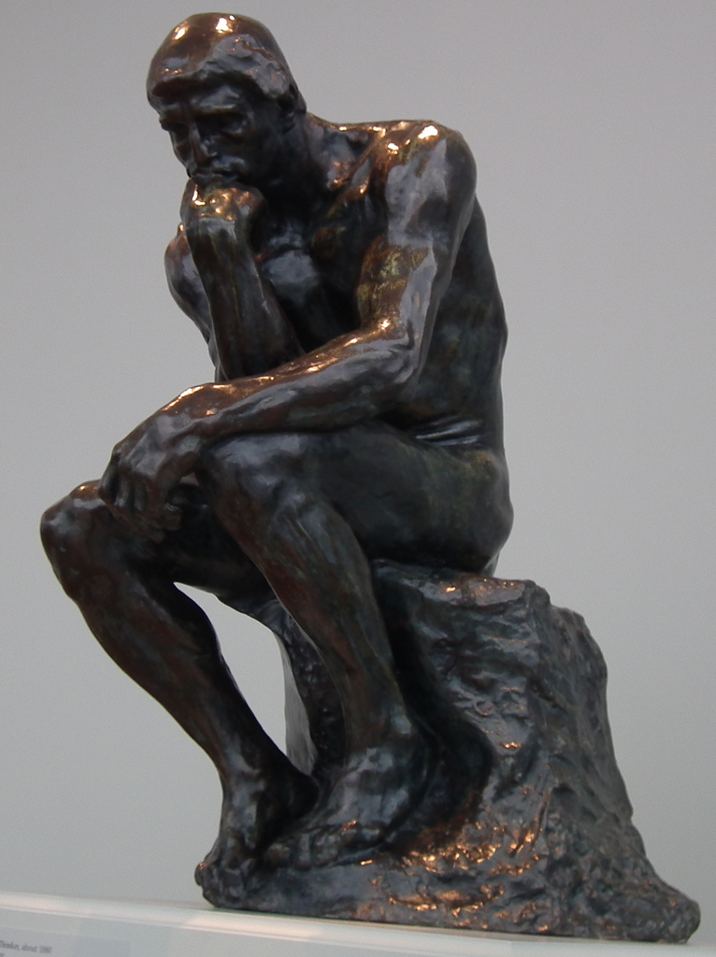
What Can we do?
Some rights reserved by Erik Daniel Drost
Notes:
Hannah has talked about the role of previous experience and I have spent a some time talking about database descriptions and the decision-making process. Where do we go from here?
http://www.flickr.com/photos/edrost88/6844600823/

Slide 49
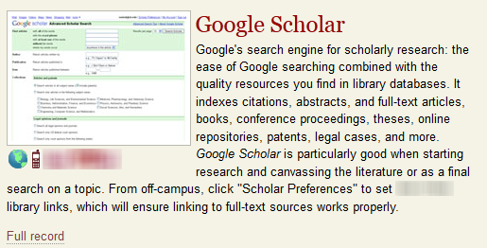
General Databases – Known Starting Points
1
2
3
Notes:
Provide useful descriptions.
Examples are from other institutions.
Descriptions range from very limited (almost none) (ex. 1) to very detailed (ex 3). Too much info may also confuse (why does it not say articles or journal articles).
Google Scholar (3) great description but will anyone actually read it?
2 has some key terms that will probably appeal to students (peer-reviewed, scholarly)
Balance we need to think about.

Slide 50
General Databases – Discovery tools
1
2
3
Notes:
Libraries looking at discovery systems to make things easier. Generally offering very brief descriptions. It’s challenging to come up with a good short description for s a discovery tool but we found the students didn’t like “and more” or “library content and beyond” (what does that mean?) These do not give them much information. Not specific enough to tell them if they would find the sources or content they want.
In this example, the 3rd choice at least gives them the option to scope to p.r.

Slide 51
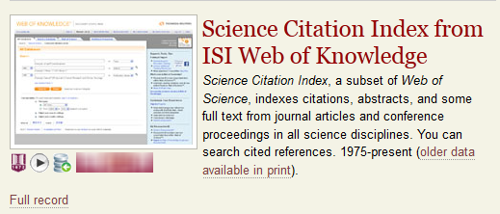
Database Description Subject databases
1
2
3
Notes:
In some examples they have to click on a more info to get an explanation of what the database contains. Would they really do this? Second example really says nothing about contents or what a student can expect to find.
Only the third example gives them some keywords to hook them although, again, would they read all of this?

Slide 52
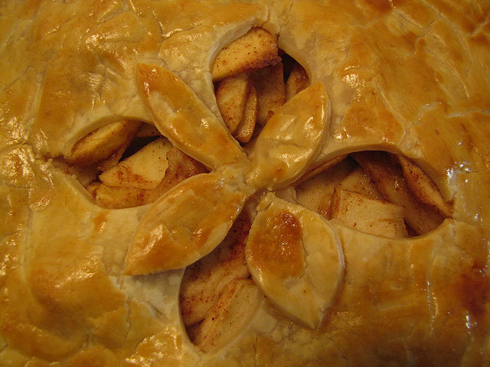
Capitalize on the familiar
Notes:
http://www.flickr.com/photos/pleeker/4088100056/
Helps 3 out of 4 of our personas
Disintermediated environment (our web sites) more consistent or simple with easy sign posts
Like this database – try these
Gale & EbscoHost

Slide 53
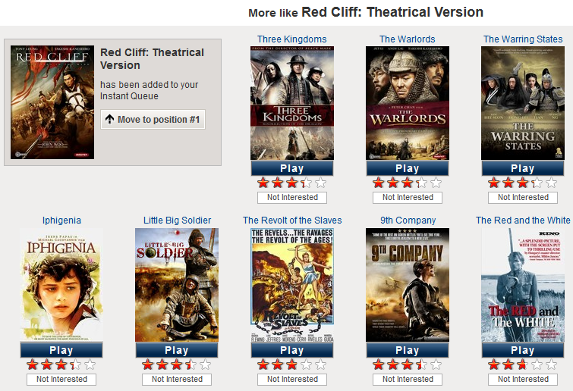
Like This Database – Might We Suggest…?
Notes:
Could we offer them more guidance? If you liked this one, why don’t you try one of these?

Slide 54
Beyond what they know
Notes:
So we’ve talked about how we can value what students already know and bring with them, but how can we push them beyond what they know? This can be done through guided instructional opportunities both online & in-person. Which of course, those of us in library instruction land are already big proponents of. But within those instructional opportunities we can begin by situating students in the familiar. We should not assume that they know more than they do, and we should take steps through either more formal pre-tests or less formal show of hands polling to establish what they do know and then move from there. For the Experimenter persona, one thing that seemed to point to her willingness to try new things and that had had a big impact on how much she knew about advanced search features and processes came from direct interactions and meetings with mentors, advisors or instructors. Occasionally that experience had come from an interaction with a librarian. While it is difficult to scale those types of interactions, and librarians are not always involved in students’ research activities, perhaps we can be more involved in outreach efforts to advisors and mentor type faculty groups to help emphasize the types of tools and research thought processes they could be sharing with their students.
http://www.flickr.com/photos/stevensnodgrass/6117660537/

Slide 55
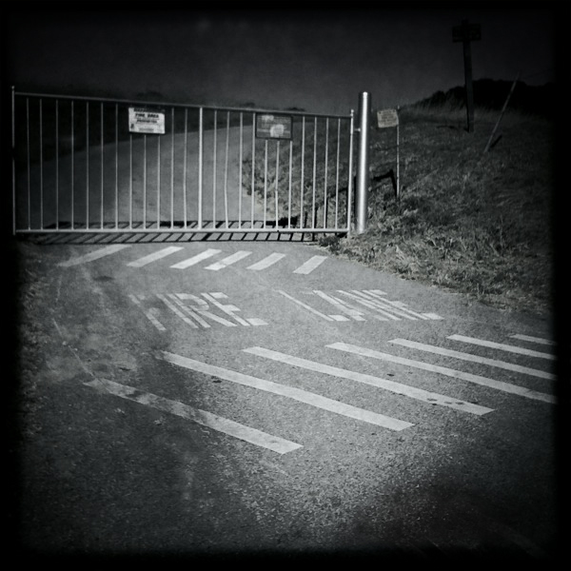
Barriers
Notes:
What barriers are there to moving beyond what they know?
Several barriers stood out to us – previous experiences as you have probably realized can create barriers. Students who remain tied to a particular tool or process and are unwilling to try new things miss out on opportunities to expand what they know. One student repeatedly kept going back to her high school website for resources and didn’t even consider seeing what the OSU Libraries might have to offer. Another variant of a barrier that past experiences that can create barriers are misunderstandings or just bad advice from classroom settings – one of our participants had the classic misconception that only print items were appropriate for an academic audience and I don’t think she would have been easily steered away from that idea.
The type of assignment given is another example of a barrier. Much has been written recently about the place of the research paper in the college writing experience, particularly for first-year students. And it might be worth continuing to discuss what role assignments involving scholarly journal articles should play for undergrads. Finally, students frustrations with finding search tools, using search tools, and getting access to articles from within those tools continues to be a barrier even within our disintermediated environments that are intended to remove those barriers.
http://www.flickr.com/photos/chucknado/4759227272/

Slide 56
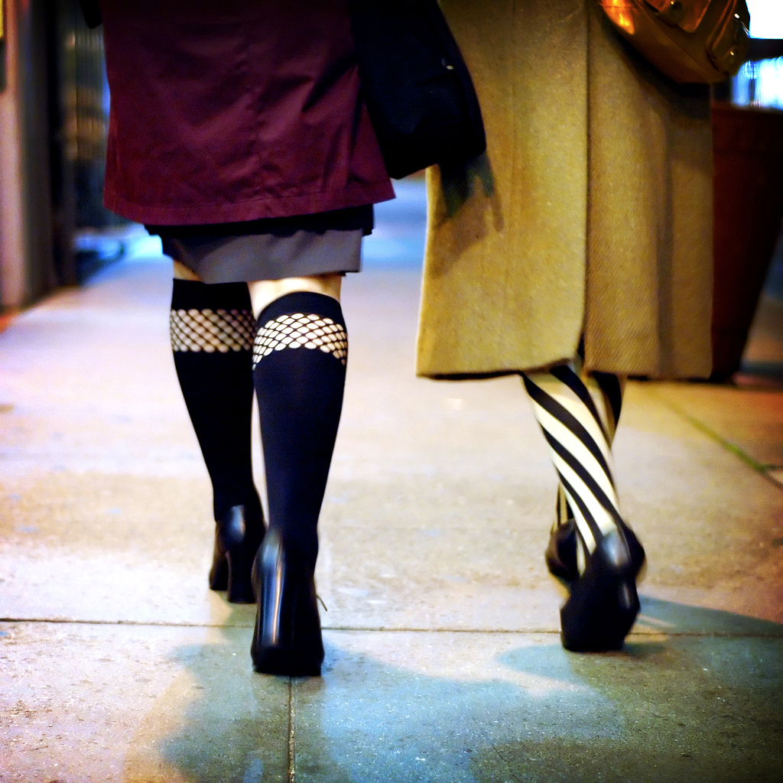
Next steps
Some rights reserved by ilmungo

Slide 57
Questions?

