Slide 1
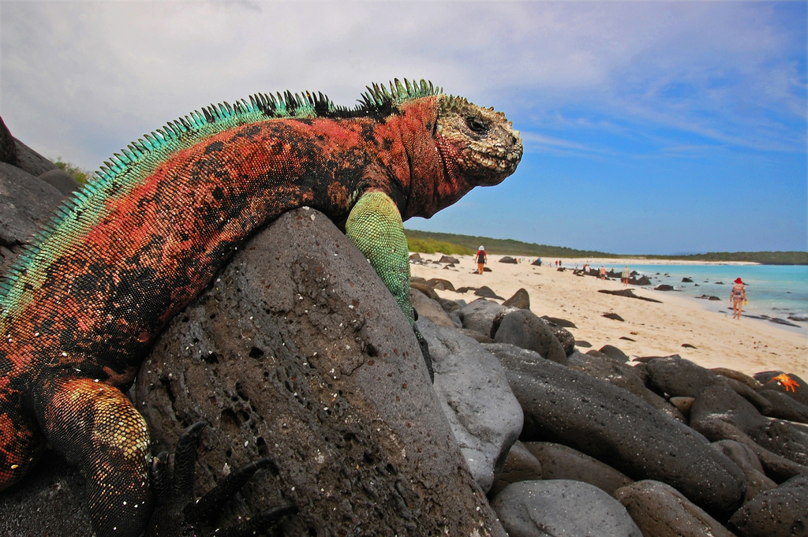
Galapagos Marine Iguanas (Amblyrhynchus cristatus)
Analysis of the threats to

Slide 2
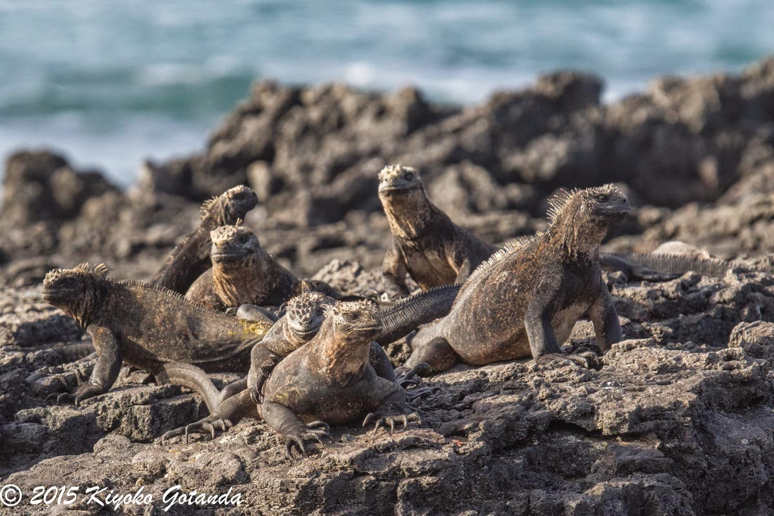
Why Do I Care?
and why should you?
Notes:
As a tourist, sometimes wondered if my presence was harmful to the Galapagos wildlife

Slide 3
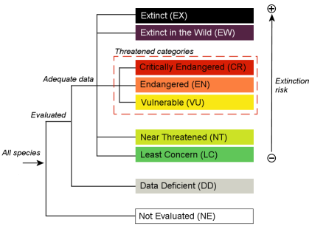
Background
Marine Iguanas are classified as vulnerable
Due to Area of Occupancy
Fragmented populations
Fluctuation in # of mature individuals
Official list of threats:
Invasive species
Oil spills
Climate change
& severe weather
Are there more…?
Figure 1. Levels of Classification for the IUCN Red List.

Slide 4
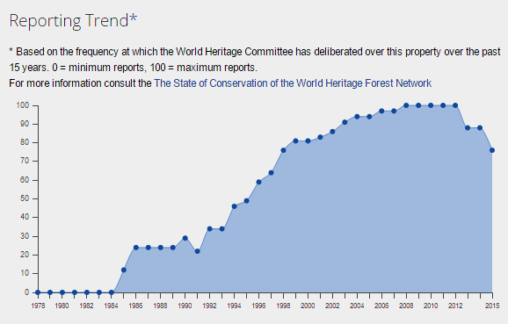
Figure 2. Reporting Trend for Concern over Galápagos Islands. The relative frequency at which the World Heritage Committee deliberated over the Galápagos Islands
Notes:
After a peak from about 2008-20013, the number of reports on the Galapagos Islands has been decreasing substantially. This indicated a decreasing concern over the well-being of the wildlife. Is this dangerous?

Slide 5
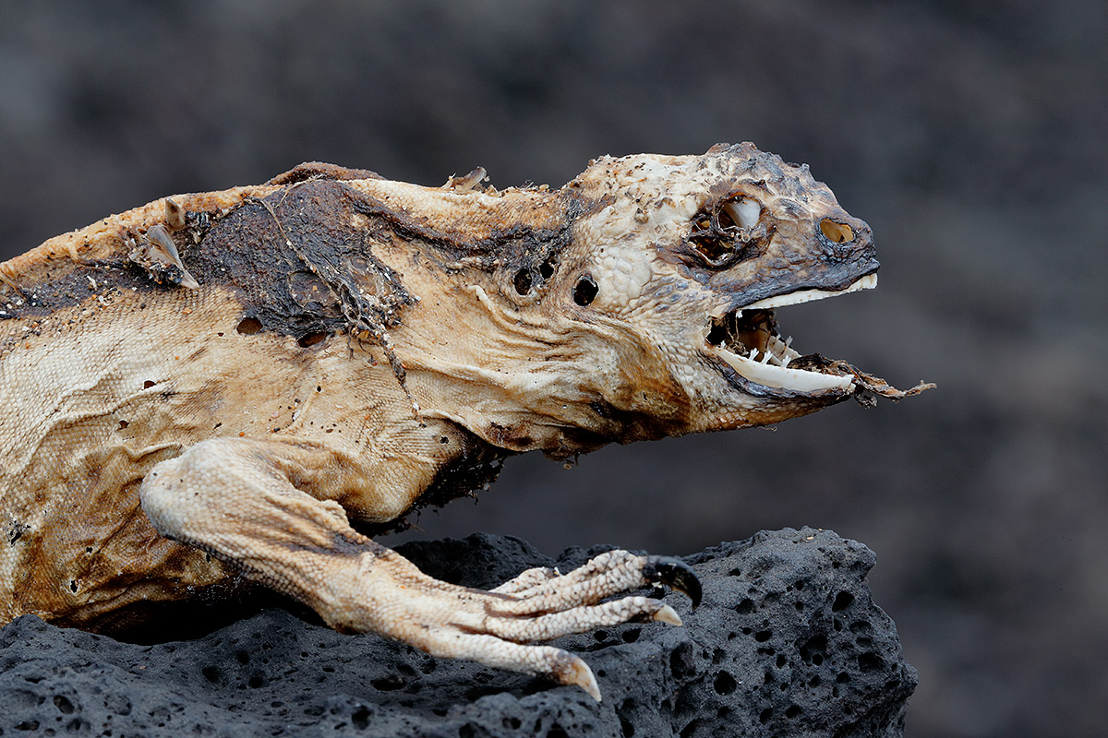
Threats
Invasive Species
Increasing Human Presence
Foreign Pathogens
Global Climate Change

Slide 6
Methods
Categorized each threat using three categories:
Deaths caused (as a %)
Impact on stress levels
Whether it was expected to increase or decrease

Slide 7
Invasive Species
Egg predation
Eggs are dug up by invasive rats
Adult/juvenile predation
Predation by dogs and cats
Minimal ability to learn anti-predator behaviors
They also have low innate predator recognition and stress response

Slide 8
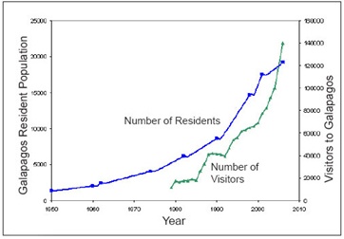
Increasing Human Presence
Figure 3. Number of residents and annual tourists in Galápagos Islands, 1950-2010. Both number of residents and tourists have been increasing since the mid-1950s. Experts expect these numbers to continue to increase. Source: Galápagos Conservancy.

Slide 9
Increasing Human Presence
Direct Human Contact
Unknown impact on stress pathways
May also alter immune system function
Environmental Disasters
Contaminants cause high stress levels
Stress leads to high mortality rates

Slide 10
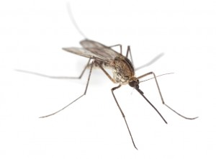
Foreign Pathogens
Naïve immunity on islands
Mosquitos as vectors
West Nile virus?

Slide 11
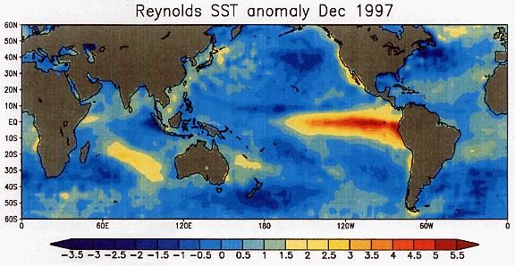
Global Climate Change
Changing oceans
Long-term alteration in food source
Worsening el Nino events
Cyclic, temporary reduction in food source

Slide 12
 | % Deaths Caused? | Chronic Stressor? | Estimated Trajectory? | Overall Threat Level
Egg Predation | n/a* | n/a | Decreasing | Mild
Adult Predation | 27% | Mild | Decreasing | Mild
Direct Human Contact | n/a | Moderate | Increasing | Moderate
Environmental Disasters | Up to 62% | Severe | Increasing | Severe
Foreign Pathogens | n/a | Moderate | Increasing | Moderate
Changing Ocean Environment | n/a | Severe | Increasing | Severe
El Niño | Up to 90% | Severe | Increasing | Severe

Slide 13
Compounding Threats
Multiple sources of stress = higher mortality
Some threats increase the impact of additional threats
Ex: High stress → weakened immune system → vulnerable to disease
Impacts on iguanas in all age ranges (eggs, juveniles, adults)
Highest mortality rates seen when 2 or more threats occur simultaneously

Slide 14
El Niño
Natural phenomenon, cannot prevent from occuring
More of a catalyst than a cause

Slide 15
Conservation: Next Steps
Mild Threats
Continue current actions
Moderate Threats
Learn more!
Do more?
Severe Threats
Learn More!
Do more!
International scale
Focus on minimizing stressors to minimize the impact of el Niño events

Slide 16
Challenges
Cost
Interest
Understanding
Logistics
Global scale

Slide 17
Limitations
Quantitative vs. Qualitative analysis
Limited data available
Concrete groups – no way to prioritize within a category

Slide 18
Future Study…
Future threats
Threats not well understood
Stress from direct human contact
Foreign pathogens
Breeding programs

Slide 19
Conclusion

