Slide 1
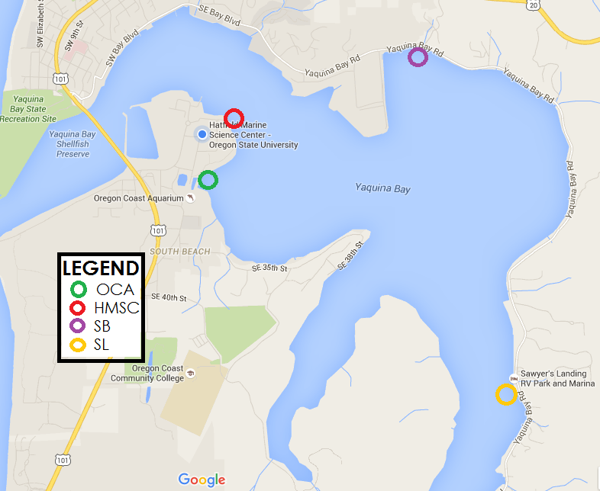
Spatial and vertical distribution of the invasive European green crab in a temperate estuarine system
Christopher A. Lundeberg* and Taylor Weldon*
Department of Integrative Biology, Oregon State University
lundebec@oregonstate.edu weldont@oregonstate.edu
Introduction
Abstract
El Niño Growth
First observed in Yaquina Bay in 1998, following strong El Niño
Reduced upwelling facilitates recruitment
Population in Yaquina Bay not self-sustainable
Requires larval input from California populations
Negative effects on local ecosystems
Measurable morphological changes in snails
New England soft-shell clam declined by 50% in 4 years, attributed to the establishment of C. maenas
Suppression of C. maenas population by native predators
Larger native crab (C. productus, M. magister)
The European green crab, Carcinus maenas, is a generalist predator that has established invasive populations throughout the world, including the west coast of North America. In Oregon, strong cohorts of green crabs recruit only during major El Niño events. The goals of this study are to: 1) compare the abundance and growth of the recent 2014-2015 El Niño cohort to that of the strong 1997-1998 El Niño in Yaquina Bay, Oregon, and 2) explore the spatial and vertical distribution of C. maenas and how it relates to that of the native red rock crab, Cancer productus. An abundance and size distribution similar to the 1997-98 cohort was observed, indicating favorable current patterns and growing conditions brought on by the strong El Niño. We did not find a correlation between the spatial distribution of C. productus and C. maenas, however it is possible that the distribution is related to the dynamics of the bay or microhabitat preference. Our data suggests a negative correlation in the vertical tidal distribution of the two species, supporting the hypothesis that C. productus sets the vertical lower limit of C. maenas. Observations of the interactions of the two species in the same trap support this hypothesis. Future studies should follow the 2015 year class and its effects on the local ecosystems. These data could prove a valuable tool in making predictions on the indirect effects of El Niño or the establishment of a self-sustaining C. maenas population in Yaquina Bay.
El Niño provides ideal growing conditions in Yaquina Bay
Increasing molt frequency
El Niño drives the recruitment of C. maenas larvae into Yaquina Bay and estuary system
Persistent northern currents and reduced upwelling
Observed size-frequency distribution of 2015 cohort similar to 1998 cohort
Objectives
Spatial Distribution
Vertical Distribution
Identify the spatial distribution of C. maenas throughout Yaquina Bay and how it relates to the site-specific abundances of C. productus
Make observations of the distribution of C. maenas along a vertical gradient in Yaquina Bay and compare with the distribution of C. productus
Document the growth and relative abundances of the C. maenas 2015 year class in Yaquina Bay following the strong 2015 ENSO event, make comparisons to the 1997-98 ENSO, and to years of normal atmospheric conditions
Carcinus maenas more abundant in high intertidal zone
Cancer productus more abundant in subtidal zone
Data suggests that C. productus has an effect on the lower limit of C. maenas but does not account for all variation in distribution (p-value < 0.02, MLR)
Figure 7: Growth of 2015 year class of C. maenas in Yaquina Bay, Oregon. Growth is measured by average carapace width in millimeters per month sampled.
Figure 2: Total amount of C. maenas and C. productus trapped at 4 sites within Yaquina Bay, Oregon in May 2016.
Methods
Utilized Fukui fish traps, with the dimensions 63 x 46 x 23 cm (LWH)
The sampling for this study took place from 16 May 2016 until 27 May 2016
All traps checked every 24 hours
We measured the carapace width (CW) from the tip of the 5th antero-lateral tooth to the corresponding tip on the opposite side of the carapace
Figure 6: Total numbers of C. maenas and C. productus caught in traps placed along a vertical tidal gradient in Yaquina Bay, Oregon in May 2016. The high was defined as the point where Ulva spp. stopped growing and the low as the point where the trap was half submerged.
Figure 8: Size frequency distribution of carapace width of C. maenas sampled from 4 sites within Yaquina Bay, Oregon in May 2016.
Figure 3: Average mass in grams of C. maenas taken from 4 sites within Yaquina Bay, Oregon in May 2016.
Every green crab was massed
We performed our analyses using ANOVAs, Tukey analysis tests, and multiple linear regressions on the data
Frequency
Carapace Width (mm)
Figure 1 (left): Map showing sampling sites within Yaquina Bay.
Figure 4: Average carapace width in millimeters of C. maenas taken from 4 sites within Yaquina Bay, Oregon in May 2016.
Figure 5: Catch per unit effort of C. maenas and C. productus calculated from sampling along a vertical tidal gradient in Yaquina Bay, Oregon in May 2016.
Figure 9: Size frequency distribution of carapace width of C. maenas sampled in Yaquina Bay, Oregon in July 1999 (Kalin and Yamada unpublished).
References: Behrens Yamada, S., C. E. Hunt, and N. Richmond. 1999. The arrival of the European green crab, Carcinus maenas, in Oregon estuaries. Marine Bioinvasions: Proceedings of the first National Conference, January 24–27, 1999, pp 94–99. Massachusetts Institute of Technology, Sea Grant Program. Behrens Yamada, S., B. R. Dumbauld, A. Kalin, C. E. Hunt, R. Figlar-Barnes, and A. Randall. 2005. Growth and persistence of a recent invader Carcinus maenas in estuaries of the northeastern Pacific. Biological Invasions 7: 309-321. Behrens Yamada, S., and G. E. Gillespie. 2008. Will the European green crab (Carcinus maenas) persist in the Pacific Northwest? ICES Journal of Marine Science 65: 725–729. Behrens Yamada, S., and P. M. Korso. 2010. Linking ocean conditions to year class strength of the invasive European green crab, Carcinus maenas. Biological Invasions 12: 1791-1804. Behrens Yamada, S. 2015. Status of the European green crab in Oregon and Washington estuaries in 2015. Pacific States Marine Fisheries Commission, Portland, OR. Cohen A.N., J. T. Carlton, and M. C. Fountain. 1995. Introduction, dispersal and potential impacts of the green crab Carcinus maenas in San Francisco Bay, California. Marine Biology 122: 225–237. DiBacco, C., and T. W. Therriault. 2015. Reproductive periodicity and larval vertical migration behavior of European green crab Carcinus maenas in a non-native habitat. Marine Ecology Progress Series 536: 123-134. Elton, C. S. 1958. The Ecology of Invasions by Animals and Plants. The University of Chicago Press, Chicago, Illinois. Glude, J. B. 1955. The effects of temperature and predators on the abundance of the soft-shell clam, Mya arenaria, in New England. Transactions of the American Fisheries Society 84: 13-26. Grosholze, E. D., G. M. Ruiz, C. A. Dean, K. A. Shirley, J. L. Maron, and P. G. Connors. 2000. The impacts of a nonindigenous marine predator in a California bay. Ecology 81: 1206-1224. Hunt, C. E., and Behrens Yamada, S. 2003. Biotic resistance experienced by an invasive crustacean in a temperate estuary. Biological Invasions 5: 33-43. Huyer, A., R.L. Smith, and J. Fleischbein. 2002. The coastal ocean off Oregon and northern California during the 1997–8 El Niño. Progress in Oceanography 54: 311-341. Jensen, G. C., P. S. McDonald, and D. A. Armstrong. 2007. Biotic resistance to green crab, Carcinus maenas, in California bays. Marine Biology 151: 2231-2243. Johnston, D., and J. Freeman. 2005. Dietary preference and digestive enzyme activities as indicators of trophic resource utilization by six species of crab. Biological Bulletin 208: 36-46. See, K. E., and B. E. Feist. 2010. Reconstructing the range expansion and subsequent invasion of introduced European green crab along the west coast of the United States. Biological Invasions 12: 1305-1318. Sheaves M., R. Johnston, A. Johnson, R. Baker, and R. M. Connolly. 2013. Nursery function drives temporal patterns in fish assemblage structure in four tropical estuaries. Estuaries and Coasts 36: 893-905. Smith, O. R., and E. Chin. 1951. The effects of predation on soft clams, Mya arenaria. Proceedings of the National Shellfisheries Association 1951: 37-44. Vitousek, P. M., C. M. D’Antonio, L. L. Loope, M. Rejmanek, and R. Westbrooks. 1997. Introduced species: a significant component of human-caused global change. New Zealand Journal of Ecology 21: 1-16.

