Slide 1
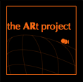
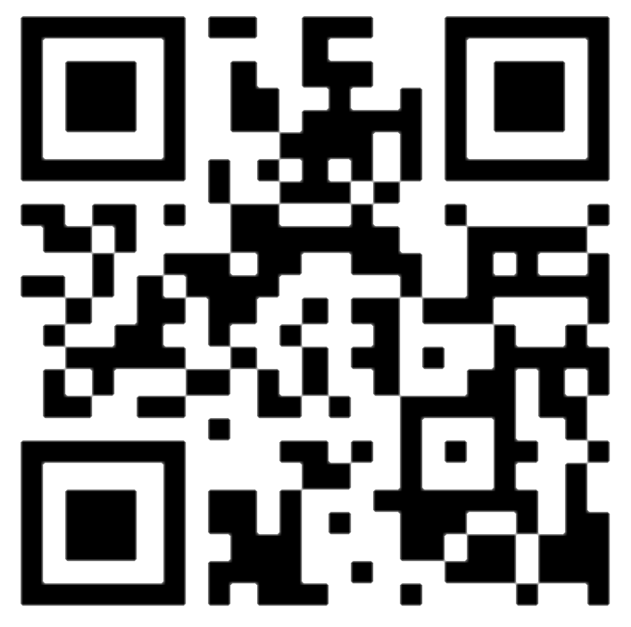
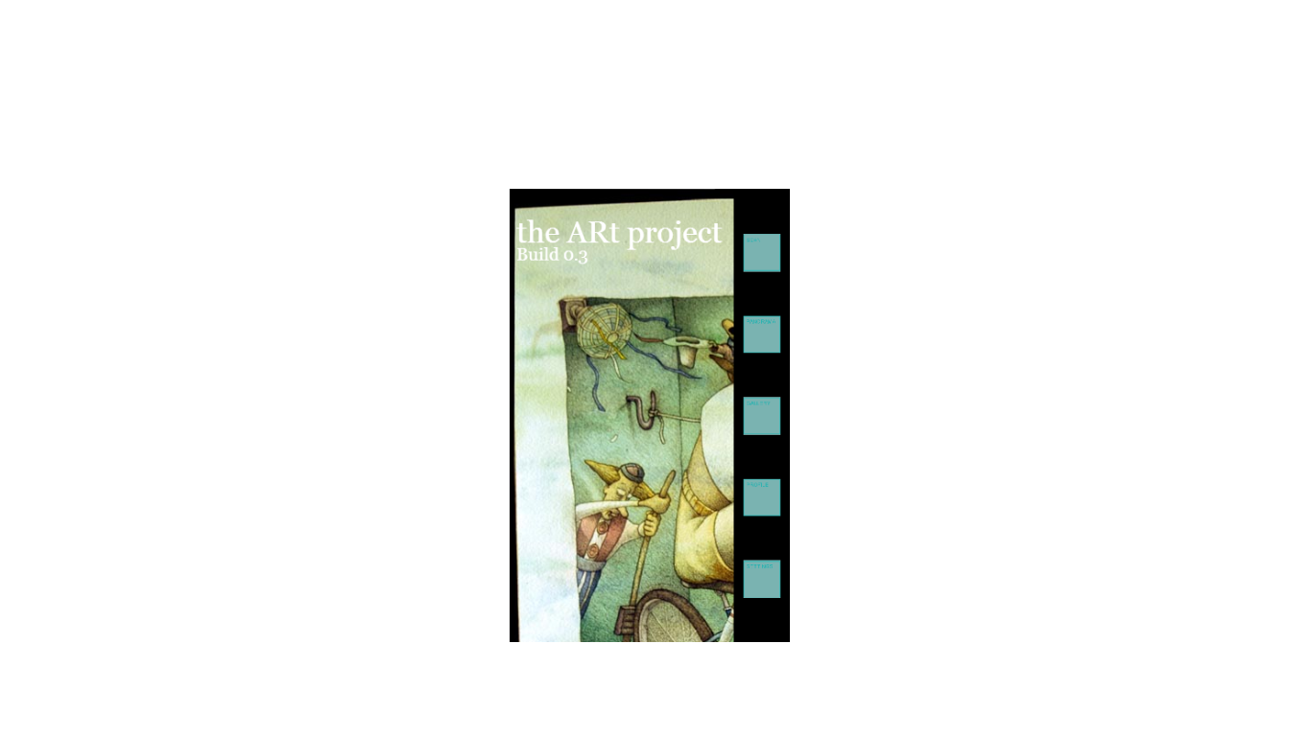
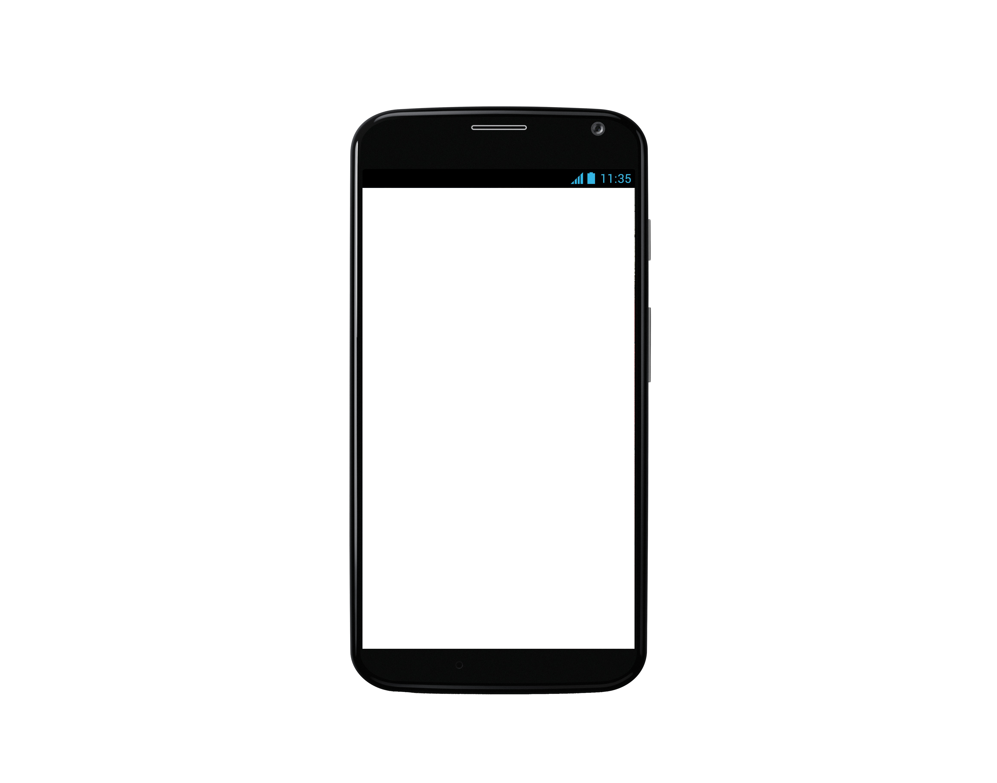
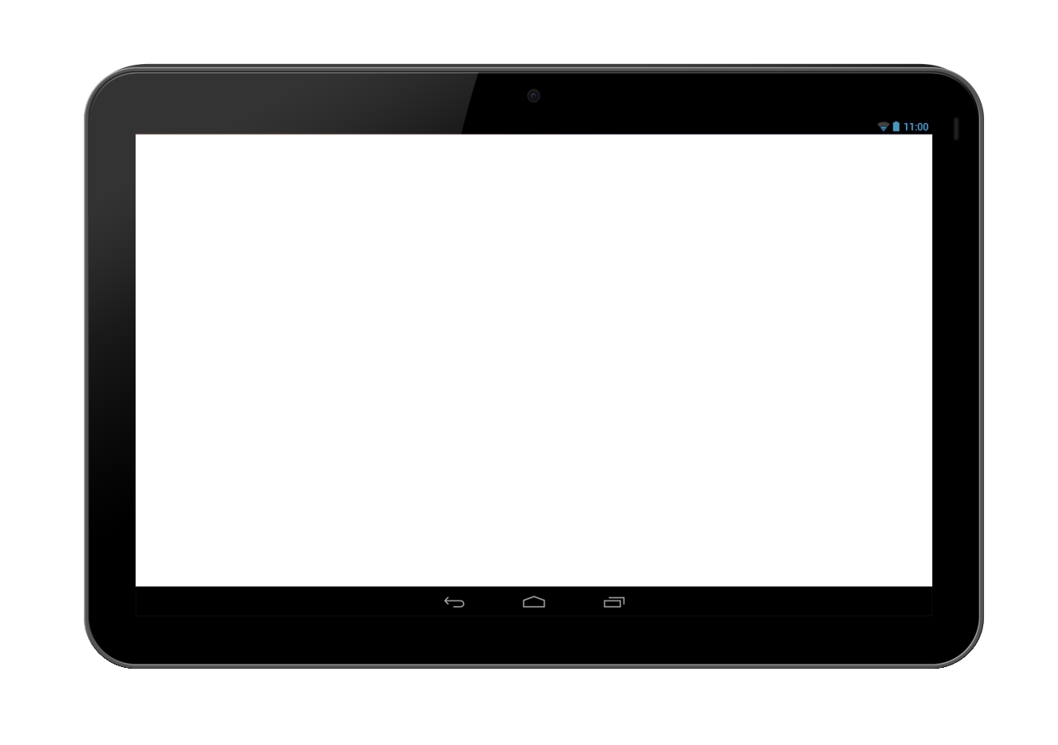
College of Liberal Arts / World Languages; College of Engineering / Electrical Engineering and Computer Science
the ARt project Making citizen-owned public art more community accessible for every Oregonian. A mobile application tool using Visual Thinking Strategies, to provide the Augmented Reality technology tour of our Oregon Percent for Art Collection, located throughout the Oregon State University campus, in Corvallis, OR.
Kerrie B. Wrye, Student-Artistic & Project Originator/Director; Tina Clawson, Assistant Director- Dixon Recreational Sports; Larry Roper, Vice-Provost- Student Affairs;
Jon Dorbolo, Assistant Director- TAC; Mark Dinsmore, Computer Engineer- TAC; Stevon Roberts, Videographer- TAC; Saralyn Hilde, Oregon Arts Commission- University Facilitator;
Brenda McCullough, Sr. French Advisor; Nabil Boudraa, French Professor; Jeff Hale, CLA Advisor; Dr. Carlos Jensen, EECS Professor; Mike Bailey, EECS Professor; Frank Chiou & Paden Atkinson- 2013-’14 Engineering Capstone student developers; and many, many more talented and supportive faculty and staff across the entire OSU academic community!
Value and Vision
Publicly-owned art has been accumulating
across the state of Oregon since the late 1970’s. Yet, the Percent for Art Collection is a permanent public cultural resource of which very few Oregonians are aware.
In 2011, Oregon State University post-Bacc student, and Corvallis artist Kerrie B. Wrye,
envisioned the basic concepts for mobile
application access to this statewide wealth, beginning in our local academic community.
Consider that in an age of increasing computer monitor-centered productivity, we continue to take for granted our abilities to visually absorb and process context-specific information.
Collaborating across the university, Kerrie chooses to uniquely adapt the ARt project content design to a visual thinking model; reflective of a deep desire to assist improved perceptual self-value and empowerment, through unlimited encounters with our public art. the Art project goals include providing a mobile content delivery system that improves our unexplored visual information processing abilities, through an engaging visual skills enrichment model, proven effective in disciplines such as Math, Science, History and Engineering.
the ARt project believes the state university setting provides a perfect niche in which to begin both public awareness and engagement with the Percent for Art Collection. Imagine: permanent public arts now more accessible to widening audience engagement, participation and development through mobile technology!
So far the ARt project prototype has under utilized a contextualized information access technology called, augmented reality. Nevertheless, the artist/projectinnovator has a strong vision concerning the highly interactive engagement potential waiting to happen between art and this kind of mobile technology. Our development teams agree that AR is too cool, not to make this happen!
Process
Because this is a collaborative development process across disciplines, the ARt project teams frequently start with traditional pencil and paper, in order to both explore and hone design integration, between digital and visual thinking strategies.
Approaching second stage user experience refinement goals this way, allows the development team to:
See their newest blueprints in action
Further brainstorm implementation and refinement
While allowing for excess feature discard.
Database design starts in the earliest brainstorming sessions to conceptualize different types and sources of information. Ease of future information addition to the app, is also included in this new 2nd phase design.
Digital Tools
A mobile development platform called Cordova, allows the 2nd Phase refinements team called Provenance, to:
Access device features like the camera and accelerometer
While developing non-natively in HTML, JavaScript, and CSS.
the ARt project Provenance team is using the Intel XDK as their development environment, because of its one-click build process; in addition to the expected features of syntax highlighting, auto-completion of functions and, an emulator to test code. Porting the web application to mobile platforms using Intel XDK allows the Provenance to test the application in the intended environment.
Entering an environment of Information Augments…
Design Decisions, and Taking the ARt project Further
By creating achievements and “digital rewards” for viewing pieces, the ARt project Provenance team has conceptualized new ARtouring features to develop the user’s own incentives over time, for both art searching and looking deeply at each art work on campus.
Discovering that the mobile development platform doesn’t readily support overlaying images on top of a camera view, the Provenance team would move to native Android and iOS development, trading the convenience of control that Cordova offers, for greater customized expression we could tailor, to the overall visionary breadth of this unique app concept.
The Provenance team also recognizes the future of the ARt project allows for curatorial opportunities to:
Build in-place tours, using the app to link together works in the collection in interesting ways
To further dimensionalize audiences’ depths of discovery.
As emerging developers, we continue to take mobile technology development- to facilitate universal human encounters with the magical sense that only discovering the arts can engender- to heart. In our experience, the ARt project is a great tool toward achieving dynamic public access to public resources such as the Percent for Art Collection at OSU.
Support the ARt project and keep up with our progress!
Follow the ARt project blog:
http://blogs.oregonstate.edu/coinartistique/
And, the ARt project facebook page. Query:
“ARt project- Accessing Culture, connecting community” in facebook.
a custom app now houses User refinements,
to help access the art in each building.

