Slide 1
Major element analysis of TEPHRA from the AMAMI-SANKAKU BASIN, Izu Bonin back arc
Jennifer Cepello Undergraduate
Frank Tepley III Professor of Geology
Oregon State University, College of Earth,
Ocean, and Atmospheric Studies.

Slide 2
Introduction
Hypotheses to be tested
Assess the major element evolution of the young and evolving IBM system using the temporally constrained record of this IBM system and compare it with Neogene Ryukyu-Kyushu and Izu-Bonin Mariana arc tephras

Slide 3
Background
The Expedition 351 drill site (Site U1438) is located on the Philippine Sea Plate in the Amami Sankaku Basin (ASB)
27.3°N, 134.3°E in 4720 m water depth.
Rear arc side of Kyushu-Palau Ridge (i.e., ancient IBM Arc)
Possibly underlain by Mesozoic ocean crust
Surrounded by Mesozoic remnant arc (Daito Ridge Group).
The structure of the ASB crust appears to be typically oceanic with 1300 m of sediment overlying a basement of 5.48 km thickness which we know through seismic profiling.
Fig. 1 Local of drill sites from IODP 351

Slide 4
Background
Map showing distribution of local tephra marker beds (>2 m) in Japan and surrounding areas.
Expedition 351 is a pioneer in an area that is not well understood!
Fig 2. Map of local tephra around Japan (Machida, 2002)
Notes:
This is map of the distribution of local tephra marker beds which are greater then 2m in thickness. The red dot (IBM-1) indicates the drill site of were the samples were retrieved.
Note there are no known marker beds near by!

Slide 5
Background
Four cores drilled and correlated to create one uniform stratigraphic column.
Lithological overview of IODP Site U1438 in the Amami Sankaku Basin. Neogene tephra taken from Unit I (pelagic and hemipelagic sediments with intercalated ash) and unit II (volcaniclastic sediments).
Fig 3. Graphic lithologic summary, biostratigraphic- and paleomagnetic-based age- depth plot for IODP Site U1438.
Notes:
A lithological overview of IODP site U1438 in the ASM is depicted against time which s was derived through biostratigrphic methods such as: radiolarians represented in blue, foraminifera in red, nanofossils, in black, and paleomagnetism represented in grey.
Given that all collected samples came from units I and II this gives a time contrant of roughly 0 -30 Ma.

Slide 6
Core sample correlation
In all, more than 100 ash and tuff layers and pyroclastic fragments were selected from temporally resolved portions of the core. The samples were prepared to determine major and minor element compositions via electron microprobe analyses.
Tephra Layer!
Fig 4. Sediment core sample
IODP 351 Site U1438
Fig. 5 SEM image of tephra

Slide 7
Methods
Samples were analyzed for major elements on the OSU’s Electron Microprobe at a 1 micron level.
Analysis of 10 glass shards per sample layer with a total of 60 sample layers.
Ages were determined by paleomagnetic and biostratigraphic-based studies.

Slide 8
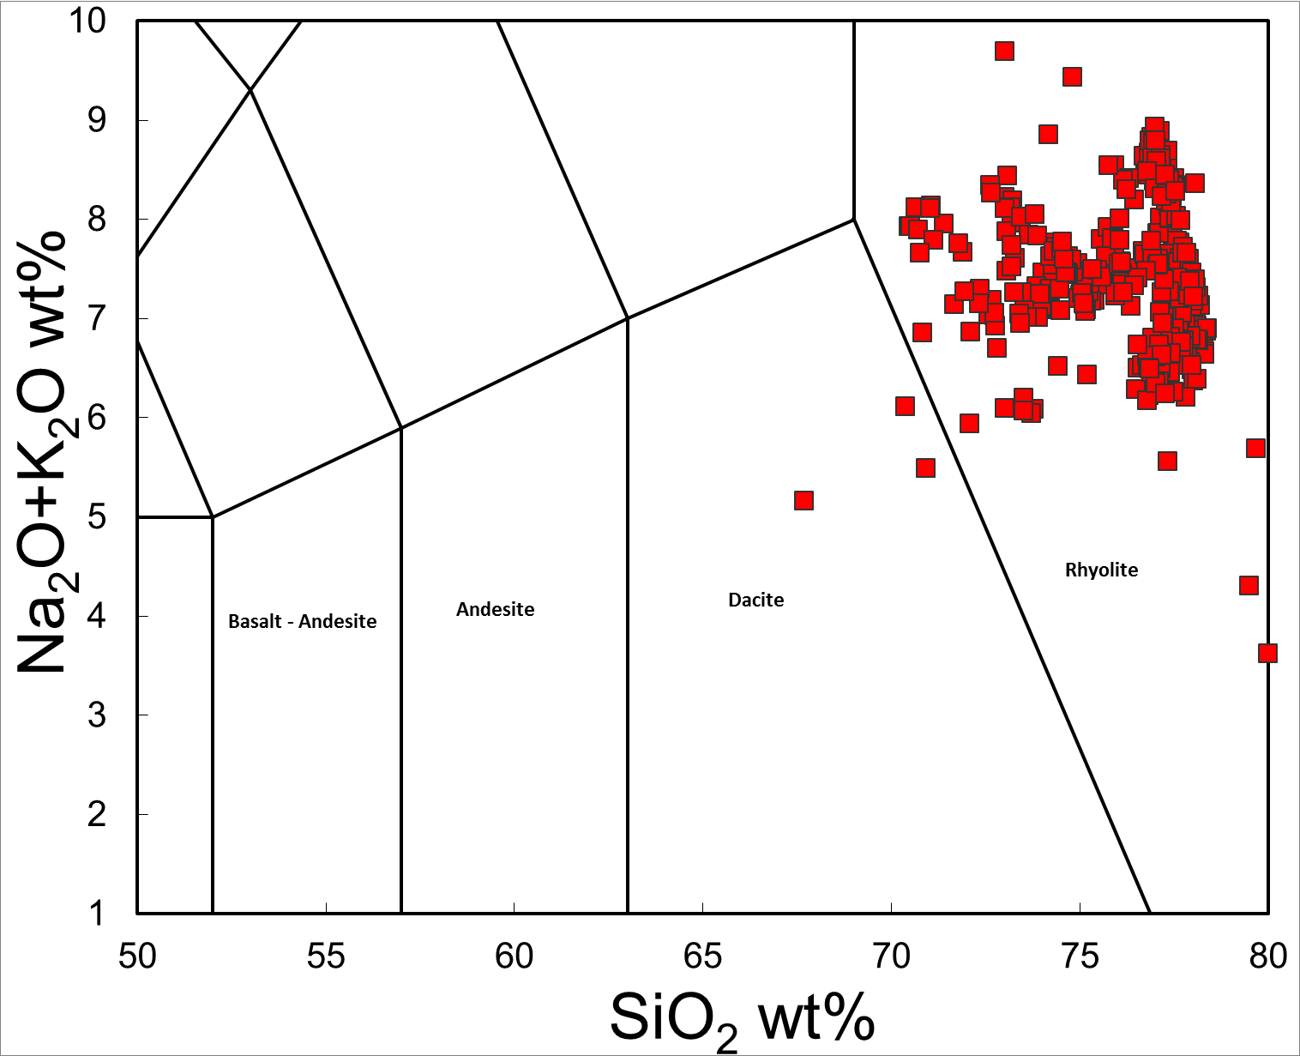
Results
Total alkali vs SiO2 displayed fairly uniform composition falling into the rhyolite portion of the diagram.
Graph 1. Total alkali vs SiO2
Expo 351
Notes:
By plotting the analyzed tephra data we obsereved some geneal trends within the data.
1: that most of the tephra is rhyolitic in composition

Slide 9
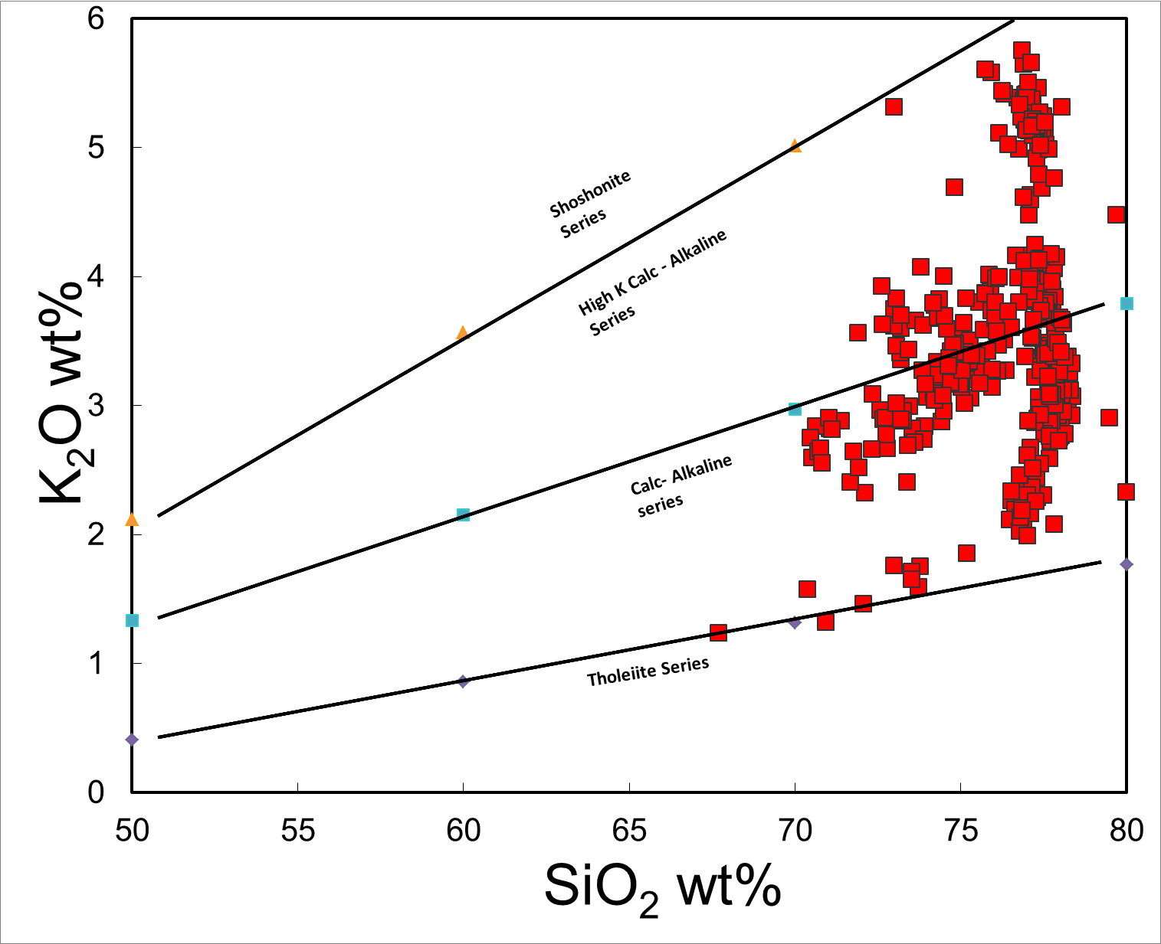
Results
K2O vs SiO2 variation diagram
depicting the compositional ranges
of glass shards represented from site U1348
Calc – alkaline
High K calc - alkaline
Two, possibly three, trends in potassium grouping within the tephra
Graph 2. K20 vs SiO2 Expo 351
Expo 351
Notes:
samples followed a calc – alkaline to high K calc – alkaline trend

Slide 10
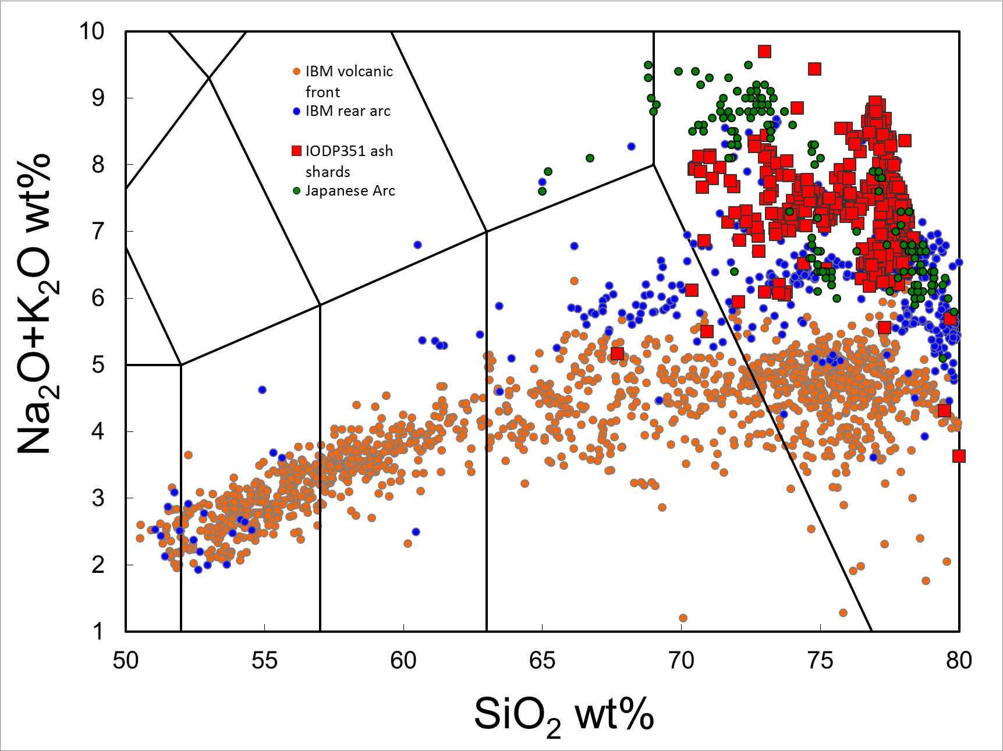
Results
Comparison of expedition 351 tephra samples with samples from the IBM front arc, IBM back arc, and the Japanese act (Ryukyu- Kyushu arc).
Graph 3. Total Alkali vs SiO2
Expo 351, IBM back arc, front arc,
and Ryukyu Kyushu volcanics
Notes:
In this plot we can observe that expo 351 ashes lay strictly in the rhyolitic spectrum of composition.
It is also observed here an overlay of composition likeness where the expo 351 samples overlay the IBM back arc, and the Ryukyu-kyushu volcanics.

Slide 11
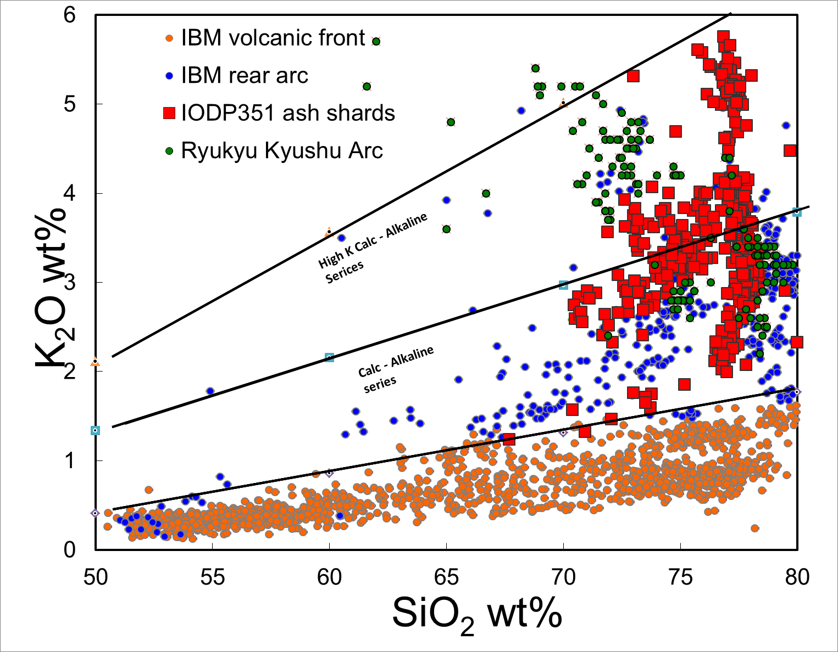
Results
Comparison of expedition 351 tephra samples with samples from the IBM front arc, IBM back arc, and the Japanese act (Ryukyu- Kyushu arc).
Graph 4. K2O vs SiO2
Expo 351, IBM back arc, front arc,
and Ryukyu Kyushu volcanics

Slide 12
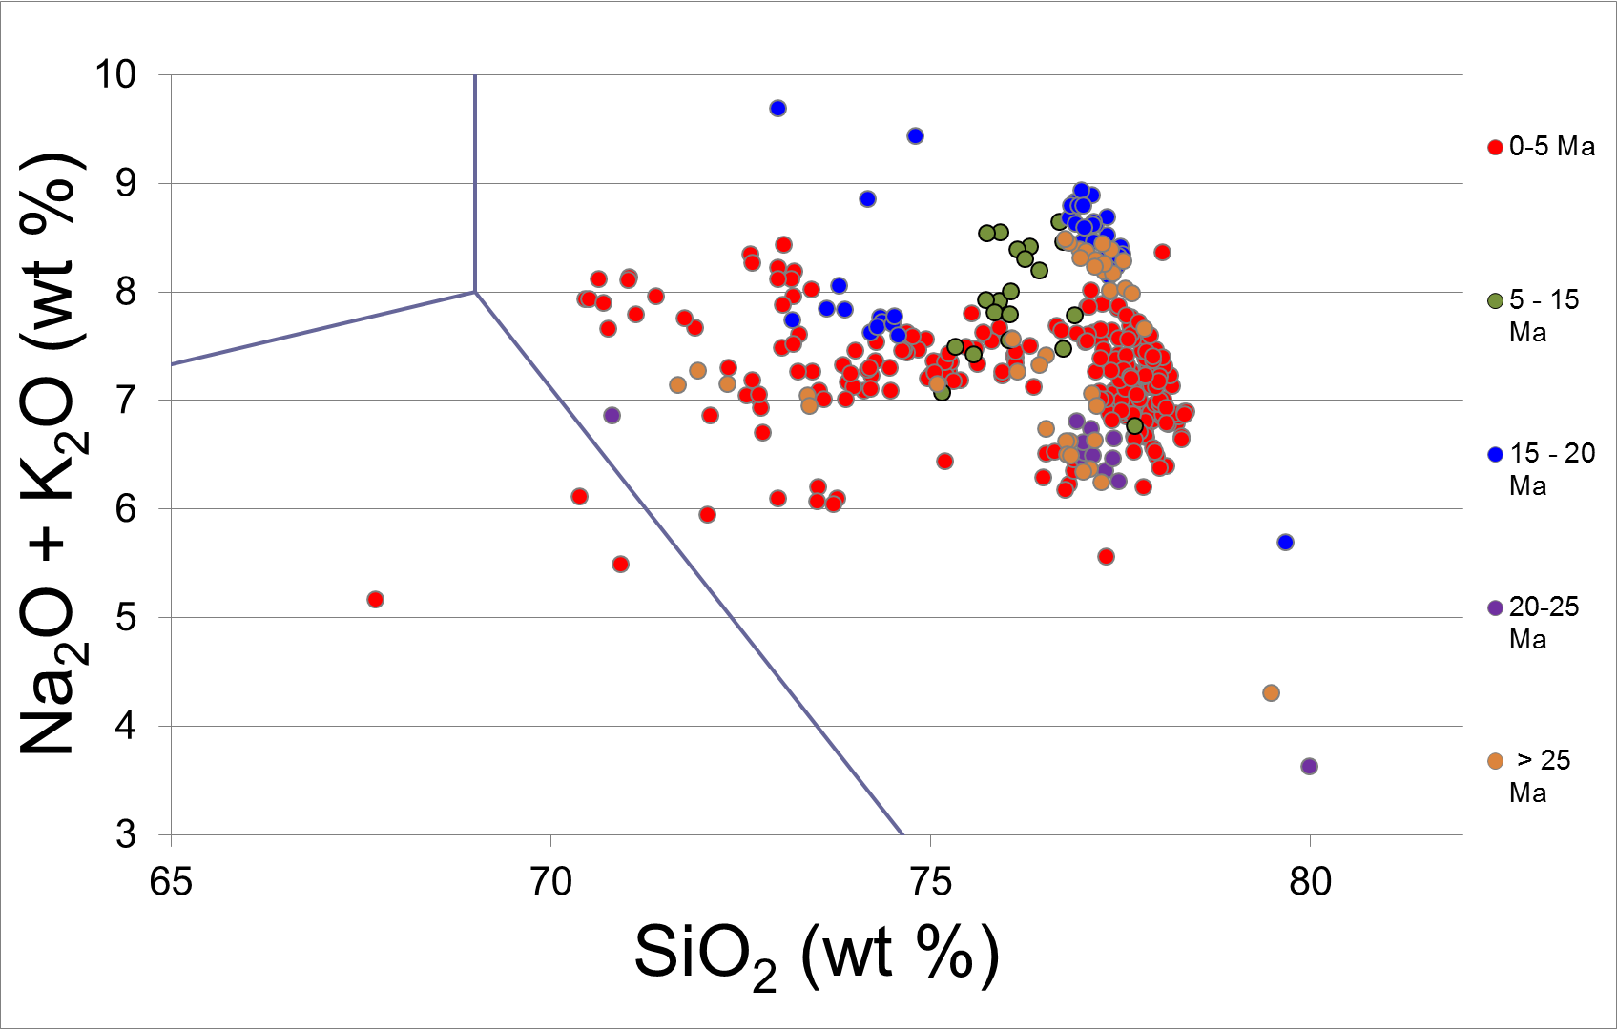
Results
In dividing the samples into 5 age constraints we can observe compositional trends in the data with relation to relative ages.
At the constraints of 20-25 Ma and 5-15 Ma there is minimal variation.
Other age constraints were observed to be variant in composition
Graph 5. collected samples separated by age
Notes:
This is another total alkali vs Si plot where only expo 351 samples are shown. Time contrants were placed to observed any compositional evolution of total alkalis over time,
What we found was that some ages (20-25, 5-15) are closely clumped together, while others such as 0-5 Ma are quite variant compositionally.

Slide 13
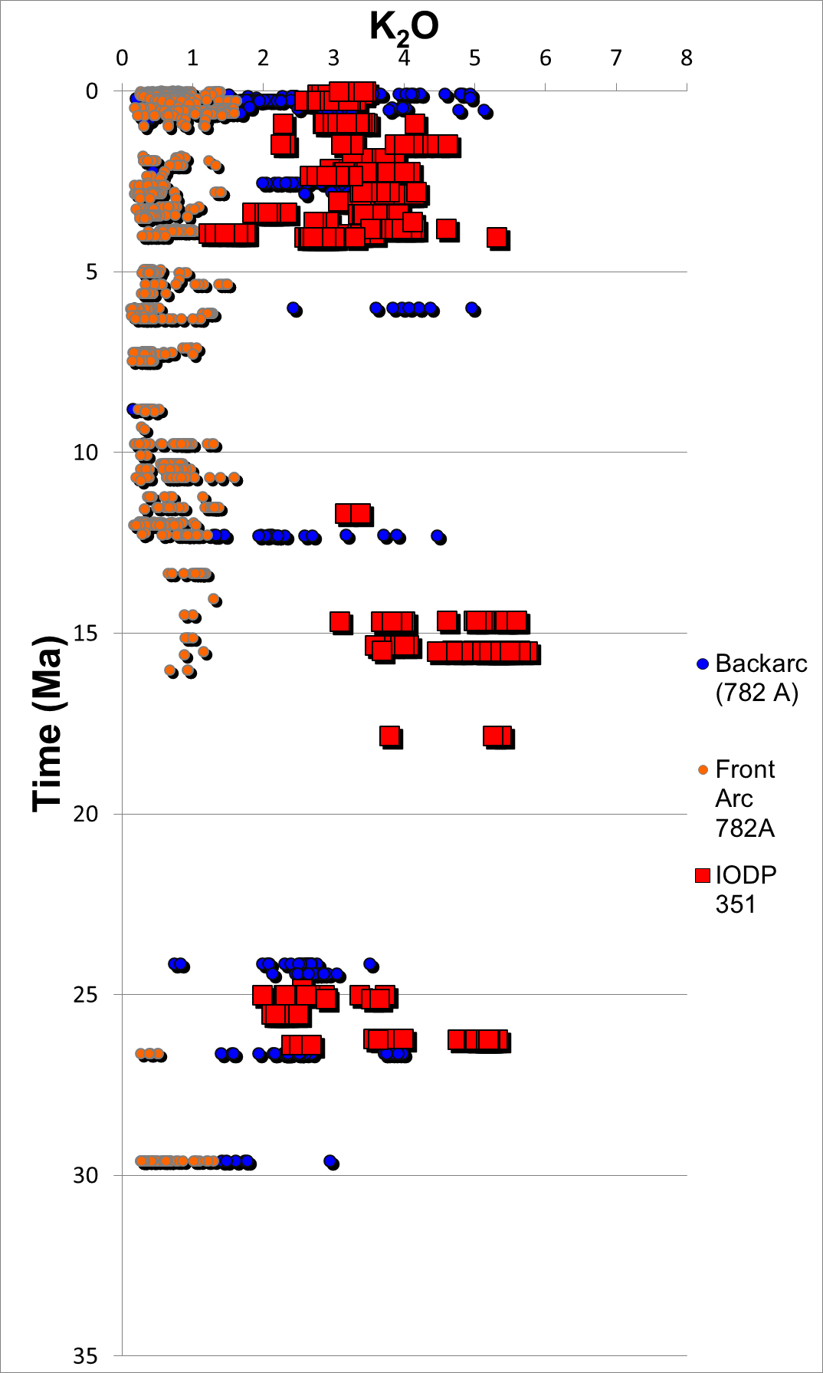
Results
Comparison of expedition 351 over time with the IBM back arc, and front arc
351 experienced a slight decrease in potassium between 0-5 mya
General overlap with IBM back arc
Graph 6 Time vs K20 in comparison with IBM back arc, front arc, and 351
Notes:
To further explore the evolution of expedition 351 tephra I plotted time vs K20, SiO2, and MgO. I also added the IBM back arc and front arc samples to observe any trends through time that may correlate with expedition 351’s.
Trends observed:
351 experienced a slight Potassium enrichment at ~15 Ma, though it generally overlaid the IBM back arc samples through out time.
SiO2 relatively high through time with minimal to no change. In this case Expo 351 samples overlay both back arc and front arc but at different times (front arc in the neogene, back arc in the Oligocene).
Mg wt% were extemely low through time again exhibiting trends of overlay from both the back arc and the front arc.
Another trend that is observed is the period of events!

Slide 14
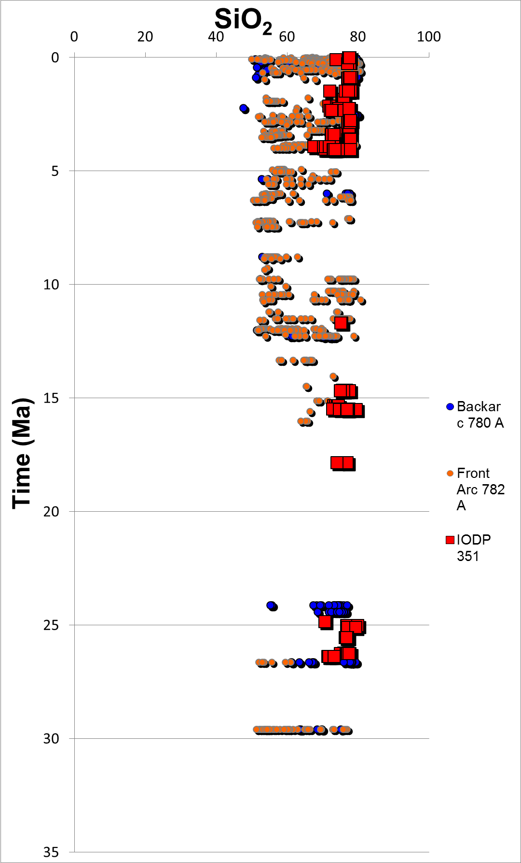
Results
Comparison of expedition 351 over time with the IBM back arc, and front arc
SiO2 relatively high through time with minimal to no change.
Observed overlap in both back arc and front arc but at different ages (front arc in the pliocene, back arc in the Oligocene).
Graph 7 Time vs Si02 in comparison with IBM back arc, front arc, and 351

Slide 15
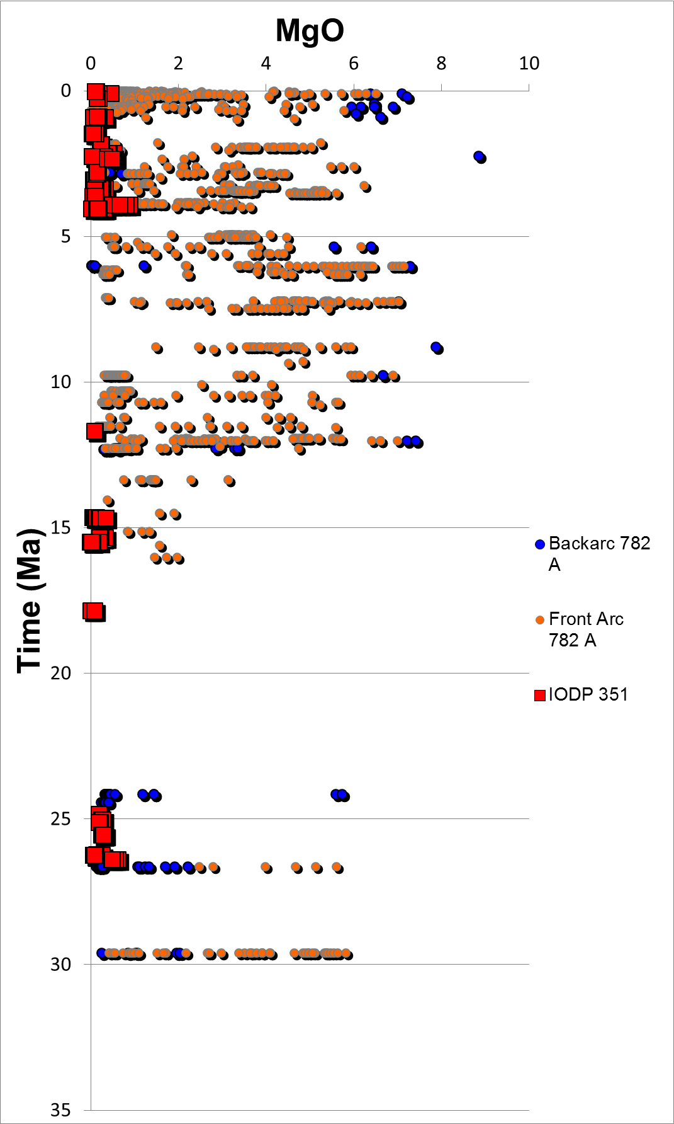
Results
Comparison of expedition 351 over time with the IBM back arc, and front arc
Mg wt% were extremely low through time.
exhibits a similar trend of overlap from both the back arc and the front arc
Graph 8 Time vs Mg0 in comparison with IBM back arc, front arc, and 351

Slide 16
Conclusions
Data shows high silica composition within the rhyolitic range of tephra
Data shows two, possibly three, trends in potassium evolution of tephra
Tephra composition series was constrained to both calc- alkaline series and the High K calc-alkaline series
Tephra exhibited two trends in composition over time
1) Positional overlap in SiO₂, K₂O, and MgO with IBM rear arc samples through time (0-30 Ma)
2) Positional overlap in SiO₂, K₂0 and MgO with IBM front arc in samples less than 5 Ma

Slide 17
Other notes
Further analysis of these samples are being carried out at another location where trace element composition will be evaluated
This study displays an array of open ended questions of which require more studies of the area and the surrounding areas.

Slide 18
Questions?

Slide 19
Refrences
Straub, S. M. 2008. Uniform processos of melt differentiation in the central Izu Monin volcanic arc (NW Pacific). Dynamics of Crustal Magma Transfer, Storage and Differentiation, 304, 261-283.
Straub, S. M. 2003. The evolution of the Izu Bonin –Mariana volcanic arcs (NW Pacific) in terms of major element chemistry. Geochemistry Geophysics Geosystems, 4, doi:10.1029/2002GC000357.
Straub, S. M., Goldstein, S. L., Class, C., Schmidt, A., Gomez-Tuena, A., 2010. Slab and mantle controls on the Sr-ND-Pb-Hf isotope evolution of the post 43 ma Izu-Bonin volcanic arc. Journal of Petrology, 51, 993-1026, doi:10.1093/petrology/egq009
Straub, S. M., Woodhead, J. D., Arculus., 2015. Temporal evolution of the marian arc: mantle wedge and subducted slab controls revealed with a tephra perspective. Journal of Petrology, 56, 409-439, doi: 10.1093/petrology/egv005.
Yuasa, M. & Nohara, M., 1992. Petrographic and geochemical along-arc variation of volcanic rocks on the volcanic front of the Izu-Ogawawara (Bonin) arc. Bulletin of the Geological Survey of Japan, 43, 421-456.

