Slide 1
Fiscal Flow Analysis
J. Cortright, Impresa
M. Spahic, Portland State University
November 2008

Slide 2
Research Question
What is the fiscal relationship between metropolitan Portland and the rest of the state?

Slide 3
Synopsis
Original study undertaken in 1999
Showed major outflows from Portland MSA to balance of state
Update key indicators
Data are annualized, reflect
2007-2009 Budget Amounts
2005-2007 Expenditure Allocations
2006 Revenue Collection Patterns

Slide 4
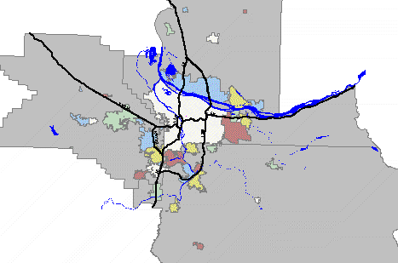
Defining Geography
Metro Portland
The Rest of Oregon
Clackamas, Columbia, Multnomah, Washington & Yamhill Counties
46% of Oregon’s Population
31 Other Oregon Counties 54% of Oregon’s Population

Slide 5
Key Indicators
Revenue
Personal Income Tax
Lottery
Corporate Income Tax
Expenditure
K-12 State School Fund
Oregon Health Plan

Slide 6
Revenue (2007-09)
Total General Fund/Lottery Fund: $15.1 Billion/Biennium $7.5 Billion (Annualized)
Sources (Millions, Annualized)
Personal Income Tax 5,571.6 (74%)
Corporate Excise Tax 428.7 (6%)
Lottery Revenues 576.0 (8%)
All Other General Funds 977.3 (13%)

Slide 7
Expenditure (2007-09)
Total General Fund/Lottery Fund: $15.1 Billion/Biennium $7.5 Billion (Annualized)
Uses (Millions, Annualized)
K-12 Education 3,122 (41.3%)
Oregon Health Plan 783 (10.4%)
All Other GF Programs 977 (48.3%)

Slide 8
Sources of Revenue
Personal Income Tax
55.2% from Portland MSA
Lottery
53.6% from Portland MSA
Corporate Tax
56.7% from Portland MSA
Melded Overall Portland Share of GF/LF
55.1%

Slide 9
Expenditure
State K-12 Expenditures
$3.1 billion
40.6% to Portland MSA
Oregon Health Plan
$782 million
42.8% to Portland MSA
Annualized estimates for 2007-2009 Biennium

Slide 10
K-12 Fiscal Flow
Portland MSA Contributes
$1.72 billion (55.1% of $3.1 billion)
Portland MSA Receives
$1.27 billion (40.6% of $3.1 billion)
Net Fiscal Outflow
$454 million annually
Annualized estimates for 2007-2009 Biennium

Slide 11
Oregon Health Plan Fiscal Flow
Portland MSA Contributes
$432 million (55.3*% of $782 million)
Portland MSA Receives
$335 million (43.8% of $782 million)
Net Fiscal Outflow
$97 million
Annualized estimates for 2007-2009 Biennium
*55.3% is melded rate for personal and corporate taxes from Portland MSA

Slide 12
Implications
Metro Portland provides a net subsidy in excess of $550 million annually for education and health in the rest of Oregon
Public services in Oregon are especially dependent on the health of the Portland metro economy
Stronger economies in rural Oregon, especially higher incomes would lessen this fiscal imbalance

Slide 13
For more information: jcortright@impresaconsulting.com

