Slide 1
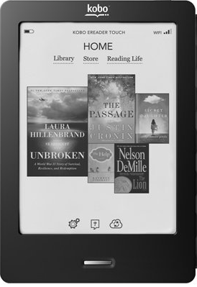
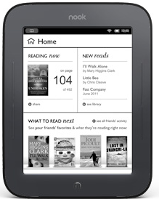
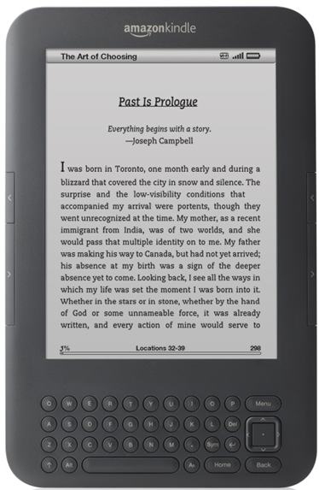
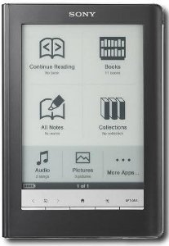
To eRead or Not to eRead: Is That the Question?
Uta Hussong-Christian
Jane Nichols
Hawaii Library Association Annual Conference
December 5, 2011
Notes:
UTA
Thanks very much for joining us this afternoon to spend some time looking at the issues around ereading. Jane and I, along with two other colleagues, have had numerous conversations about this topic related to a study you’ll hear more about in just a bit. So this presentation was an opportunity to dig into the question of whether to eRead or not to eRead.
We presumed, that as you read the title, might initially think about the concept of eReading as mutually exclusive of print reading, that there is an inherent dichotomy addressed by this topic. You might think of headlines over the years forecasting the demise of the printed book or maybe you’re more visual and something like this comes to mind…

Slide 2
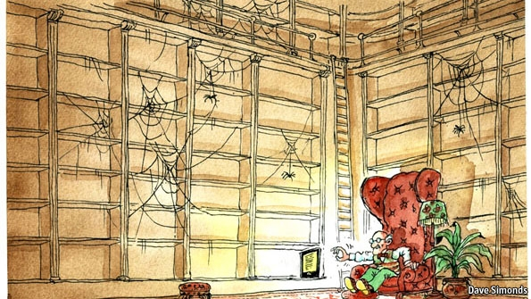
Notes:
UTA
This is the graphic that went along with a September article in the Economist about how e-books are changing publishing and it certainly feeds into the dichotomy implicit in our presentation title. Either our physical bookshelves will be full or…not. Either we will be reading printed materials or not.
Teasing apart publication data is complicated but in general it shows that print publishing net revenue is down across almost all categories while ebook publishing revenue is continuing to increase, and at a fairly dramatic rate (http://www.publishersweekly.com/pw/papercopy/48729-print-declines-outpace-digital-gains.html). The demise of retailers like Borders doesn’t bode well for the future of print…but we need to keep in mind that print is still the predominant format for now and the predominant revenue source. Bookstore bookshelves, college bookstores bookshelves and our own bookshelves are not empty and won’t likely be for quite some time.
And what this means is that the dichotomy question is not a useful question at this point. Print and digital formats co-exist. We read in multiple formats for a variety of reasons. So we need to dig a little deeper, get past the either/or aspect of the e-reading debate and that is what we hope to do this afternoon.

Slide 3
Notes:
UTA
http://www.polleverywhere.com/multiple_choice_polls/MTA2MjgzODY1NA
Along the way we want to actively engage you in this conversation. So we going to stop for a minute and have you think about how YOU read. Think about the reading you do for work, school, pleasure…any reading that doesn’t involve email. What device or technology do you use to do the majority of that reading? We realize that this is not an easy question to answer as one technology or tool may not dominate. But do your best.
This is a live poll so you will see responses as they come in (I have to confess that I went the cheap route and used the free version will allows up to 40 responses. So not all of your answers might be reflected). Anyway, there are two ways to respond to the poll. Either text the code that corresponds to your reading format to the number at the top of the screen or go to the url listed and submit the code that corresponds to your reading format.
We anticipated that reading in print and reading on the computer might dominate and we see this is the case from your answers. While print is the single dominant format, we do see, however, that with all ereading formats combined exceed print reading. But it will be some time before print is no longer in the mix.

Slide 4
Kobo
Nook
Kindle
2 months
4 eReaders
30 librarians & press staff
Sony
Notes:
JANE
As Uta said we got started on the question of eReading or not because of a study we are conducting at our library. With 2 other colleagues we received an internal grant to conduct a year-long longitudinal study exploring factors that influence eReader adoption among library faculty and press staff when the barrier of purchasing an ereader is removed. The grant enabled us to purchase eReaders for OSU librarians and staff and develop the study. So, this summer we distributed 4 different ereaders among 30 librarians and press staff and have subsequently held 2 interviews with each participant. The first was held upon receipt of the ereader and the second one month later. You can see the readers we distributed the Kindle, Kobo, Sony and Nook. Of course newer editions of the readers have since come out.
Because we needed a framework to understand our participants’ eReader adoption process; we decided to frame our study questions around a model called the Innovation-Decision Model which is a five-step process describing innovation adoption. The five steps include: knowledge, persuasion, decision, implementation, and confirmation. This model comes from Everett Rogers’s (2003).
Follow up interviews will be conducted Winter term and August/September 2012.
As we held the first two interviews; debriefed afterwards and generally talked about our experiences with eReaders some common observations and questions started to arise about our changing ereading and reading practices and about the adoption of ereaders. So let’s start with a few of our findings.

Slide 5
Previous eReader and eBook Experience
Notes:
JANE
Asked our participants to describe their past experiences with eReaders or eBooks –and we see that brand awareness dominates the “mind set” of our participants. Reviewing responses we see that our participants couldn’t tallk about ereades w/o referenceing kindle even though other products are on market & have been for a long time. Just one quick note the word “One” generally refers to eReader”
People’s experiences was mostly limited to a particular device: kindle, iphone, ipod touch; and for many it was limited to playing around w/ ebooks and ereaders and most of that was using it for a couple minutes; Some had downloaded the apps for iphone and ipod touch. Some used the kindle from our library’s lending program or their spouses to read books.

Slide 6
Prior eReader Ownership
(27%)
Notes:
JANE
Then we asked whether they owned an ereader. Of our participants, the majority owned kindles.
Gathering prior ownership data was important as one of the long-term objectives of the study is to determine how knowledge of this technology can lead to enhanced library or Press services. How can we develop these services without personal knowledge of the device and related technology?

Slide 7
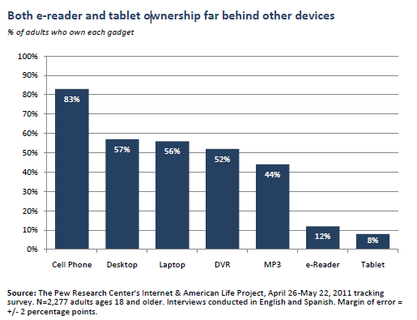
eReader Adoption
Notes:
Putting our participants experience and ownership in a larger context we pulled on a Pew study from this past June. Here we see that just 12% of their respondents own an ereader—suggesting that a whopping 88% of people at that time did not. So while headlines may heavily focus on the growth of ereaders and ebooks; ereader ownership is still just a small part of the overall ereading picture. But we know that this situation is rapidly changing.
While our own colleagues have a higher rate of ownership than the general public, overall we still lack the needed experience to develop informed services.

Slide 8
Factors Preventing eReader Purchase
Notes:
UTA
When asked what factors prevented people from purchasing an ereader, it became clear that our study participants just prefer physical books; for various reasons there was no clear need to adopt a new technology or to change their current habits –their current needs are met with print books.
Other reasons included wanting a multipurpose tool; cost of books; cost of buying an ereader vs. a tablet (or both); needs met through iphone/ipod touch; how to choose a device? When’s a good time to buy and the challenges faced by early adoption: what if something better comes along and holding off and just “Waiting to see if the technology sticks”
It is interesting to see that some of these concerns have already been addressed over the past two months with the release of tablet version of popular ereaders and significantly reduced prices on popular devices.

Slide 9
Participant’s Current Reading Formats
Notes:
UTA
The responses to this question we asked of our study participants are a bit different than what we asked of you at the outset of this presentation. We asked our participants to parse out, by format, all of the non-email reading they do.
While print is still the single dominant format, if you total all the eReading formats, then eReading does have the edge. One thing we did not ask our participants to do was break out work and pleasure reading. So we don’t know if the paper reading is largely reading for pleasure or reading for work and same with the eReading formats. Given our interest in this area, we are working on tweaks to our remaining interview questions that may help us answer some of these questions.

Slide 10
Downloaded Materials
Notes:
UTA
Participants want to use their eReaders for work and leisure reading and clearly tried. But reading success really only came with leisure reading.
I want to clarify why we broke out Kindle downloads separately:
- the Overdrive-Amazon deal was not finalized until the week prior to our second set of interviews so that is reflected in the low downloads
- Our main ebook providers EBL, & ebrary, not compatible with the Kindle – we didn’t want these numbers dragging down the overall downloads for the other devices.
I also want to clarify that the document downloads are mostly pdf articles and we had handful of participants who downloaded large numbers of pdfs – on the order of 20-40 and in one case 70! So this is skewing the data upward. The articles are combination of both work and pleasure reading.

Slide 11
Hurdles
Content
Finding
Getting
Managing
Competing Technologies
Device Comfort
Miscellaneous Annoyances
Notes:
JANE
As participants became familiar with their devices, they encountered numerous hurdles. Unfortunately there were so many that we had to categorize them. You may be able guess what what these are. We choose to categorize under: content, competing technologies, device comfort and misc.
Content includes
time to re-find content; determining whether content is device-compatible; deciding whether or not to pay for content; locating free content – many people expressed a desire for free content; navigating vendor’s websites for finding and getting content (in our case, OverDrive and EBL)
Getting content onto the device: Should I push content? Should I pull content? Syncing to a computer? The need to be tethered. Learning what works best for the device and personal workflow.
Managing content: organzing it, deleting it, syncing it across multiple devices (e.g. Kobo reader and kobo app), sharing? Can I or not? How do I know?
Competing Technologies
Coming to the eReader with expectations from other technologies such as tablets for smart phones: lack of touch screen but wanting it to be; no wireless but wanting it to be; no backlighting with e-ink but wanting it
Device Comfort
from initial learning curve through to more advanced use; setting it up instructions; remembering to charge it; tethered: having to use the cord to get content onto the device; getting used to the physicality of the device-left v. right handed;
Miscellaneous Annoyances
not a priority; remember to take with me; ads (ad-supported Kindle); screen fatigue; prefer print
Learning a new device affects adoption. Users expect initial set up to be easier than was

Slide 12
“The biggest hurdle would be the providers and the content, for sure. Especially OSU libraries, sad to say.”
“The backlight thing. I don't have a book light.”
“Time to refind books.”
“I think its purchasing, vs borrowing.”
“I guess the lack of…it’s not intuitive. It wasn’t intuitive to me.”
“Remembering to plug it in regularly so that it recharges because it needs to be tethered for that piece.”
“…the idea that you have to be attached to something else or that you’ve really got to be maintaining this library on, in my case, two computers.”
Notes:
JANE

Slide 13
Notes:
JANE
Hurdles show that are participants are just getting acclimated to the devices. Meanwhile the 4 investigators have had numerous conversations during our weekly meetings and hallway moments about our own experiences as well as those of our study participants. We’re seeing that it is hard to replicate some of the tasks with eReading that we naturally do with print reading.
As the photo illudes to, it is hard to flip back and forth between pages to compare or refer back to information previously read
Effectively annotating can be much more challenging using eReader devices; imagine taking notes with a stylus or miniature keybord
With eReading it can be harder to get a sense of the overall structure of a long-form work
We experience these things as barriers because we are new to the devices and we’re still trying to replicate our print reading practices when eReading. We need to move beyond replication and develop new skills in order to make better use of eReading technology. It is much easier, for instance, to pull together a list of bookmarks on an eReader or mobile device than it is to do so from printed materials that are physically bookmarked.

Slide 14
“Love my Kindle(s)!! Love my library, too. As I said before, there's no conflict. ...For me it's not a choice of 1 or the other; it's the joy of both.”
Gmwhit ,2011
Notes:
UTA
While the headlines that we keep seeing about about eReaders and eReading lend a sense of urgency to the development of new skills to surmount the hurdles that Jane just laid out, we should recognize that print is not dead.
And while we have time to work on eReading skills, the sooner we become comfortable the sooner we are able to enjoy the benefits of both, much like our happy blog poster here. To find enjoyment and utility across multiple reading platforms can only benefit us in the long run.

Slide 15
When and Why to eRead?
THAT is the Question!
Notes:
UTA
And this realization is useful for reframing the initial question about whether to eRead or not to eRead. We ARE eReading (our various polls show us this)…in various ways. So the more useful question then becomes what drives us or influences us to choose one way or another. When and Why should we or do we eRead? THAT is the question.
As we move forward with our own research project and our colleagues choose, or not, to adopt eReaders our working theory is that context, content and convenience will influence their eReading practices and potential eReader adoption.
We have begun to look at reading practices more generally to understand the practices or skills that we need to translate to the eReading environment.
But before examine those we want to ask you about your current eReading habits. So poll time again. Get out those devices!

Slide 16
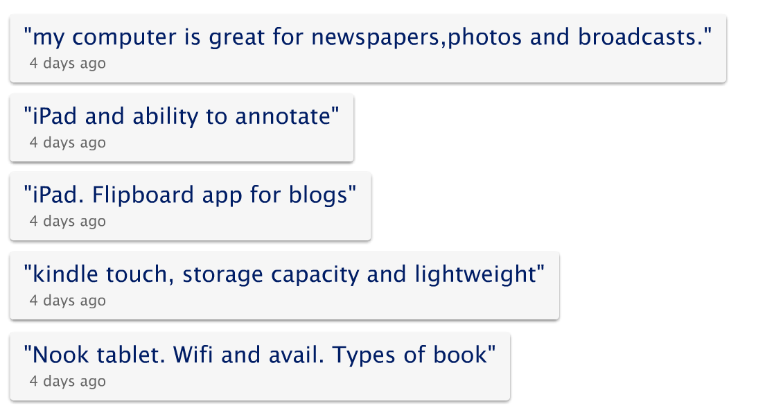
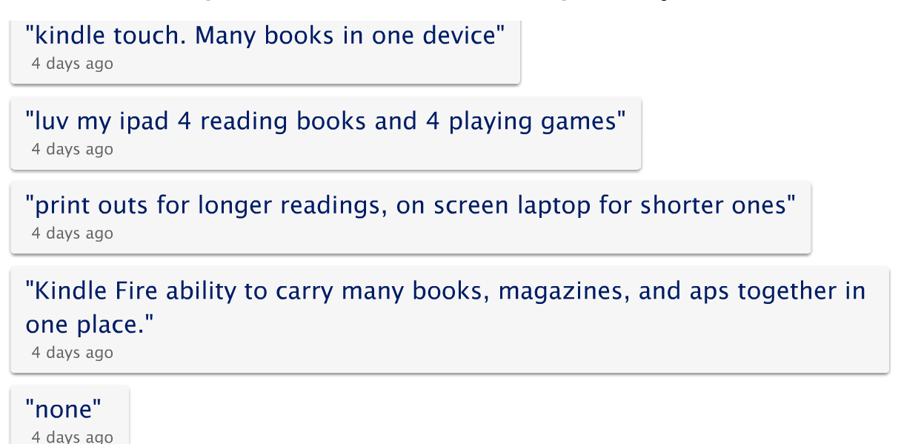
Notes:
UTA
http://www.polleverywhere.com/free_text_polls/MTg4OTA1NTIxNw
This time we are asking you to think about what you like best about your ereading experiences. Responses to this poll will be done a bit differently as your answers are open ended. Again you will text to the number at the top of the screen, include the code noted and then add your answer text. We want you to respond with your favorite technology for eReading along with the feature or experience you enjoy. So for example your response might be: tablet – multitasking
<Hopefully will start to see some context or content decisions show up here; just discuss briefly what we are seeing here.>

Slide 17
 | Reading Practices
Goodman 1994 | environmental, occupational, informational, recreational, ritualistic
Lorch et al. 1993 | exam prep, to research, class prep, to learn, to apply, to self-inform, to intellectually challenge, for stimulation, light reading (student reading)
Adler et al. 1998 | skimming, to identify, to remind, to answer questions, to self-inform/learn, to cross-reference, to review text, to support listening, to support discussion (student reading)
Greaney 1990 | utility, enjoyment, escape (children)
Pugh 1978 | scanning, search, skimming, receptive, responsive (adult reading)
Schcolnik, 2002
Thayer et al., 2011
Notes:
UTA
There is a quite a bit of research on the different ways that we read. While we are using the term practices to present some of this research to you, these practices are also identified in the literature as purposes or skills or styles.
This research has been done in many different contexts and while they each employ their own terminology, most of the concepts they reflect overlap. These taxonomies cover the different practices and skills we employ when reading and you can see we read for many different purposes including education and pleasure.
As we pulled together this list of reading practices, the work of Pugh really resonated with us, partly because his categorization of reading styles seem to work across the many different types of reading that we might encounter in our personal and professional lives and with both our print and our ereading.

Slide 18
Pugh’s Reading Styles
STYLE | Scanning | Search | Skimming | Receptive | Responsive
DEFINTION | known item search * rapid matching or rejection | uncertain of form and keywords *close reading to determine match | looking for structure of ideas / review * rapid moving through text | reading for content *linear, following author | Deep reading for short periods *time away for reflection & knowledge development
Pugh, 1978
Notes:
UTA
In just a few moments we are going apply Pugh’s styles to both print and eReading. But before we do that we want to review the definitions that Pugh uses for each reading style.
Scanning – known item searching and is characterized by rapid matching or rejection of information, close reading if accepted
Search – relates to the kind of reading we do when we are uncertain of the form that information will take or the appropriate keywords, more intellectual activity as potentially relevant information is evaluated, periods of close reading
Skimming – generally rapid movement through text to determine structure of information and determine utility and level of engagement on next encounter (if there is one);
Receptive – reading linearly from beginning to end; following path the author is setting
Responsive – synonymous with active reading; reader engages deeply for short periods, more focused more on reflection and construction of new knowledge, not necessarily linear reading

Slide 19
Reading in Context
 | Scanning | Search | Skimming | Receptive | Responsive
 | Yes | Yes | Yes | Yes | Yes
 | Yes | Maybe | Maybe | Yes | Maybe
 | Yes | Maybe | Maybe | Yes | Maybe
 | Yes | Maybe+ | Maybe+ | Yes | Yes
Honan, 2009
IntelFreePress, 2011
Madelinetosh, 2007
Notes:
Using Pugh’s reading styles, we combined a number of ideas:
We evaluated reading devices including print for how well they support each reading practice.
We made initial judgments about where the technology or our skills need to change
Scanning, Yes for all: Because the reader knows what they want and knows when they see it we feel they can use any of the devices to quickly accomplish their task. For known item searching, use can use device features like an index or a search box to quickly accept or reject content.
Search - used when the reader is uncertain of the form the information will take or the terms that will help them locate the information,
Yes in print; using the document structure to help them find where the info is located; TOC/Index/headers will support this task along with skimming (NOTE: these reading practices don’t exist in isolation, in practice there can be rapid movement from one to another)
maybe for eReader/handheld- depends on features the device and the content has: is TOC or the index hyperlinked? Willingness to employ features? How much effort is someone willing to put into moving around a text if had to scroll between an unhyper-linked TOC or index and its referenced pages
Maybe+ for tablets - because you can see more text on the screen, easier to see potentially relevant information in context
Skimming – looking for structure of author’s ideas
Yes in print; can easily flip through the text to see the structure of the author’s ideas; might think of earlier image of fingers in text or think of rapidly flipping pages
Maybe for eReader/handheld;
Can be done but cumbersome because of screen size; can’t easily scroll down or rapidly flip through pages; harder to make a rapid assessment of text in entirety, especially applies for long-form text;
however some people might feel that its not cumbersome to flip through pages using touch device because you can use page scrolling to rapidly move through the text. But because you are not viewing interim pages, by the time you land on a page you’ve missed substantial content and seeing ideas out of context which can give a faulty sense of overall structure.
Maybe+ for tablet - because you can see more text on the screen, easier to get through the content quickly but having to flip through pages one by one may still be a barrier for the same reasons as eReaders and handhelds
Having said all that we anticipate software will be developed to allow these tasks or people will learn workarounds; Can you imagine Flipbook or Coverflow technology for viewing the individual pages within a text on your device?
Receptive-all of these technologies all us to do linear reading very easily; we can follow the path the author setting for; for this type of reading, all of the investigators have really enjoyed our devices
Responsive—reflections and developing new knowledge;
Yes for print
Maybe for eReader – this is possible if you work at it; we are expecting that readers will want to annotate passages which can be cumbersome; often working with productivity tools and developing a workflow for managing this technology can be difficult (e.g. depending on the features your device has, you may find it challenging to use an annotation on your eReader for a document you are creating)
Maybe for handheld – largely for the same reason but also for the size of the screen even if there are apps that help make this workflow easy.
Yes for tablet – because of screen size and the ease of use of productivity apps on the device
This is an area is which substantial innovation will occur as device manufacturers and publishers work to solve these problems and integrate this technology into people’s workflows.

Slide 20
Final Thoughts/Future Work
“No revolution in communication media succeeds without a transitional period during which it imitates the old.” (Waller, 1986)
“…a rise in one innovation does not mark the end of another.” (Bauer, 2011)
Transliteracy - interaction among literacies
Ipri, 2010
Notes:
UTA
As we wrap up we want to leave you with a few quotes that high light where we with eReading and eReading technology and some thoughts on what we need to work on. Waller’s comment comes from a 1986 article entitled “what electronic books will have to be better than”. In this article Waller addressed a number of concerns: permanence of text; length of text and physical cues the let one map the info; referencing previously read text (remember fingers in text photo); linear text is the norm but lots of exploration in other ways to present content (there are several presentations today about how that might be accomplished). As the publishing and technology industries strive to push past simple imitation--and they’ve come a long way--we need to pause and recognize that in some really important ways we are still in that transitional period.
For those of us working in the academic realm, this is particularly important as students will need the functionality of their eReading devices to match or exceed what they an do in the print world in order to fully embrace eReading and eReading technologies for learning. Studies of eReaders in academia currently show that students will abandon their eReader devices if they can’t be as productive with them as they can with other technologies. Notetaking, annotating and bookmarking are all very important academic reading practices. Thayer and his colleagues as U Washington showed the difficulty that students have with these practices when using eReaders.
For pleasure reading and in the public library realm, eReading has been much more widely adopted. But even so, our own study results show that there are difficulties with finding relevant content and navigating the process of getting this content onto various devices unless the user is willing to purchase content from the online retail outlet associated with the device. That part is really easy.
As Bauer notes in her recent article on the rapid adoption of eReaders that the rise of one technology, in this case, eReaders and eReading devices, does not mean the end of print, an older but still important technology. Multiple technologies co-existing is both convenient and challenging. Having the older technology at our disposal gives us “fall back” options but at the same time we experience challenges trying to use the new technology with “old practices.”
While improvements in the technology itself can certainly help us get past the difficulties we encounter, we as readers need to develop and improve our skills--specifically we need to develop transliteracy skills. Transliteracy is defined by Sue Thomas of Dumont University and her colleagues as “the ability to read, write and interact across a range of platforms, tools and media”. The literacies we develop in order to operate with the various technologies we encounter can’t happen in isolation as pointed out by Ipri in his C&RL News article on transliteracy . If we’re only good with print or social media for instance but can’t translate those skills into the eReading world, we face significant hurdles. For example, many eREading devices have social bookmarking or annotating features. If they are turned on, there are advantages and creative possibilities. It might be fun to see what others are hlighting and sharing but we could easily become overwhelmed (think Facebook status updates). If I am transliterate I apply my ability to create social groups on a platform like Facebook to the eReading experience. In this situation, I can engage in a meaningful and constructive social reading experience where group annotations enhance my understanding of a difficult text.
Becoming transliterate means we will have developed new personal workflows. Doing so won’t be easy, but the reward is significant. In picking up on the idea of the blog post I showed earlier, about the joys of both print and ereading, transliteracy moves us past limitations of one or maybe a few literacies to the joy and enhanced productivity that comes with using them all. Knowing when to eRead and when not to eRead, that is our new challenge.

Slide 21
?
eReader Recommendations:
http://www.pcworld.com/article/243924/ereaders_which_one_is_best_for_your_bookworm.html

Slide 22
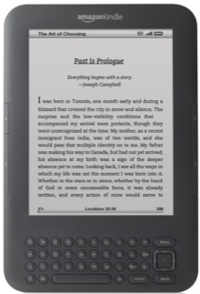
uta.hussong-christian@oregonstate.edu
jane.nichols@oregonstate.edu

Slide 23
References/Sources
Bauer, Sarah. (2011, November 18). Lessons in perception: ebook technology and the fast train it runs on [Blog post]. Retrieved from http://www.kelownawebdesigns.com/miscellaneous/lessons-in-perception-ebook-technology-and-the-fast-train-it-runs-on/
Gmwhit. (2011, October). @hobbitss, captainsuperdawg and many others [Blog comment]. Retrieved from http://deals.woot.com/questions/details/41d198d1-5bf2-4a6a-b972-9d6b2fdbfd96/where-do-you-stand-e-reader-paper-books-both-neither
Honan, M. (2009, January 29). iPhone app organization [flickr image]. Retreived from http://www.flickr.com/photos/honan/3238508928/
Ipri, T. (2010). Introducing transliteracy: What does it mean to academic libraries? College &Research Libraries News, 71 (10): 532-567. Retrieved from http://crln.acrl.org/content/71/10/532.full
Madelinetosh. (2007, July 21). Reading [flickr image]. Retrieved from http://www.flickr.com/photos/madelinetosh/974784929/
IntelFreePress. (2011, August 1). Amazon Kindle Touch [flickr image]. Retrieved from http://www.flickr.com/photos/intelfreepress/6310359399/
Pugh, A.K. (1978). Silent reading: An introduction to its study and teaching. London: Heinemann Educational Books.
Purcell, K. (2011). Ereader ownership doubles in six months: Adoption rate of e-readers surges ahead of tablet computers.
Washington, D.C.: Pew Research Center. Retrieved from
http://pewinternet.org/Reports/2011/E-readers-and-tablets.aspx
Rogers, E.M. (1995). The Diffusion of innovations (4th ed.). New York: The Free Press.
Schcolnik, M. (2002). Are e-readers viable instruction delivery systems? Journal of Instruction Delivery Systems, 16 (4), 6-17. Retrieved from http://www.salt.org/jidstoc.asp
Simonds, Dave. (2011). The offline experience. Retrieved from http://www.economist.com/node/21528611
Thayer, A., Lee, C.P., Hwang, L.H., Sales, H., Sen, P., & Dalal, N. (2011). The imposition and superimposition of digital reading technology: The academic potential of e-readers. Proceedings from CHI '11: The Annual Conference on Human Factors in Computing Systems. New York: ACM.
Thomas, S., Joseph, C., Laccetti, J., Mason, B., Mills, S., Perril, S. & Pullinger, K. (2007). Transliteracy: Crossing divides. First Monday, 12 (12). Retrieved from http://firstmonday.org/htbin/cgiwrap/bin/ojs/index.php/fm/article/viewArticle/2060/1908
Waller, R. (1986). What electronic books will have to be better than. Information Design Journal, 5(1), 72-75.

