Slide 1
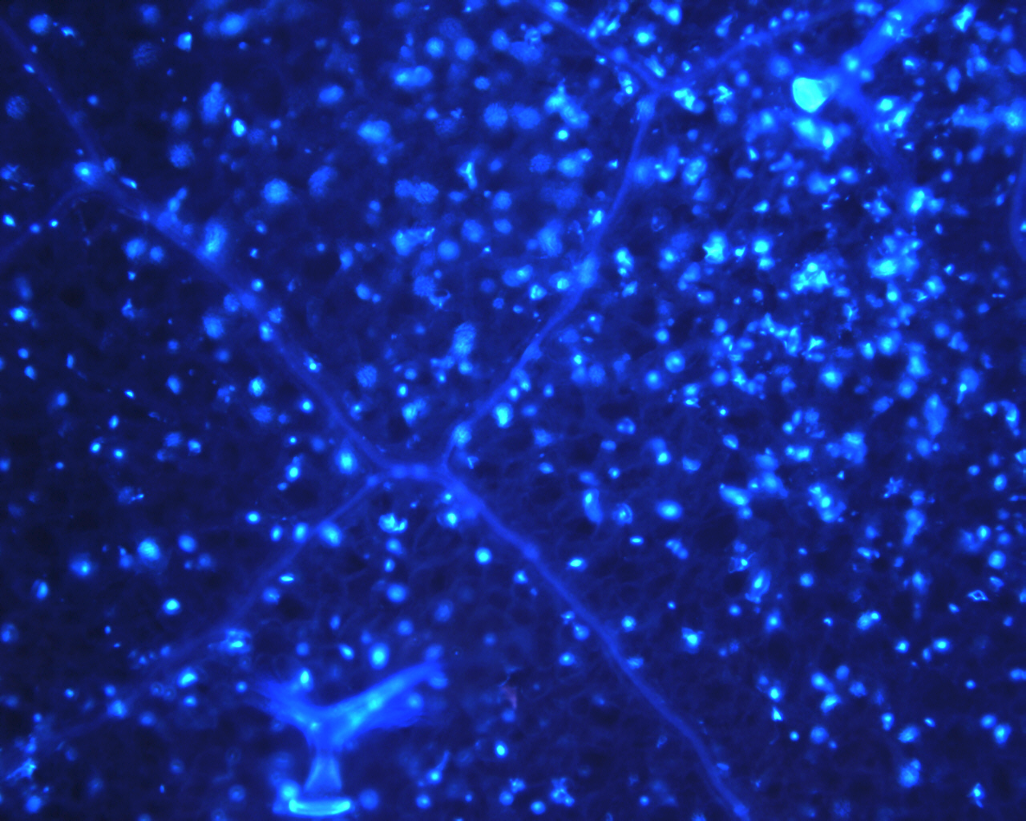
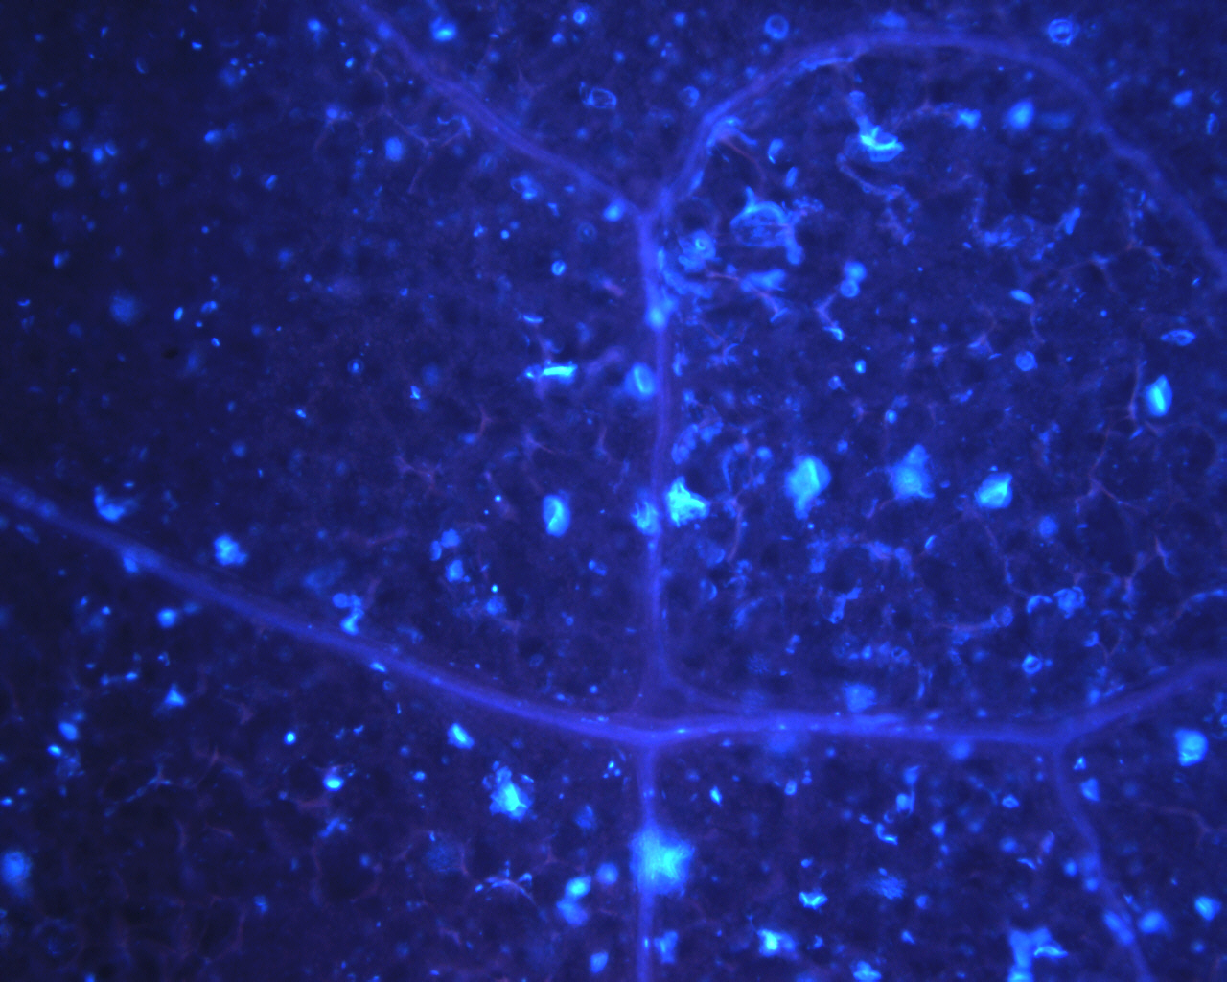
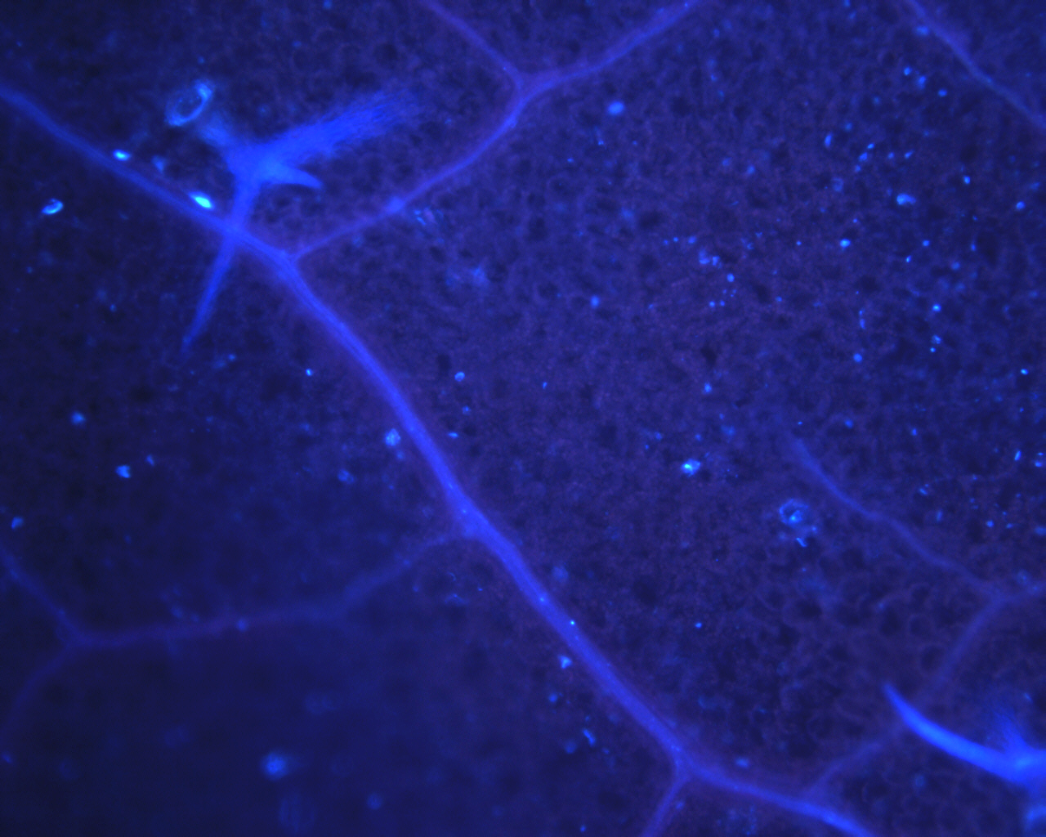
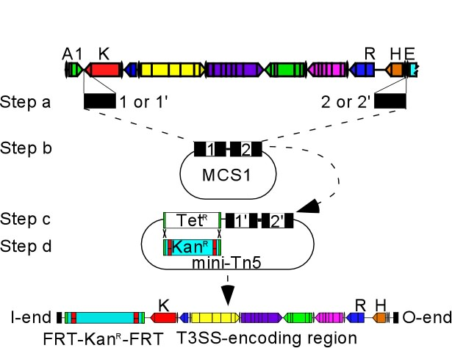
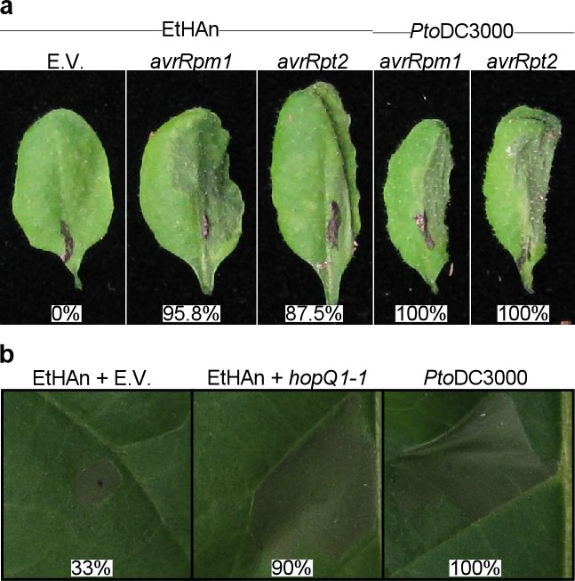
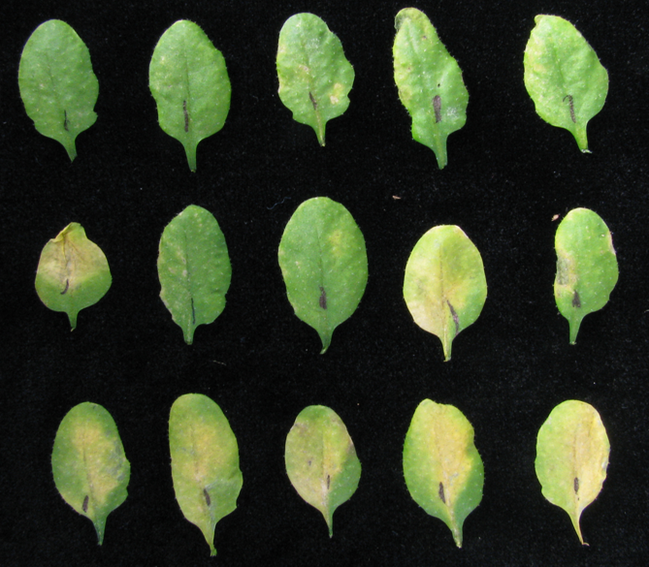
Recombineering and stable integration of the Pseudomonas syringae pv. syringae
hrp/hrc cluster into the genome of the soil bacterium Pseudomonas fluorescens Pf0-1
William J. Thomas^{1,2}, Caitlin A. Thireault¹, Jeffrey A. Kimbrel^{1,2}, and Jeff H. Chang^{1,2,3}
¹Department of Botany and Plant Pathology, ²Molecular and Cellular Biology Program, ³Center for Genome Research and Biocomputing
Oregon State University, Corvallis, OR 97331, USA
INTRODUCTION
Plant pathogens must overcome host defenses triggered by pathogen-associated molecular patterns (PAMPs).
Many bacteria employ a type III secretion system (T3SS) to subvert this PAMP-triggered immunity (PTI) and establish infection.
The T3SS delivers type III effector proteins (T3Es) directly into the host cell.
Plant-associated bacteria typically have large collections of T3Es with overlapping functions and limited homology to proteins of known function, making the characterization of individual T3Es challenging.
We have developed a stable delivery system, the effector-to-host analyzer (EtHAn), to deliver individual T3Es into host cells.
HYPOTHESES
T3Es function to dampen PTI and allow the bacterium to establish infection
The effect of individual T3Es on PTI can be observed using a downstream event, such as callose, as a readout of PTI.
ΔhrcC
PtoDC3000
Figure 4. EtHAn carrying avrPto or hopM1 dampens the callose response, a measure of PTI
Average number of callose deposits per field of view (1.5mm²) 15 leaves were photographed for each treatment; 10 fields of view were analyzed for each leaf.
EtHAn + E.V.
EtHAn + hopM1
b) Representative microscopic images of Arabidopsis leaves stained with aniline blue for callose deposition
Figure 1. Construction of EtHAn.
Sticky-end PCR was used to amplify 0.5 kb flanking the T3SS-encoding region and cloned into pBBR1-MCS1 and mini-Tn5 vectors.
and c) Vectors linearized and used to sequentially capture 26-kb T3SS-encoding region via recombineering, first into pBBR1-MCS1 (step b), then into mini-Tn5 (step c).
d) Replaced Tet^{R} gene with Kan^{R} flanked by FRT sites via recom-bineering.
*
**
**
*
**
**
**
**
**
**
**
**
c) Of the 21 T3Es tested from PtoDC3000, 12 dampen callose deposition when compared to EtHAn empty vector control. The significance of differences was determined using a Student’s t-test; * , p < 0.05; **, p < 0.01.
Figure 2. EtHan has a functional T3SS.
EtHAn carrying the perceived type III effectors AvrRpm1 or AvrRpt2 triggers a hypersensitive response in Arabidopsis leaves.
EtHAn carrying the perceived type III effector HopQ1-1 triggers the hypersensitive response in tobacco leaves.
CONCLUSIONS
EtHAn functions to deliver individual T3Es into host cells.
Most T3Es function to suppress PTI, as measured by dampening of the callose deposition response.
Future directions: Use digital gene expression (DGE) to study the effects of individual EtHAn-delivered T3Es on the host transcriptome.
Leaf | Effector | Leaves responding
1 | Pf0-1 | 5/18
2 | EtHAn | 8/18
3 | ShcM1-HopM1 | 14/18
4 | HopE1 | 12/18
5 | HopD1 | 7/18
6 | ShcF2-HopF2 | 10/18
7 | HopAM1-2 | 6/18
8 | HopX1 | 8/18
9 | ShcF2-HopU1 | 13/18
10 | HopC1 | 10/18
11 | ShcF2-HopF2-HopU1 | 13/18
12 | HopK1 | 12/18
13 | HopP1 | 15/18
14 | HopAA1-1 | 14/18
15 | ShcA-HopA1 | 15/18
Figure 3. Delivery of individual T3Es causes observable phenotypes.
Arabidopsis leaves infected with EtHAn carrying individual effectors resulted in chlorosis and/or necrosis within 6 days post-infection.
ACKNOWLEDGEMENTS
We gratefully acknowledge the assistance of Jason Cumbie, Philip Hillebrand, Ryan Lilley, Rebecca Pankow, Allison Smith, and Jayme Stout. We thank Jim Carrington for the use of his light microscope. Special thanks to Ethan Chang for his help and inspiration in the naming of the type III delivery system. This research was supported in part by start-up funds from OSU to JHC, and by a grant from the National Research Initiative of the USDA Co-operative State Research, Education, and Extension Service (grant 2008-35600-18783).
1 2 3 4 5
6 7 8 9 10
11 12 13 14 15
REFERENCES
Thomas, W.J., Thireault, C.A., Kimbrel, J.A., Chang, J.H. (2009) Plant J

