Slide 1
The Hidden History of Women at OSU (HC 407)
Tiah Edmunson-Morton & Chris Petersen
May 12, 2021

Slide 2
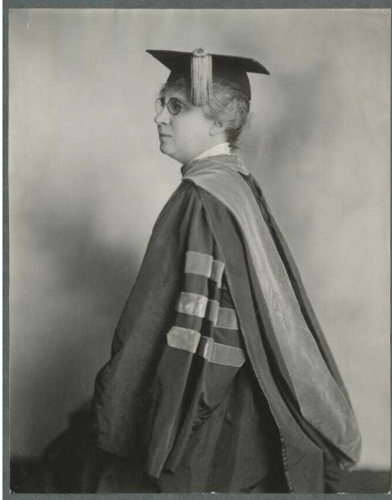
Women have been fundamental to OSU’s story since it was founded in 1868, but their achievements, struggles, and day-to-day experiences are often omitted from mainstream accounts of the university’s history.
Notes:
Women have been fundamental to OSU’s story since the university was founded in 1868, but their achievements, struggles, and day-to-day experiences are often omitted from mainstream accounts of the university’s history.

Slide 3
Class Introduction
Our class uncovers the pieces of this rich but hidden narrative, focusing on the themes and individuals who have shaped the academic and social milieu for women at OSU for more than 150 years.
Students contribute to the historical record by conducting an oral history interview with a woman connected with OSU, describing and indexing the interview, and making it available on a web portal.
We take a combined approach to instruction, using lectures, historic images, film clips, discussion, and document analysis.
Notes:
In our class, we introduce students to the hidden narrative of women through lectures, historical documents, discussion, film clips, oral history interviews, and picture time with Chris, which you’ll get a taste of tonight.
We also give students an opportunity to contribute to the historical record by conducting an oral history with a woman connected with OSU, not an easy or comfortable task for many. They index the interview and write up biographical information, and we provide access to the interviews through an online portal.

Slide 4
Class Goals
Increase appreciation for OSU as a place
Increase/complicate understanding of OSU’s history
Build historical empathy for past women’s experiences
Provide students opportunity to contribute to the historical record
Bolster the historical record related to women at OSU
Help students build interviewing skills and increase self-confidence
Reflect on ethics of sharing a story, particularly in the digital age
Provide students with the opportunity to get to know one another
Notes:
We have many goals for the class. We want students to understand that women’s experiences at OSU were varied. There isn’t a singular “Woman at OSU” experience. Instead, women are individuals, and their time here was shaped by the curriculum, built environment, and cultural expectations. We want students to learn about people, groups, and the institution, and to cultivate a sense of historical empathy for those who were here before. Historical empathy is a cognitive and affective engagement with historical figures. It involves understanding what people from the past did, thought, felt, and how they made decisions. We put the past into context and ask students to internalize it on a deeper level.
We also want them to be empowered themselves, learning from and connecting with each other as much as they do with our lessons.

Slide 5
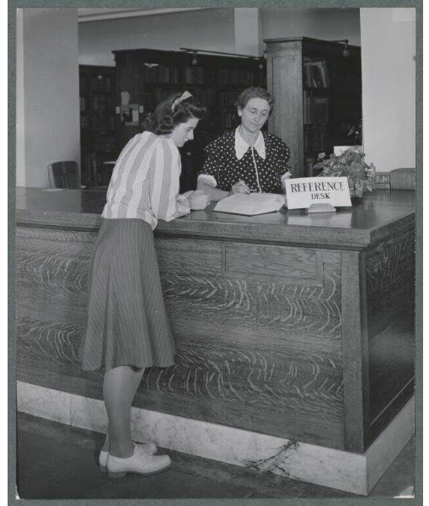
Class History
Motivated by an interest in doing something to connect with the OSU 150 sesquicentennial and to talk about oral history.
After HC Learning Community experience, narrowed focus to women’s history at OSU.
Notes:
In 2017, Chris and I proposed a class to the Honors College that would combine lessons on the history of women at OSU with oral history. We knew we wanted to teach something related to OSU’s sesquicentennial and oral history, but after Chris took part in an Honors College Learning Community we decided to focus specifically on women.
Our class is a colloquium class, which is designed to give students experiential learning opportunities outside the traditional curriculum.

Slide 6
Class History (Continued)
Taught each winter term 2018 - 2021
Class size has varied: 7 the first year, 4 the second year, 10 the third and fourth years.
Always pass/no pass: we want them to focus on learning and engaging with the materials and doing their project without worrying about points.
Gender breakdown: has always been heavily female class, but in 2021 had two male students.
Notes:
We’ve taught each winter term for the past 4 years. It has always been pass / no pass, which is nice for the students AND us! Each class has been different in terms of size, gender breakdown, and student majors. This year, in addition to having two male students, we had a trans student, recently married student, and non-binary queer student.

Slide 7
Class History (Continued)
First year there were more theory readings; evolved to shorter, OSU-specific readings.
Students now turn in weekly writing before class; enables us to direct conversation based on their observations and facilitate student participation in discussion.
Non-history readings that have stuck around:
Brittany Backen paper on Marriageability at OSC -- a student paper that used oral history as a primary research method
(Sir) Alistair Thomson’s article on memory and remembering
Oral History Association best practices
Nunn Center (University of Kentucky) best practices
Notes:
We’ve made some changes from year to year. The first was to drop most of the oral history theory readings we included the first year. While fascinating to us, and of course important to read, it was too much for students and would have been more appropriate if this was just a class on oral history. We did keep readings related to OSU history (the Backen paper on marriageability in the 1950s has become a really important one for us), an article on memory and remembering that appeals to people who like to think about brain science, and readings on professional best practices.
We’ve also changed how we ask for their weekly writing: students now turn it in 2 hours before class, which enables us to direct conversation based on their observations and directly ask students to share.

Slide 8
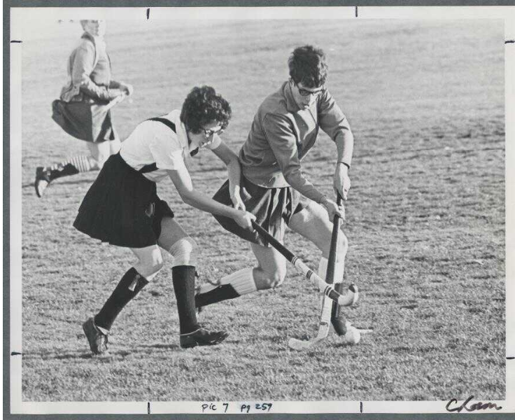
Themes of Our Class
The built environment for women
Rules for women/in loco parentis
The impact of Title IX
The history of the Women and Gender Center, and women as activists on campus
Academic spaces for women, especially Home Economics and Secretarial Science.
In recent years, this has expanded to include librarianship and Food Science.
Notes:
We focus on a variety of themes each week, including the built environment, social and academic life, and Title IX, which was surprisingly topical this year for OSU.

Slide 9
Historical Resources We Use
Student handbooks
Etiquette primers
Alumni magazine articles and other OSU publications
Scrapbooks
Memoirs, both published and unpublished
Formal institutional reports and pamphlets
Historic films and audio clips
Oral history interview transcripts, abstracts and bio sketches
Alumni group newsletters
Notes:
Working in the archives means we have many kinds of primary sources to draw from, and many have been digitized and are available online, which was nice this year. We look at rule books, etiquette primers, scrapbooks, yearbooks, and reports.

Slide 10
Class Activities
Discussion of thematic readings
Practice interviews with one another
Spotlights on pioneering women in OSU history
Training on how to use recording equipment
Discussion and reflection on interviewing ethics
Write a haiku summarizing an oral history interview.
A student from 2020 listened to an interview (conducted by a student in 2018) with a female veterinarian and OSU alum from Southern Oregon.
As a little girl
I never thought possible
The things I do now
Notes:
At times, class moves at a breakneck pace! While we want to give them a strong foundation in history, we’ve included a variety of activities, including practice interviews, equipment training, and Chris’ addition one year of the “interview haiku,” which asks them to summarize an oral history in only a few words. Here’s one from last year, a nice nod from a 2020 student to an interview done by another in 2018.

Slide 11
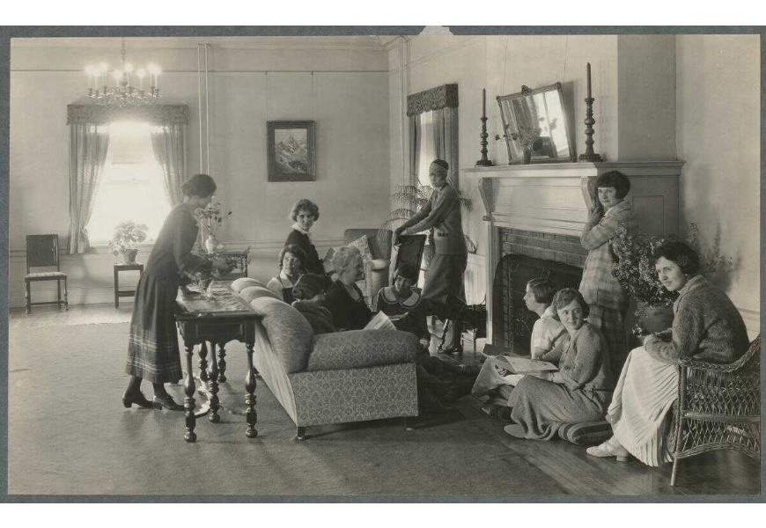
Class Activities (Continued)
Picture time with Chris (most weeks) and historic film clips
Research and preparation for a group interview with guest narrators
Discussion and reflection on oral history issues: e.g. talking to women about gender and the value of video vs. audio recording
Training on indexing an interview in the Oral History Metadata Synchronizer and how to write an interview abstract and biographical sketch
Notes:
We also have time for interview research and discussions about ethics, lessons on how to make their interview accessible through the Oral History Metadata Synchronizer, which is a mouthful to say, and picture time with Chris, which I promise is coming.

Slide 12
Outcomes for Students
“Throughout my experience in this class and conducting an interview as an interviewer as well as a narrator, my appreciation for the art of oral history interviews has grown exponentially. At the beginning of the term, I could see why oral history interviews were useful in the long term, but didn’t quite understand the meaning it gave to people’s words.”
Notes:
We took the quotes on the next 4 slides from some student’s final reflection papers, and I like that they show the different ways class has impacted them. They’ve come to understand the importance of oral history.

Slide 13
Outcomes for Students
“I now have a deeper appreciation for the fact that I am an HC student at OSU who is also queer and also non-binary and also Mexican-American. It is impossible to separate these various identities as they are all intertwined in who I am and I respond to things. I think oral history interviews really highlight the fact that everyone’s identity is intersectional. Not just one aspect contributes to how you respond to any given situation, but instead it is the culmination of all of you.”
Notes:
They might think about themselves in different ways.

Slide 14
Outcomes for Students
“Overall, I think that this class really taught me how to ‘drive the boat.’ I learned how to contact someone, set up a Zoom, and execute the meeting with a plan that I had to formulate. Of course I had so much help and reference material, but this really pushed to work on some of those more interpersonal and leadership skills.”
Notes:
They gain confidence and leadership skills.

Slide 15
Outcomes for Students
“Overall the lessons I gained from this class and my interview were invaluable. As a freshman I didn’t feel connected to this university; however, as a result of taking this class I have learned so much about this institution as well as the influential women that have shaped Oregon State University into what it is today. During the majority of this class, I was campaigning for ASOSU Senate so reading a myriad of articles about amazing women at Oregon State was very inspiring and uplifting and was what I needed during the stressful campaign season. This class was a pivotal moment in my college career and I hope I can positively contribute to this university just as the women we studied accomplished.”
Notes:
And they are inspired by the women they learn about.

Slide 16
Outcomes for Instructors
2018 article: "Fostering Historical Empathy in Unusual Times: A Case Study of the Course 'OSU, Women and Oral History: An Exploration of 150 Years,'" in Case Studies on Teaching with Primary Sources, Society of American Archivists.
Two HC thesis projects
Honors College Course of the Year (2020)
Women’s Words, Women’s Work digital exhibit
Voices of OSU Women digital exhibit
Notes:
The impact of this class has reached outside the 2 hours a week of class time. Chris and I wrote a case study article about our first year of teaching it, we designed an exhibit and provided access to the interviews through a dedicated portal, we’ve had 2 of our students incorporate oral history into their honors college theses, and we were the HC course of the year last year.

Slide 17
Teaching / Learning Over Zoom: Pros
Recording added flexibility (extra mini lecture when we ran long)
No worries about snow day cancellations
Chat was helpful
More comfortable for some people; less distraction from one’s own physical body or crowded classroom spaces
Shared Google docs worked well
Covid-19 group interviews were really cool
Pets!
Notes:
This year, obviously, was different. We tried some new things, like conducting a group interview that focused on student’s experiences over the past year, substituted a shared Google doc for writing on the white board, and dealt with pets demanding screen time.
There were lots of benefits. In some ways, the physical distance was a benefit for class participation, especially as it related to the use of chat, which allowed for parallel conversations and direct messaging when people didn’t want to be asked to share on certain topics. It allowed for privacy and participation. People could also turn their cameras off, which added an extra layer of protection when talking about difficult experiences.

Slide 18
Teaching and Learning Over Zoom: Cons
Chris’s family had to stay offline every Wednesday morning
Some students had problems with their connections
Needed to make sure that everyone was going to the right meeting
Hard to “read the room” as far as understanding of concepts or points of confusion
Communications regarding assignments was more difficult
In the past wrote on the board and went over things in detail
Tried the same in the online space and had more problems
Pets!
Notes:
Besides the addition of a “how to interview on Zoom” presentation, the content of our class and bumps in the road were familiar, though in years past we always made it to the right room after team activities…
It was still hard for students to schedule an interview and some were first year students who hadn’t met people in person. The problems with computer cameras were similar to those past students had with physical cameras. Interestingly, students didn’t necessarily know how to set up and record Zoom meetings, despite how much time they are there. We also dealt with bandwidth issues and spotty internet, which wasn’t unexpected but still not ideal.
While I mentioned chat being helpful on the last slide, we both found it hard to gauge understanding or the emotional impact of the content and discussion in a remote environment.
It’s difficult to know which of these pieces we’ll bring forward once we can be in the same small room, but I am extraordinarily grateful we had the technology to keep working, terrific students, and a supportive Honors College.

