Slide 1
The Fatality Effect: How U.S. House of Representatives Respond to Mass Shootings
Owen Hatch Trent Fornasier
OREGON STATE UNIVERSITY OREGON STATE UNIVERSITY
Gloria Ramirez Dr. Christopher Stout
OREGON STATE UNIVERSITY OREGON STATE UNIVERSITY

Slide 2
The Fatality Effect
Increase in fatalities leads to an increase in outcry via Twitter
Not a partisan issue, both sides respond more to greater fatalities
Can this have an effect on the public discussion over gun legislation?

Slide 3
Research Question
Is there a correlation between the race of a mass shooter and the language and number of tweets regarding the mass shooting?
Could there be other correlating issues such as:
Mental health
Age
Firearm used
Number of Fatalities

Slide 4
Why Speak Out?
Mass shootings have become one of the issues of our generation
Younger Americans have become disproportionately targets of mass shootings but lack the political representation to change laws
A national consensus has been reached recognizing the problem, however, a real solution remains at large
Special interest groups and political jockeying dominate proceedings
Research shows the nation is aware and willing to speak out, but to what effect
Words versus actions is key at this stage

Slide 5
Hypothesis
H1: Different language and a different amount of tweets will be seen depending on the race of the mass shooter
H2: Mental health status and firearm used in the assault will affect number of tweets
H3: Number of fatalities will affect number of tweets about the assault

Slide 6
Data
~850,000 Tweets from Over 600 U.S. House Representatives in the 112th-115th Congress
DV: # of Tweets about a Shooting
Independent Variables:
Shooting Information from 149 Mass Shootings
Age, Race, Mental Health, Fire Arm, Number of Shooters, Number of Victims

Slide 7
Results
Strong correlation found between the increase of fatalities and the increase in tweets about the mass shooting
Increase found across political spectrum
Correlation also found showing Republicans increase in tweets about mass shootings by assailants younger in age
Lack of correlation between the race of the shooter, mental health, firearm used, and the number of tweets

Slide 8
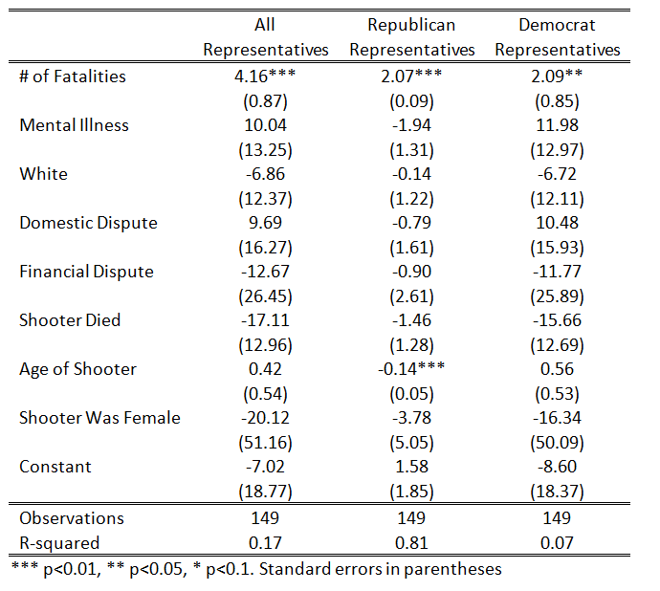

Slide 9
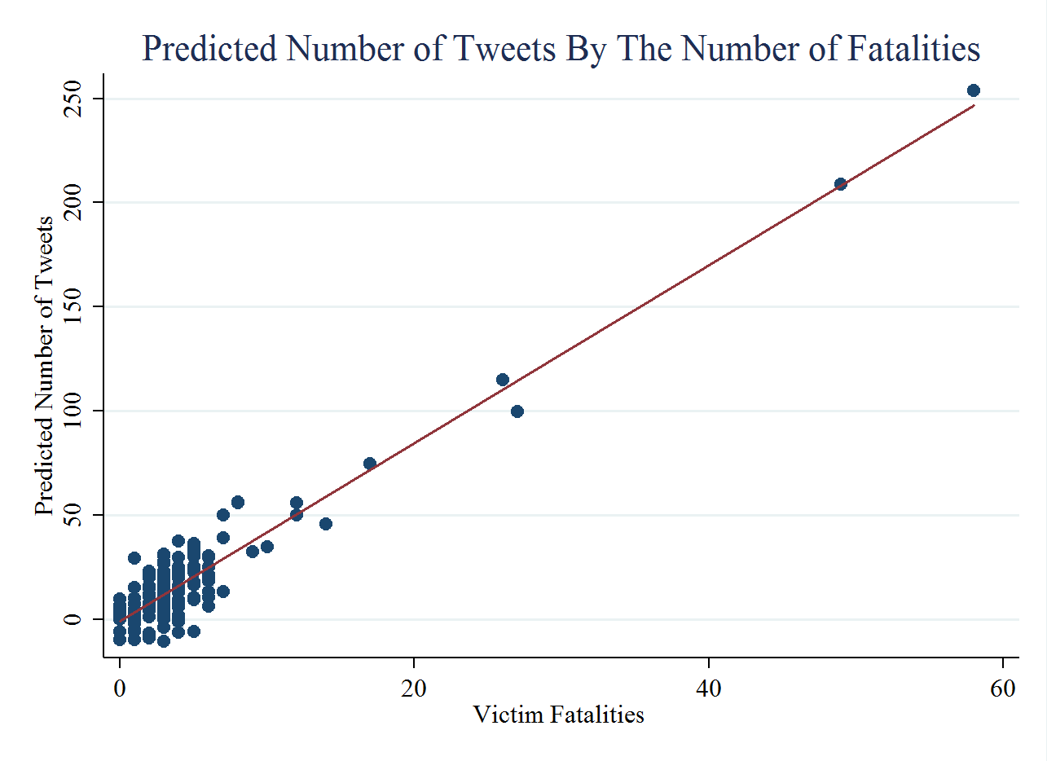

Slide 10
Conclusion
Greater number of fatalities lead to politicians giving the mass shooting more coverage
Each additional fatality results in 4x the number of tweets about the shooting
This result is seen across both sides of the political spectrum
Confirms general thinking on the issue, the more gruesome the incident the higher amount of coverage

