Slide 1
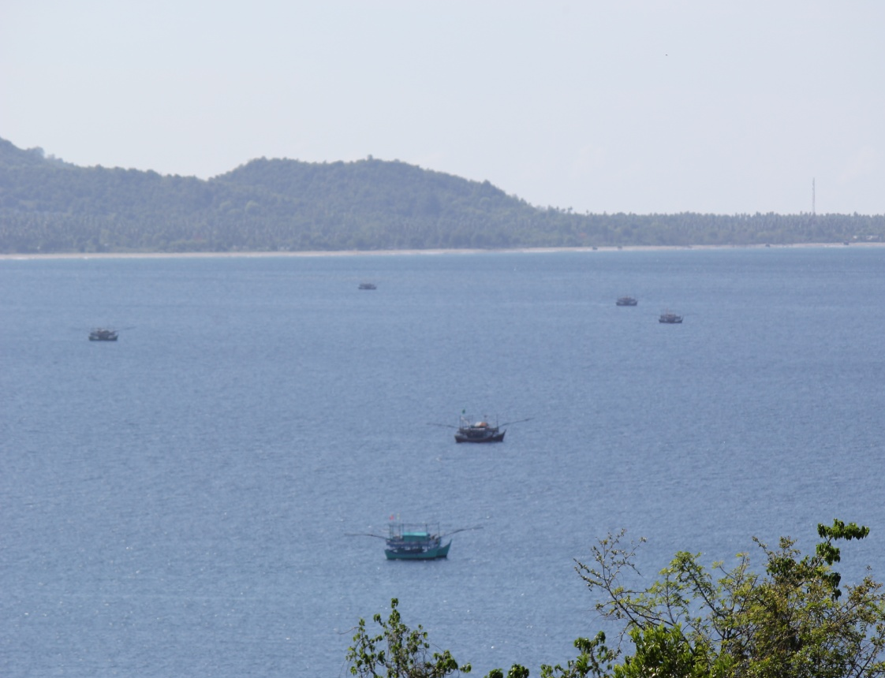
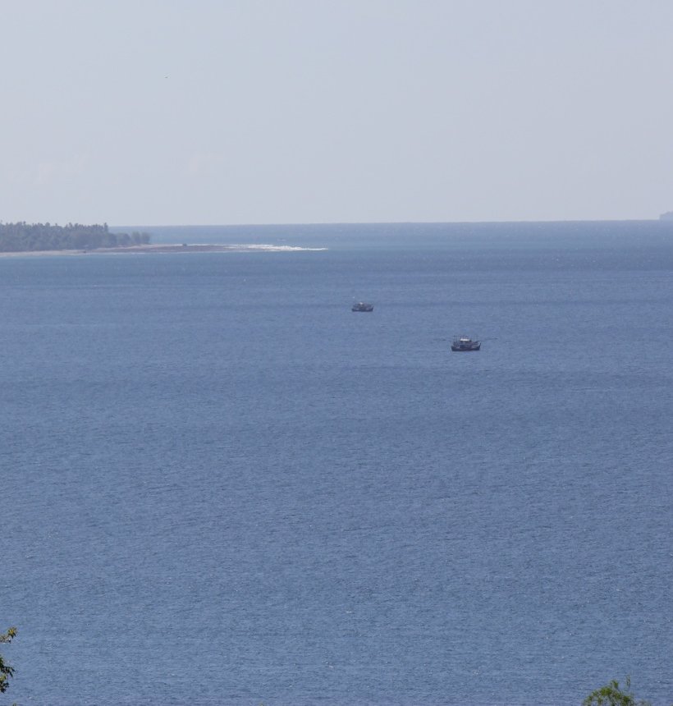
Factors Affecting on the Depletion of Anchovy Fisheries in Krueng Raya Bay, Aceh-Indonesia
Krueng Raya Bay from Soharto Hill, Oct 2012
Zulhamsyah Imran and Masahiro Yamao
Present on International Conference of International Institution of Fisheries Economic and Trade, 7-11 July 2014
Graduate School of Biosphere Science, Hiroshima University
Notes:
I am Zulhamsyah Imran from Hiroshima University. I would like to present my paper which the entitle Factors Affecting on the Depletion of Anchovy Fisheries in Krueng Raya Bay, Aceh-Indonesia

Slide 2
Outline Presentation
enzim31
Background
Selected Literature
Research Framework
Methodology
Result and Discusion
Conclusion and Recommendation
Notes:
I devided my presentation to six parts, as can be seen in this slide.

Slide 3
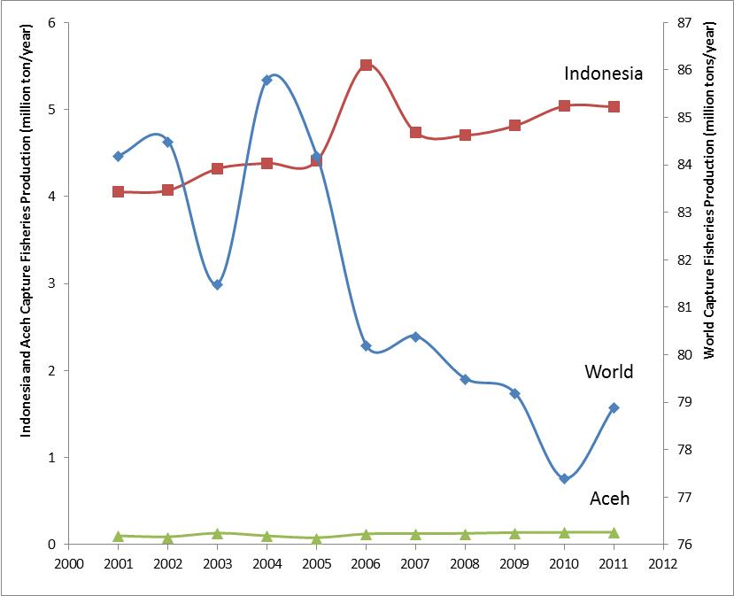
Background: Production of capture fisheries
enzim31
PRODUCTION GROWTH
Indonesia : 2.58%
After Tsunami
World : -0.61%
Aceh : 5.97%
FIGURE 1. Production of capture fisheries in World, Indonesia, and Aceh Province during 2000-2012
Sources: Data analyze from ¹(FAO 2006 & FAO 2012), ²(KPP 2005 & KKP 2012), and ³(KKP Aceh Province 2002 and KKP Aceh Province 2012)
Overall production of capture fisheries shown a downward trend.
Tsunami was few influenced on capture fisheries production in Indonesia and Aceh.
Notes:
Let we start from the background of my research. Overall production of capture fisheries shows a downward trend. This figure shows that production growth was -0.61% around the world; however, was around 6% in Aceh Province. Tsunami was few influenced on capture fisheries production in Indonesia and Aceh

Slide 4
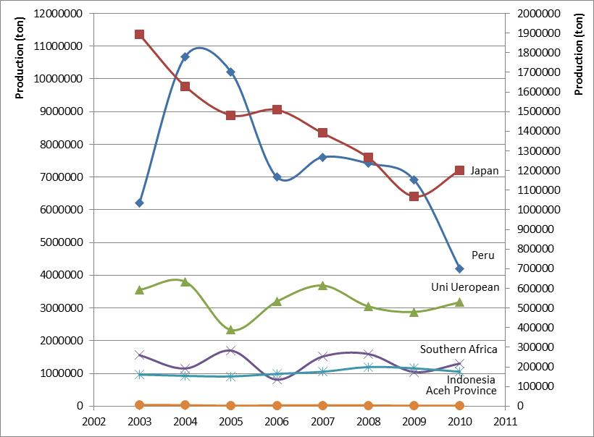
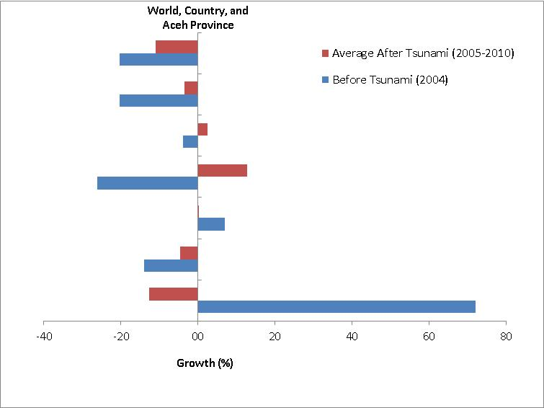
Background: Anchovy production
enzim31
Japan, Uni Ueropean,
Southern Africa, Indonesia, Aceh
Peru
World
Aceh
Indonesia
Southern
Africa
Uni Ueropean
Japan
Peru
(a)
(b)
FIGURE 2.. Anchovy production (ton) around the world during 2003-2010 (a) and production growth (%) (b)
Sources: FAO Yearbook of fisheries and aquaculture statistics (2007 and 2010), MMAF Yearbook of Capture Fisheries (2011), and MMAF Aceh Province Yearbook Fisheries Statistics (2002-2011)
PRODUCTION
PRODUCTION GROWTH
Decreased in the world (2005-1010)
Fluactuated in Indonesia (2005-2010)
Decreased in Aceh before and after tsunami
-11% around the world after tsunami
- 20.3 before and -3.6% after tsunami in Aceh
Anchovy fisheries was indicated under pressure circumstance
Notes:
This figure points out that anchoy production around the world, Indonesia, and Aceh Province show a downward tend in the period 2005-2010. The right side figure shows that the growth of anchovy production was -20.3% and -3.6% in both befofer and after tsunami respectively. These figure show that anchovy fisheries indicated on under pressure circumtance

Slide 5
Problem Statement, Research Question and Objectives
enzim31
Problem Statements
Anchovy resources had over exploited before tsunami hit in Krueng Raya Bay
Ecosystem degradation, particularly mangrove and coral reef ecosystem, have influenced to fish resources
Overcapacity of fishing fleet has propelled overfishing of anchovy resources
Tsunami has affected indirectly to anchovy resources avaliability, particularly destryed coral and mangrove ecosystem
Research Questions
What does the of anchovy resources state Krueng Raya Bay?
Why do anchovy catch decline before and aftermath asian’s tsunami?
What are key factors anchovy fisheries depletion occur?
Objectives
To identified anchovy resources
To analyze maximum sustainable yield of achovy before and after tsunami
To examine level of degradation on anchovy fisheries
To investigate factors affecting on the state of anchovy resources
Notes:
I defined four problems statement and three research questions as can we see in this slide. The objectives of this research are to identified anchovy resources; to analyze maximum sustainable yield of achovy before and after tsunami; to examine level of degradation on anchovy fisheries; and to investigate factors affecting on the state of anchovy resources

Slide 6
Selected Literature Review
enzim31
FIGURE OF FISHERIES RESOURCES
Indicated Overfishing
Declining
Tsunami Affected
FMA- 571:
Aceh Jaya District
Pidie District Lhokseumawe City
Langsa City
Aceh Timur District
Aceh Besar District
Banda Aceh City
Total catch of pelagic fish,
species composition
size distribution
No major change in benthic habitats and Negative impact on reef fish (Campbell et al 2006)
Few impact on fish resources (FAO 2007; pp 18)
Negative impact on mangrove and coral reef ecosystem (FAO 2007; pp 18)
(FAO 2007, pp 18)
(LIPI and IMR 2006)
FIGURE 3. Profile of capture fisheries and tsunami affected
Fisheries resources was on overexploited and degradation state in FMA-571
Notes:
This structure shows the figure of capture fisheries in Aceh Province. Several district within Fisheries Management Area 571, Malacca Strait, was indicated overfihing state, particularly in Aceh Jaya, Pidie, Aceh Timur, Aceh Besar District, Lhokseumawe (FAO, 2007), Langsa, and Banda Aceh City. Indonesia Science Institute (2006) reported that Total catch of pelagic fish, species composition, size distribution were declining state. However, tsunami impact was no major change in benthic habitats and Negative impact on reef fish; few impact on fish resources, and high negative impact on mangrove and coral reef ecosystem. Regarding this structure, Fisheries resources demonstrated on overexploited and degradation in FMA-571

Slide 7
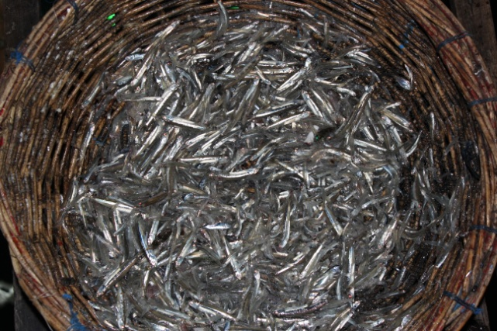
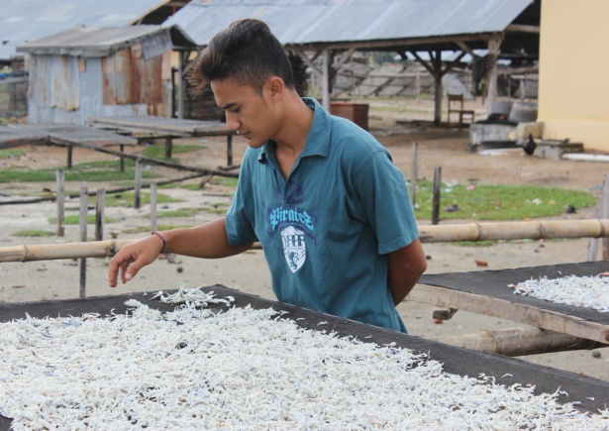
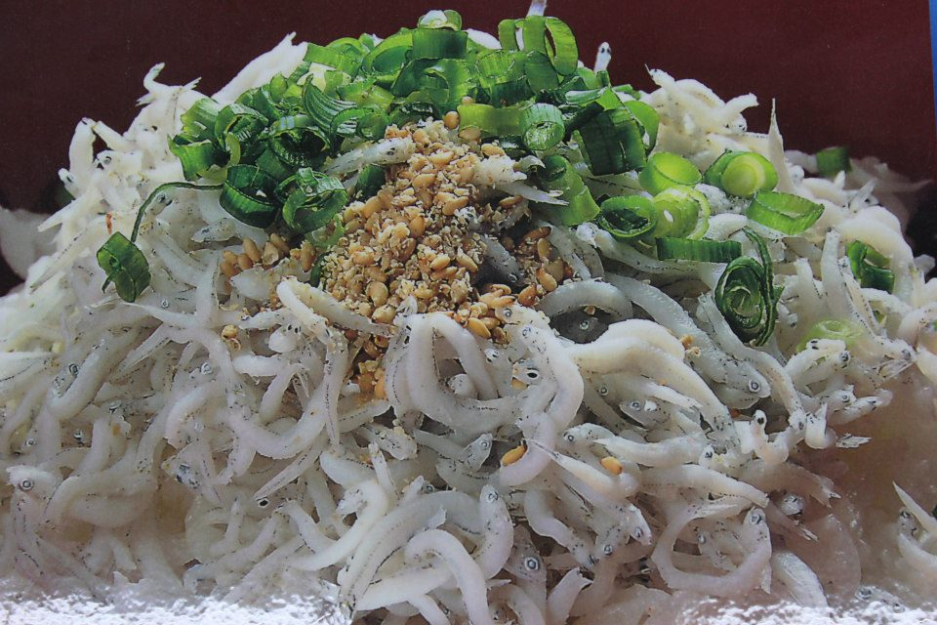
Selected Literature Review
enzim31
Potential factors cause of collapse
Overcapacity of fishing fleet: Increased 9% (from 3,998,100 unit in 1995 to 4,355,500 unit in 2010 ) (FAO 2010, pp. xxii)
Natural disaster: 61.5% potential impact on fish resources (World Disaster Report (2010, pp 35)
Increasing exploitation rate and ecosystem degradation (Worm et al., 2009)
Fish stock state and the most potential collapse of fisheries resources
19% of fish stocks were overexploited in world (FAO, 2007)
The Peruvian anchoveta was the first collapse because of El Niño effect in Peru within 1971–1972 (Pauli et al ., 2002)
Indicated overfishing because actual catch of anchovy (about 18 million tonnes) was more tha reported catch (12 million tonnes) (Pauli et al ., 2002)
Anchovy product from Krueng Raya Bay, Aceh (Doc. Imran 2012)
Anchovy product from Beppu Gulf (Doc. Imran 2013)
Notes:
Overcapacity of fishing fleet, natural disaster, increasing exploitation rate and ecosystem degradation are the potential factors which are cause fish resources overfishin, depletion, and collapse. FAO (2007) mentioned that 19% of fish stocks were overexploited stated in world. The peruvian anchoveta was the first collapse in the period 1971-1972 said Pauli et al (2002) in Peru, because actual catch was more than reported catch

Slide 8
Selected Literature Review: our hypothetic of achovy fisheries under presure
enzim31
Under-Pressure
Natural Disaster
Number of Fishing Fleet
(+)
Fish Production/Catch
Line of poverty
(-)
(-)
(-)
Mangrove Condition
(+)
(-)
(-)
(+)
(-)
(-)
Anchovy Resources:MSY
Income of Fishermen
(+)
(+)
(-)
Poverty
Sharing System
(-)
(-)
(-)
(+)
(+)
Coral Reef Condition
(-)
(+)
(+)
(-)
(+)
Operational Cost
Regional Labour Wage
(-)
(-)
(+)
(-)
Antrophogonic
Investment
(-)
(+)
Number of Fishermen
(-)
(-)
Ecological Factors
(+)
Social Factors
Economic Factors
FIGURE. 4. Inter-corelationship of ecology and social system in Krueng Raya Bay: under-presure of anchovy resources (Imran and Yamao 2014)
Notes:
According to several literature, we difined the hipothetic that ancovy fisheries in Krueng Raya has faced under pressure circumtances. There are relatioship among ecological, economic and social factors why anchoy fisheries in Krueng Raya Bay faced under pressure condition. This figure shows that natural disaster and anthropogenic factors has negative contributed on degradation of coral reef and mangrove ecosystem. At the end, the degradation of these ecosystem would be direct impacted on anchovy resources. In the same thing, social and economic factors also affect on oveexplotation of anchovy resources. Income and poverty of fisheries communities are the main factors that they can drive on anchovy depletion, as can we see in thi figure.

Slide 9
Research Framework
enzim31
Investigation and comparative analysis
Descriptive Analysis
Anthropogenic factors
Overcapacity
Destructive fishing
Ecosystem degradation
Fishing community knowledge
Tsunami impact
Link to
Social System
Affected to poverty
Anchovy production before and after tsunami
Define anchovy state : overfishing and depletion
Challenging on fishermen income
Fishing vessel identification
MSY, trend and comparative Analysis
Fish stock classification
Anchovy identification
Economic-Ecological System
Social System
Researh Focus
FIGURE 5. Research framework
Notes:
I defined my research framework according to correlation social system and economic-ecological system. We can see here that anchovy production state before and aftermath the tsunami were influenced by overcapacity of fishing fleet, ecosystem degradation, and tsunami impact. However; anthrophogenic factors, dectructive fishing, and lack of fisheries communities knowledge were also contributed on overfishing and depletion of anchovy resources. So why, our research try to (1) identify anchovy species and fishing fleet characteristics, and fish stock classification; and (2) analysis anchovy trend and maximum sustainable yield

Slide 10
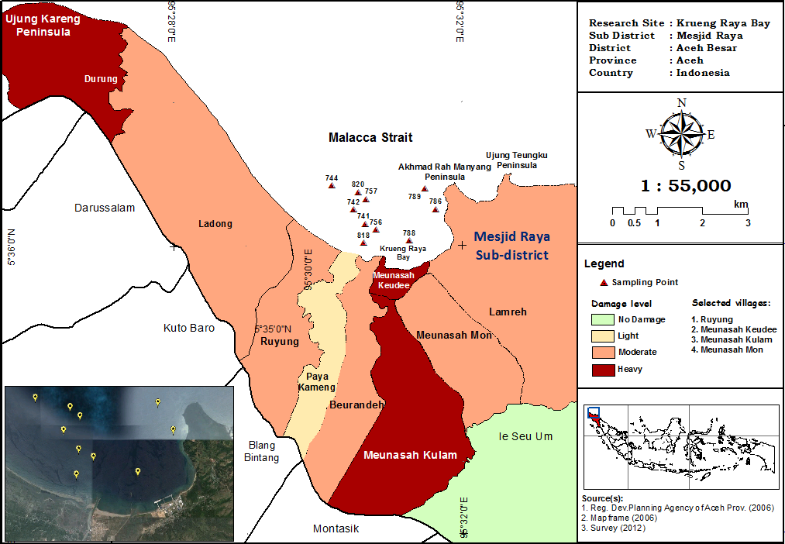
Research Site (FIGURE 5)
Research Study Area
Notes:
To improved our hyphotesis, we was carried out our reserch in Krueng Raya Bay, Aceh as one of heavy affected by the tsunami

Slide 11
Methodology
enzim31
Contents | Details
Study area | Krueng Raya Bay, Aceh-Indonesia, center of anchovy production
Target object | Anchovy, coral reef and mangrove ecosystems, fisheries communities (83 respondents)
Dominant Fishing Fleet | Lift net boat: 91 unit (before tsunami) and 31 unit (after tsunami)
Sample & Data | 8 points randomly in Krueng Raya Bay, secondary data
Materials and Methode | Fishing vessel and lift net fishing gear, GPS, data sheet, ruler, camera, structured questionnaires, data sheet Random sampling, interview, structure quisionares, focus gruop discussion
Time periods | September-October 2012
Analyzing methods | Descriptive and iinferential statistics, Surplus Production Model, Stock Categories Analysis, and fish book identification
Notes:
This research was carriet out by using survey method during September-October 2012. Seven points sampling randomly in Krueng Raya Bay was selected for taking sample of anchovy by using lift net boat. Data was analyzed by using descriptive and inferential statistics, surplus production model, stock categories, and fish book identification

Slide 12
Procedure and Analysis Data
enzim31
Define stock clasification
Equation | Stock classification | Recent average catch in MSY (%)
% of recent catch in MSY_{t0} = $\frac{ŷt0}{MSYt0}$ X 100% where: ŷ_{t0} : average catch last three years before disaster; MSY_{t0} : MSY during the period before disaster. % of recent catch in MSY_{Δt} = $\frac{ŷt1}{[MSYt0−MSYt1]}$ X 100% where: ŷ_{t1} : average catch last three years during recovery process; MSY_{Δt} : changing MSY during before disaster and recovery; MSY_{t1} : MSY during recovery process. | Abundant Less Abundant Declining Depleted Collapsed | > 80 50-80 26-49 6-25 < 5
Sources: Modifeid from Muhammad (2005)
Notes:
This table shows one of our analysis how to identified stock classifiction in study area

Slide 13
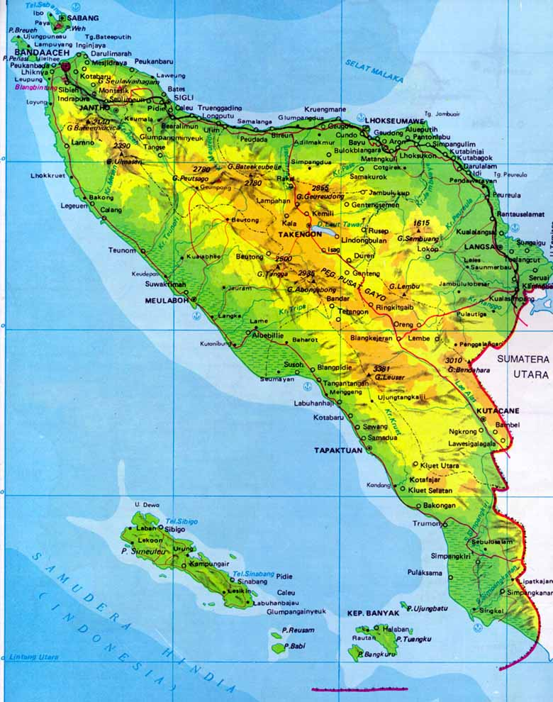
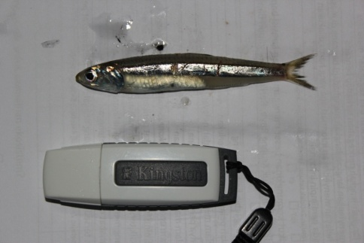
Result and Discussion
enzim31
Anchovy identification and distribution
Malacca Strait
Hindia Ocean
Stolephorus spp distribution in world
(http://www.aquamaps.org/receive.php#)
Aceh Province
Krueng Raya Bay
Finding
Anchovy is potential resources in Indonesia and Krueng Raya Bay (relative probabilities accurance 0.8 – 1) (http://www.aquamaps.org/receive.php#)
Stolephorus commersonnii
(Randall, J.E. 1995)
Stolephorus spp (Doc. Imran 2012)
Notes:
As I known, there is 139 species of Anchovy which is distributed around coastal waters around the world. We identifed that anchovy in Krueng Raya Bay is Stolephorus commersonnii as can be seen in the above of right side figure. It was potential resources in Krueng Raya Bay because its pobabilities accurance in range 0.8-1.

Slide 14
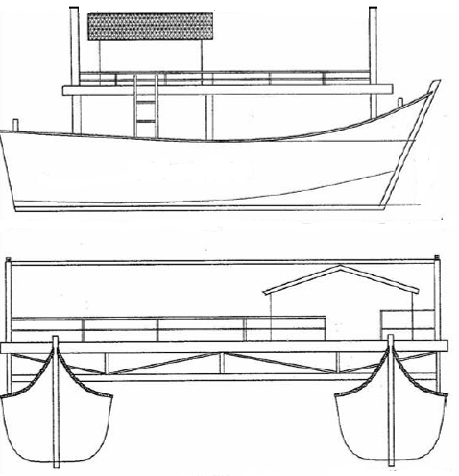
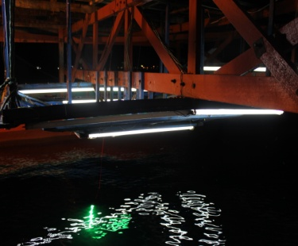
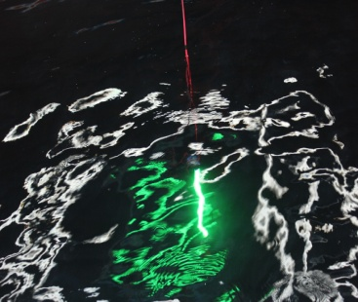
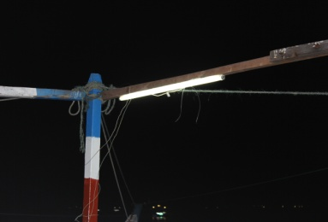
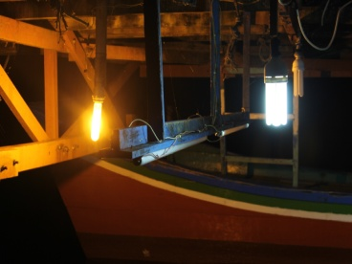
Result and Discussion
enzim31
Lift Net Fishing Gear Specification (FIGURE 7)
Light
Light
Light
Specification
Size: L X W = 18 X 18 M² – 25 X 25 M²
Mesh size net: ¼ cm, ¾ cm, and 3/5 cm, treatment net
Light: 25-30 unit (flourescent) and 1 unit green colour
Form: block
Light fishing
No selection size of anchovy catch
Over using ligh fishing can threat stock of Anchovy
Notes:
In study area, fishermen have used the lifnet fishing gear for withdrawal anchovy. According to mesh size and number of ligh fishing which used by lift net boat, we say that this fishing gear can be categories to no selection size of anchony catch and over using of ligh fishing.

Slide 15
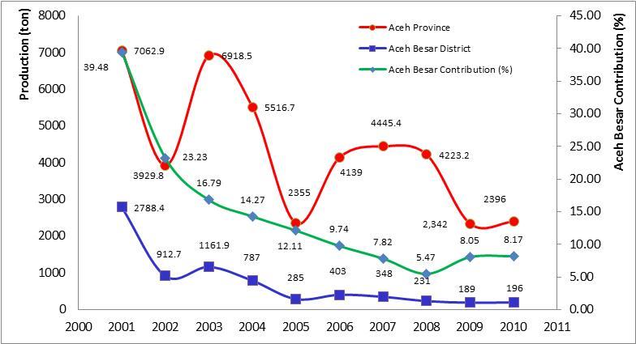
Result and Discussion
enzim31
Anchovy production in Aceh Province and Aceh Besar
After Tsunami
FIGURE 8. Anchovy production in Aceh Province and Aceh Besar District contribution during 2001-2010
Aceh Province
Aceh Besar District
Shows fluctuation trend during 2001-2010, and extremly declined aftermath tsunami;
Decreasing trend in 2001-2004, sharply declining to 12.11% after tsunami and continue fall down during 2006-2010
Anchovy fisheries were indicated under pressure in both Aceh Province and Aceh Besar District
Notes:
Out analysis found that anchovy fisheries were indicated under presure in both before and aftermath tsunami. This figure shows that anchovy production demonstrated an declining trent in the period 2001-2010.

Slide 16
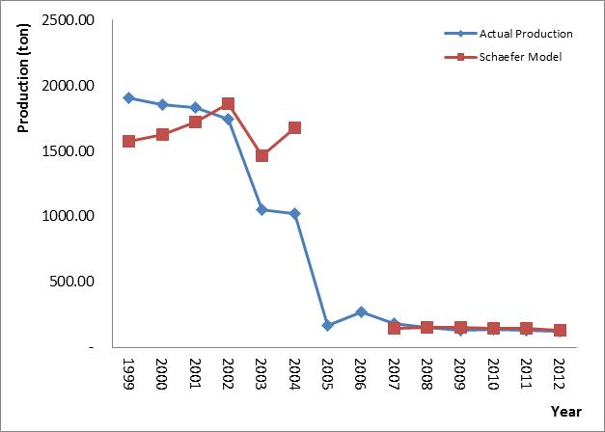
Result and Discussion
enzim31
....Trend of Anchovy production in Krueng Raya Bay
critical point
Tsunami 2004
FIGURE 9. Comparison of actual production of anchovy and Schaefer Model recommendation in period 1999-2012 in Krueng Raya Bay
Production
Finding
1999 : 1,905.58 tons
2004 : 0.5 time ofproduction 1999
2005 : 166.9 tons
2006-2010: average 162 ton/years
2012 : 12.4% of production 2004
Shows a downward trend
Critical point (2005-2006)
less than schaefer model
Notes:
According to this figure, we can see here that actual production had already been less than surplus production model recommendation during the period 1999-2012. And the critical point was occured within the period 2005-2006, aftermath tsunami.

Slide 17
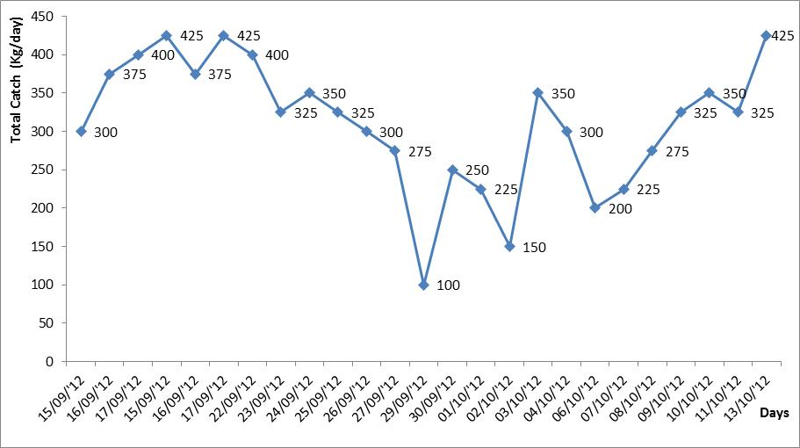
Result and Discussion
enzim31
Anchovy production during field survey in Krueng Raya Bay
Based on interview
Before tsunami (peak season)
Anchovy : 0.8-1.2 ton/trip
Estern little tuna : 1-1.25 ton/trip
After tsunami (peak season)
Anchovy : 0.5-1 ton /trip
Estern little tuna : 0.5-1 ton/trip
FIGURE 10. Anchovy production in Krueng Raya Bay during
15 September- 13 October 2012
Anchovy production shows a declining trend and overcapacity of effort
Operated 7-29 unit lift net boat (15 Sept-13 Oct 2013)
Anchovy production : 7.8 ton,
CPUE: 13.5 kg/day
Fish catch composition: anchovy (52%), sardine (25%), pony fish (14%), mackarel (3%) and jellow tail travelly (6%)
Notes:
This figure also prove that anchovy production shows a fluctuation trend; however, the production of anchovy after tsunami in peak season was less than it production in the same season before tsunami. Our survey revealed that anchovy production was ineficiency if comparison to a number lift net operation by fishermen.

Slide 18
Result and Discussion
enzim31
Relationship anchovhy production with effort and CPUR during 1999-2012 (TABLE 1)
Period | Year | Production (ton)¹ | Number of vessel² | Effort (trip)² | CPUE
Before Tsunami | 1999 | 1,905.58 | 73 | 9,344 | 0.2039
 | 2000 | 1,855.47 | 72 | 9,216 | 0.2013
 | 2001 | 1,833.11 | 71 | 8,946 | 0.2049
 | 2002 | 1,743.29 | 68 | 8,568 | 0.2035
 | 2003 | 1,053.47 | 76 | 9,576 | 0.1100
 | 2004 | 1,024.18 | 73 | 9,198 | 0.1113
After Tsunami | 2005 | 166.94 | 6 | 432 | 0.3864
 | 2006 | 272.12 | 18 | 3,067 | 0.1575
Recovery Process | 2007 | 182.32 | 24 | 2,715 | 0.059
 | 2008 | 156.79 | 22 | 2,839 | 0.055
 | 2009 | 129.82 | 23 | 3,086 | 0.048
 | 2010 | 136.28 | 24 | 3,150 | 0.044
 | 2011 | 129.87 | 26 | 3,325 | 0.039
 | 2012 | 126.57 | 29 | 3,654 | 0.035
Sources: ¹ Analysis from Fisheries Statistical Data Yearly (2000-2012) and ² Field Survey (2012)
CPUE show a dowmward trend before tsunami, dramatically went down after tsunami, continued declining during recovery process

Slide 19
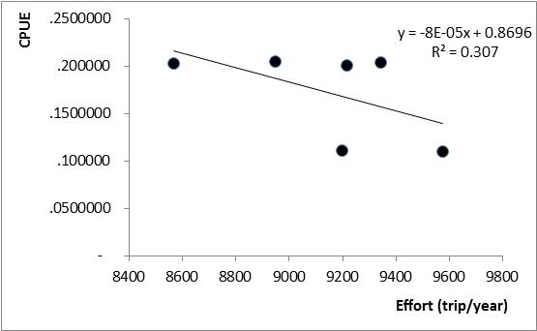
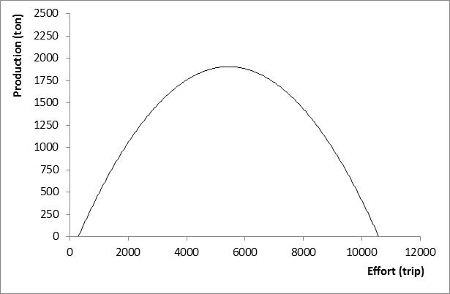
Result and Discussion
enzim31
Correlation of effort and CPUE (a), and MSY Curve (b) before tsunami (FIGURE 11)
Actual Production and Effort
MSY
MEY
(a)
(b)
Figures
Finding
Optimum effort : 5,435 trip
MSY : 2,363.14 ton/year
MEY : 1,890.51 ton/year
Optimum fishing fleet : 43 unit,
Actual fishing fleet : 89 unit ,
Effetive operation : 71 unit
Recent average catch in MSY (%) : 53.9%
Anchovy fisheries was overfishing state
Effort increase-CPUE decrease
Actual production less than MSY
Category less abundant
Indicated no fisheries management
Notes:
Our examination by using surplus production model shows that MSY of anchovy fisheries was overfishing state before tsunami. According to left site figure, we can see that CPUE will decrease if the fishermen add a number of effort. The righ site figure also shows that actual effort had already more that optimum effort. However, the production of anchovy had already less than MSY. We can said that effort had already ineficience and ineffective in produce of anchovy. According to this model, I can concluded that anchovy state had already in less abundand categories before tsunami. It must reduce a number of lift net boat to 43 units.

Slide 20
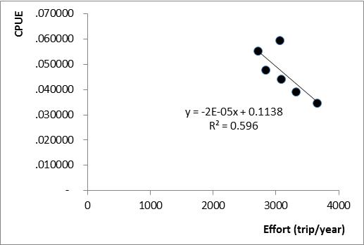
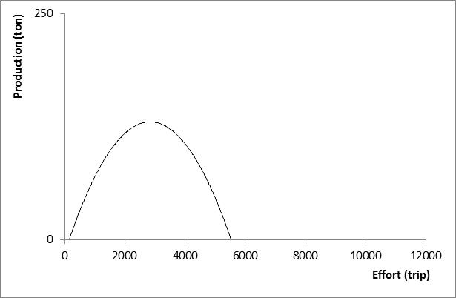
Result and Discussion
enzim31
Correlation of effort and CPUE (a), and MSY Curve (b) after tsunami (FIGURE 12)
Actual Production and Effort
MSY
MEY
(a)
(b)
Figures
Optimum effort : 2,845 trip
MSY : 161.88 ton/year
MEY : 129.5 ton/year
Optimum fishing fleet : 23 unit,
Actual fishing fleet : 31 unit ,
Effetive operation : 22-29 unit
Recent average catch in MSY (%) : 6%
Finding
Anchovy fisheries was overfishing state
MSY_{after tsunami} < MSY_{before tsunami}
Actual production less than MSY
Depletion category
Notes:
This figure also shows that MSY of anchovy fisheries was also overfishing state in after tsunami. According to left site figure, we can see that CPUE will decrease dramatically if the fishermen add a number of effort. The righ site figure also shows that actual effort had already more that optimum effort. However, the production of anchovy had already less than MSY. We can said that effort had already ineficience and ineffective in produce of anchovy. According to this model, I can concluded that anchovy state had already in less abundand categories before tsunami. It must reduce a number of lift net boat to 23 units.

Slide 21
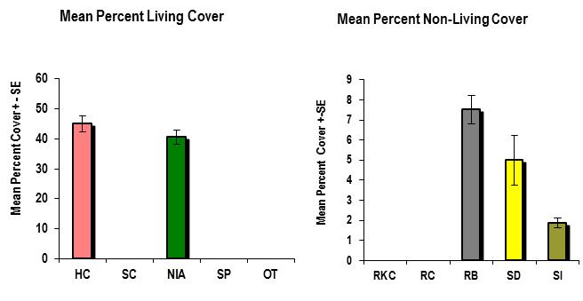
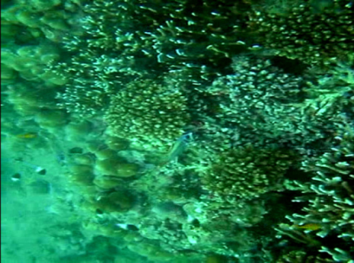
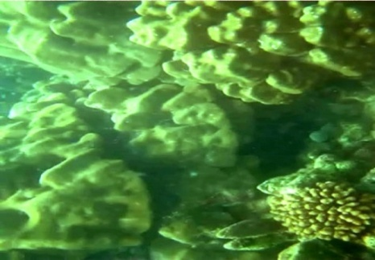
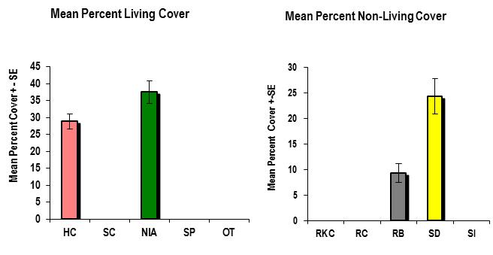
Result and Discussion: Coral Reef Condition
enzim31
Pencentage of hard coral live cover : 28.75-45% (average 36.88%)
Condition: moderate damage (KLH 2001)
FIGURE 13.. % live cover of coral reef in Lhok Mee, Krueng Raya Bay (Source: ODC 2011)
FIGURE 15. Hard coral in Krueng Raya (Source: MMAF 2006)
Coral reef condition influenced to anchovy resources
Tsunami affected on coral reef ecosystem
FIGURE 14. % live cover of coral reef in Akhmad Rahmayang, Krueng Raya Bay (Source: ODC 2011)
Notes:
Other factors influence on anchovy overfishing and depletion were coral reef condition. This figure shows that the lifeform of coral reef condition was 36,86%, it be categories to moderate damage. Tsunami direct affected on coral reef ecosytems

Slide 22
Result and Discussion: Mangrove Condition
enzim31
Area mangrove in Krueng Raya Bay (Panglima Laot Krueng Raya Boundaries) (TABLE 2)
Ecosystem | Geografic Position | Lenght/Wide | Current Status | Ecosystem Services
Mangrove Sapling Tree | KR 1, KR 2 KR 5 | 14.13 ha 5.11 ha | Good condition Replanting in 2006 and 2007, around 4-5 years | Source of alternative fisheries activities.: collector of mud crab and oister; Supply nutrient; Nursery, feeding, spawning ground; Protection beach; and Pollutant trap and filter
Source: Field Survey (2012) and Google Eart
Potential area mangrove before tsunami: 300 ha
% Cover life mangrove= 5% (very damage category according to KLH 2004)
Finding
Mangrove condition can be categories to very damage condition
Mangrove influenced on anchovy resources
Tsunami had been affected on mangrove ecosystem
Notes:
Krueng Raya Bay had 300 ha area mangrove in 1980s, decreased in before tsunami, tsunami was huge affected on this ecosystem, left it 5% in 2012 (very damage categories). Mangrove might influence on anchovy resources depletion.

Slide 23
Conclusion and Recommendation
enzim31
Conclusion
Identified that anchovy species in Krueng Raya Bay is Stolephorus spp (Lecepede 1803 in http://www.fishbase.org/summary/566)
Anchovy, Stolephorus commorsonii, face under pressure condition in both before and aftermath tsunami in Krueng Raya Bay.
MSY of anchovy decline 20 time of MSY of anchovy before tsunami; thus, anchovy stock can be categories to depletion categories aftermath tsunami.
Overcapacity of fishing fleet, actual effort more than optimum effort are direct affected on overfishing and depletion of anchovy resorces; meanwhile, coral reef and mangrove ecosystem degradation is indirect affected on anchovy fisheries resources
Recommendation
Implementing responsible fisheries management to reduce overcapacity of fishing fleet (i.e.: lift net boat), destructive fishing, and total allowable catch by incoorparate sea commander role base social-ecological boundaries.
Establishing Good Governance of Fisheries Resources Management to recovery fisheries resources by integration sea commander role and MMAF district level.
Building fisheries communities ecological knowlege to increase their awardness about interesting function of coastal ecosytems on fisheries resources.
Identifying, establishing, and managing marine protected area to preserve coral reef and mangrove ecosystem by using collaborative management between sea commander and MMAF district level.
Notes:
Finally we can concluded that anchovy species in Krueng Raya Bay is Stolephorus commorsonii ; Anchovy’s MSY after tsunami decline 20 time of Anchovy’s MSY before tsunami; Anchovy fisheries face the overfishing state in both before and after tsunami; Anchovy stock categories is less abundang before tsunami and become a depletion after tsunami; and Overcapacity of fishing fleet, actual effort more than optimum effort are direct affected on overfishing and depletion of anchovy resorces; meanwhile, coral reef and mangrove ecosystem degradation is indirect affected on anchovy fisheries resources; however, tsunami affect on coral reed and mangrove condition

Slide 24
Thank You
Question, suggestion and feed back
Zulhamsyah.imran@gmail.com

