Slide 1
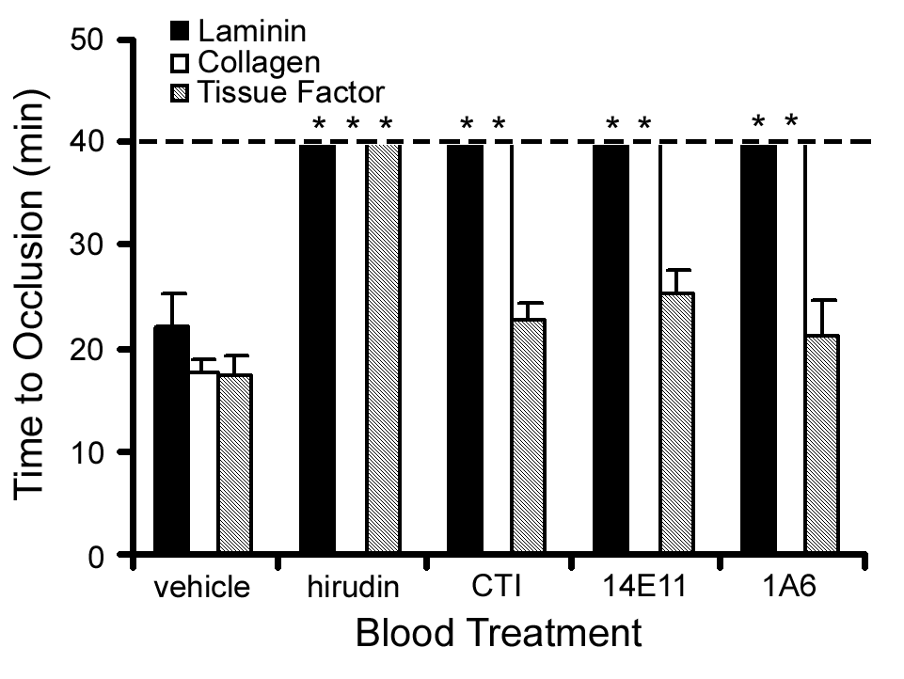
No. 00335
Rational Design of Ex Vivo Model of Thrombosis
Ishan A. Patel¹, Michelle A. Berny-Lang¹, Garth W. Tormoen¹, Tara C. White-Adams¹, Erik I. Tucker¹,
Sandra M. Baker¹, András Gruber¹, and Owen J. T. McCarty^{1,2}
¹Department of Biomedical Engineering and ²Cell & Developmental Biology, Oregon Health & Science University, Portland, OR
AIM
Occlusive thrombi that cause cardiovascular diseases form on the walls of blood vessels and propagate across the lumen under pressure gradient-driven flow, impaired antithrombotic, and enhanced prothrombotic conditions. Development of a well controlled and validated ex vivo model that can mimic these pathological conditions would provide a useful tool for the investigation of prothrombotic and antithrombotic molecular mechanisms, supplementing or replacing animal experimentation.
CONCLUSION
We have developed a model of occlusive thrombus formation that relies on gravity to drive blood flow through a capillary tube under a constant pressure gradient. Inhibition of both FXIa and tissue factor significantly prolonged times to occlusion on surfaces that had been coated with both collagen and tissue factor. This study also identifies a role for laminin in the formation of occlusive thrombi in a FXII-dependent manner. The use of this model may be expanded to characterize the mechanisms of thrombosis and to determine the efficacy of pharmacological agents designed to prevent occlusive thrombus formation.
RESULTS
Figure 1: Schematic representation of the ex vivo model.
Figure 3: Laminin supports occlusion under a constant pressure gradient.
A)
B)
C)
(1)
min:sec
(2)
Fig. 1 A) Treated blood was recalcified with CaCl2 and MgCl2 (final concentration 7.5 and 3.75 mM, respectively), added to a reservoir to a set height (hb), and allowed to drain through collagen-coated capillaries into a PBS bath as shown. At a height of 3 cm (hb), the pressure gradient caused by gravity gave an initial shear rate of 325 s⁻¹. Times for occlusions were measured from the moment blood exited the capillary until flow ceased.
B) Time course of whole blood perfusion through a collagen-coated tube. C) The Navier–Stokes equation in the z-direction simplified after application of system assumptions (1) and shear rate expression upon integration of Eq. 1 and application of boundary conditions (2).
Fig. 3 Whole human blood in 0.38% sodium citrate was recalcified and perfused through a laminin-, collagen-, or tissue factor-coated glass capillary until occlusion. Blood flow was driven by a constant pressure difference. In selected experiments, blood was pre-treated with either the FXIIa inhibitor, CTI (40 μg/mL), or the anti-FXI mAb, 14E11 or 1A6 (20 μg/mL). Data are reported as mean ± SEM of at least 3 experiments. * P < 0.05 compared to occlusion time in the presence of vehicle on each respective surface.
Figure 4: FXI inhibition suggests tissue factor pathway mediated occlusion.
Figure 2: Occlusion times recorded from coated collagen capillaries.
A)
B)
Fig. 2 Experiments were performed in the presence of PBS (-), the integrin αIIbβ3 antagonist eptifibatide (anti-αIIbβ3 ), the thrombin inhibitor hirudin, the activated factor X (FXa) inhibitor rivaroxaban, or activated protein C (APC). Time to occlusion is reported as mean ± SEM from at least three experiments. Statistical significance of differences between means was determined by ANOVA. * P <0.05 with respect to PBS-treatment (-).
Fig. 4 A) Human sodium citrate-anticoagulated whole blood was pretreated with vehicle, the anti-TF mAb (50 μg/mL), or the anti-FXI mAb, 1A6 (10 μg/mL), either alone or in combination. Samples were recalcified and perfused through collagen or collagen-tissue factor coated tubes (100 μg/mL collagen; 1nM tissue factor). Data are reported as mean ± SEM of at least 3 experiments. *,** P <0.05 compared to occlusion time on collagen- or collagen-tissue factor-coated surfaces, respectively. B) Neutralizing anti-human FXI antibody (1A6) inhibits FXIa from activating FIX. Antibody 14E11 binds FXI and interferes with FXI activation by FXIIa in vitro.
This work was supported in part by the National Institute of Health (1U54CA143906-01 and R01HL101972) and the American Heart Association (11UFEL7360009). I.A.P. is a Goldwater Scholar, American Heart Association Undergraduate Research Fellow, and Oregon State University Johnson Scholar. M.A.B. and T.C.W-A are ARCS scholar.

