Slide 1
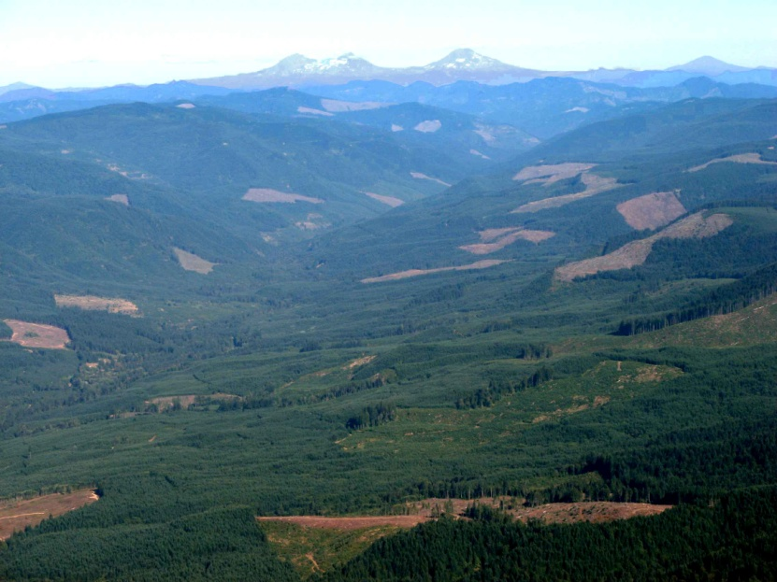
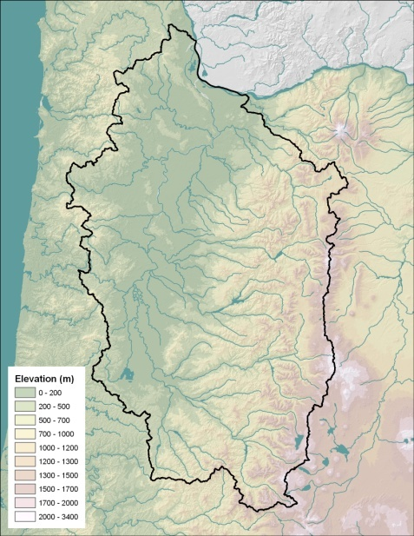
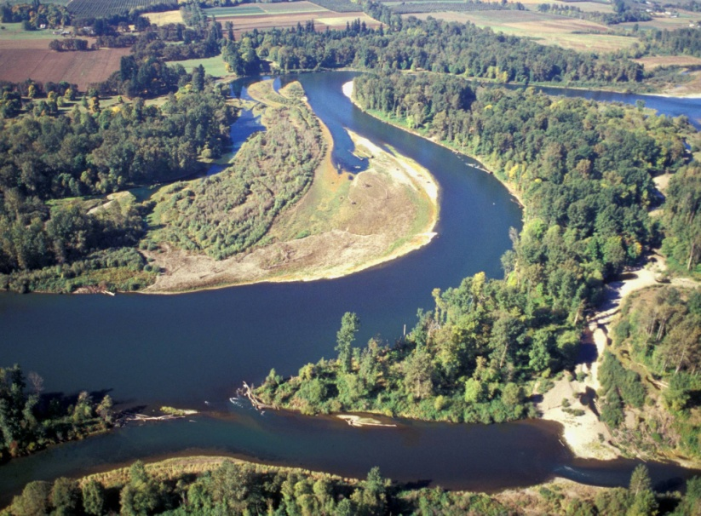
Seasonal and elevational variation of surface water δ¹⁸O and δ²H in the Willamette River basin
J. Renée Brooks¹, Parker J. Wigington¹, Jr., Carol Kendall²,
Rob Coulombe³, and Randy Comeleo¹
¹Western Ecology Division, U.S. Environmental Protection Agency
²U.S. Geological Survey, Menlo Park CA.
³Dynamac Corporation,

Slide 2
Project Goals
Part of a larger EPA project to determine biological, physical and chemical linkages between non-navigable headwater streams and wetlands to the nation’s navigable waters.
Isotopes could be a useful for tracing these linkages.

Slide 3
Specific Objectives
Charactize spatial and temporal variation of δ¹⁸O and δ²H in small watershed streams within the Willamette Valley.
Determine the major drivers of variation.
Use the variation as a tool for understanding navigable river dynamics and linkages to small streams.

Slide 4
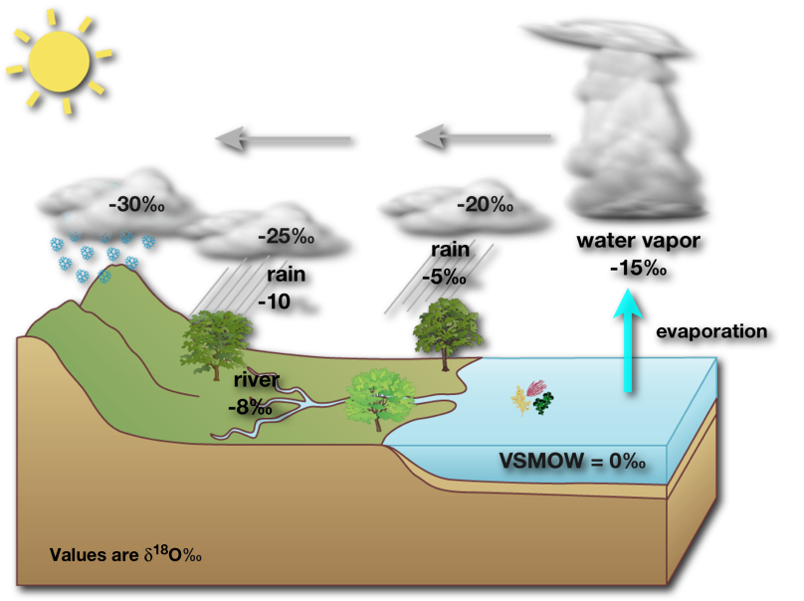
Water isotopes are partitioned by hydrologic fluxes
Water isotopes change with phase changes:
Vapor ↔ Liquid (precipitation and evaporation)
Liquid ↔ solid (freezing and thawing)
Solid ↔ Vapor (snow and sublimation)
Notes:
The major movements of water can have unique isotope values and fluxes associated with them - we’ll explore some of these and Gabe Bowen and Dave Williams will explore the rest next week

Slide 5
Variance in Precipitation
δ²H

Slide 6
Evaporation
δ²H

Slide 7
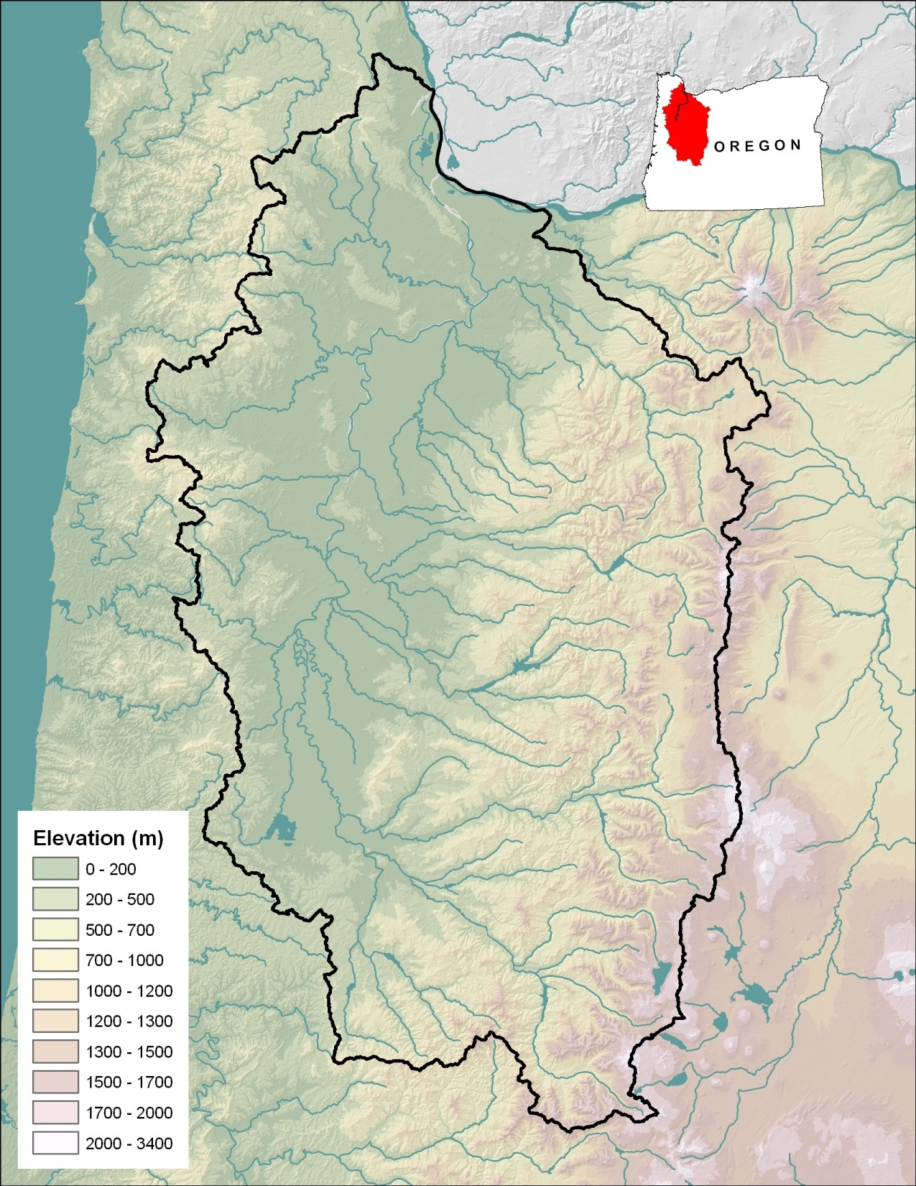
Study Site
Willamette River Basin, Oregon.
Bordered by
Coastal Range (West)
Cascade Range (East)
Elevation gain most on East border.

Slide 8
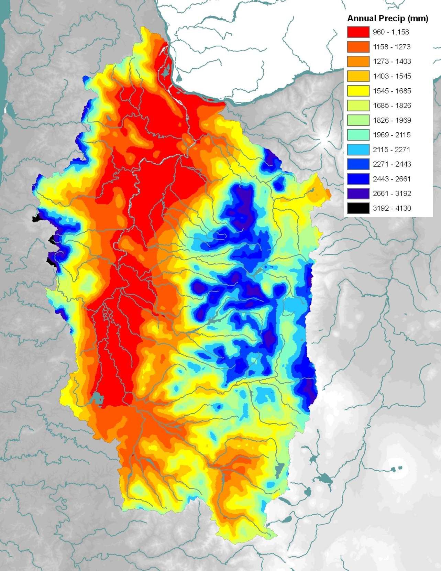
Annual Precipitation Patterns
1 m
4 m
Mediterranean Climate
Warm dry summers
Cold wet winters
95% of rain falls between Oct - May
Storm Trajegory

Slide 9
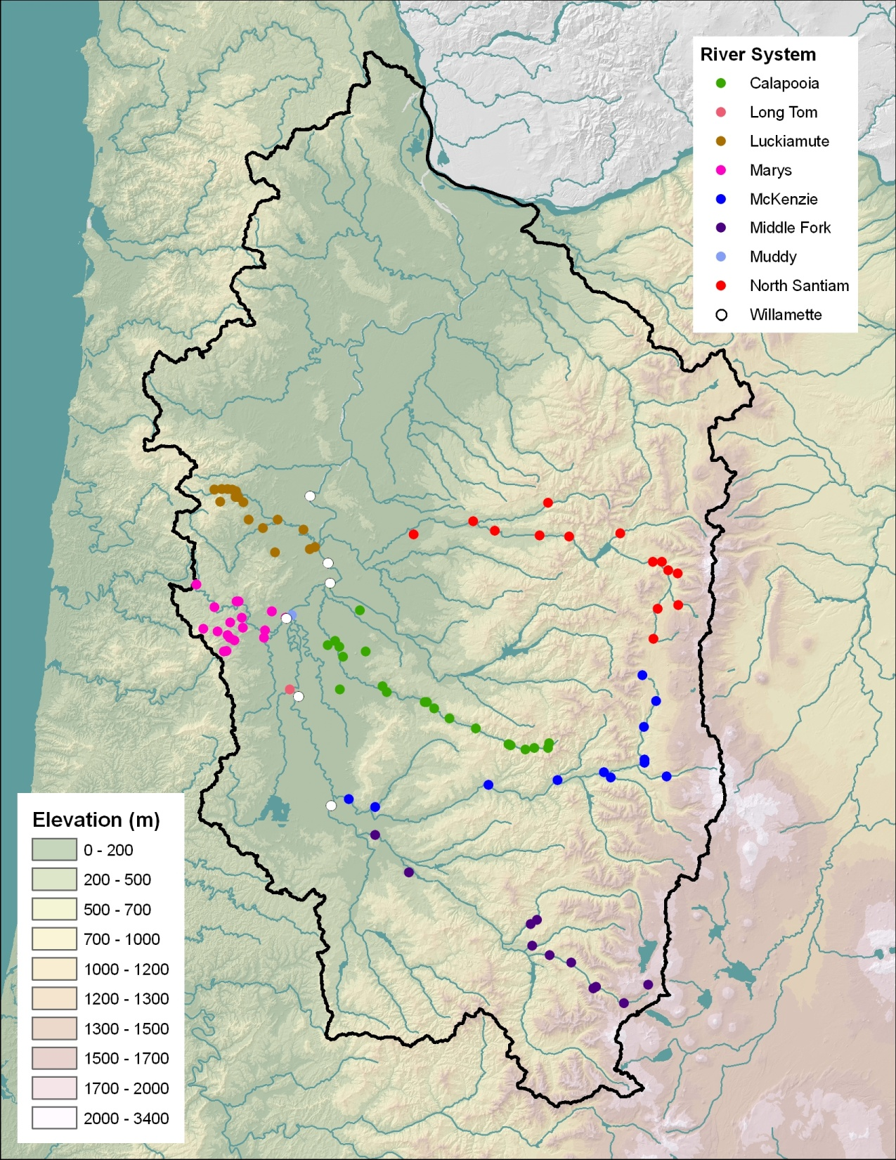
Study Design
Southern Willamette Focus
Willamette River Samples at each river confluence
6 Major Tributary
Middle Fork Willamette River
McKenzie River
Calapooia River
North Santiam River
Luckiamute River
Marys River

Slide 10
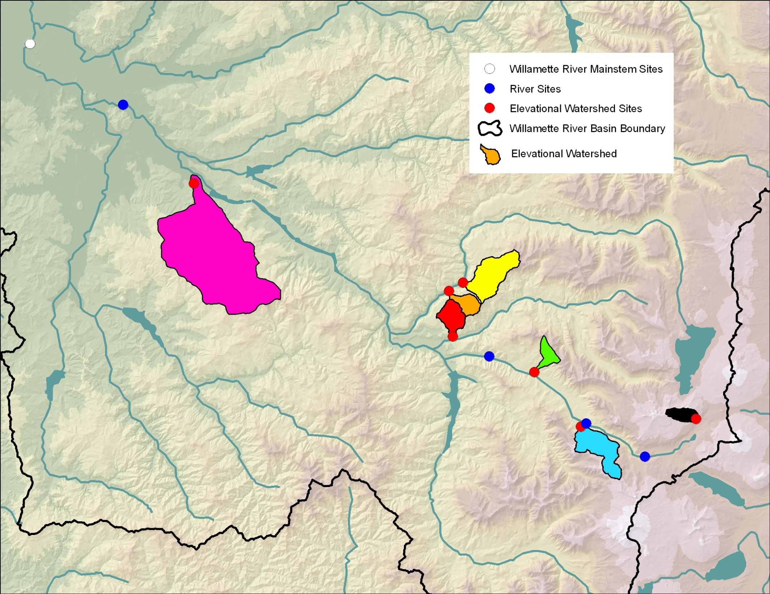

Slide 11
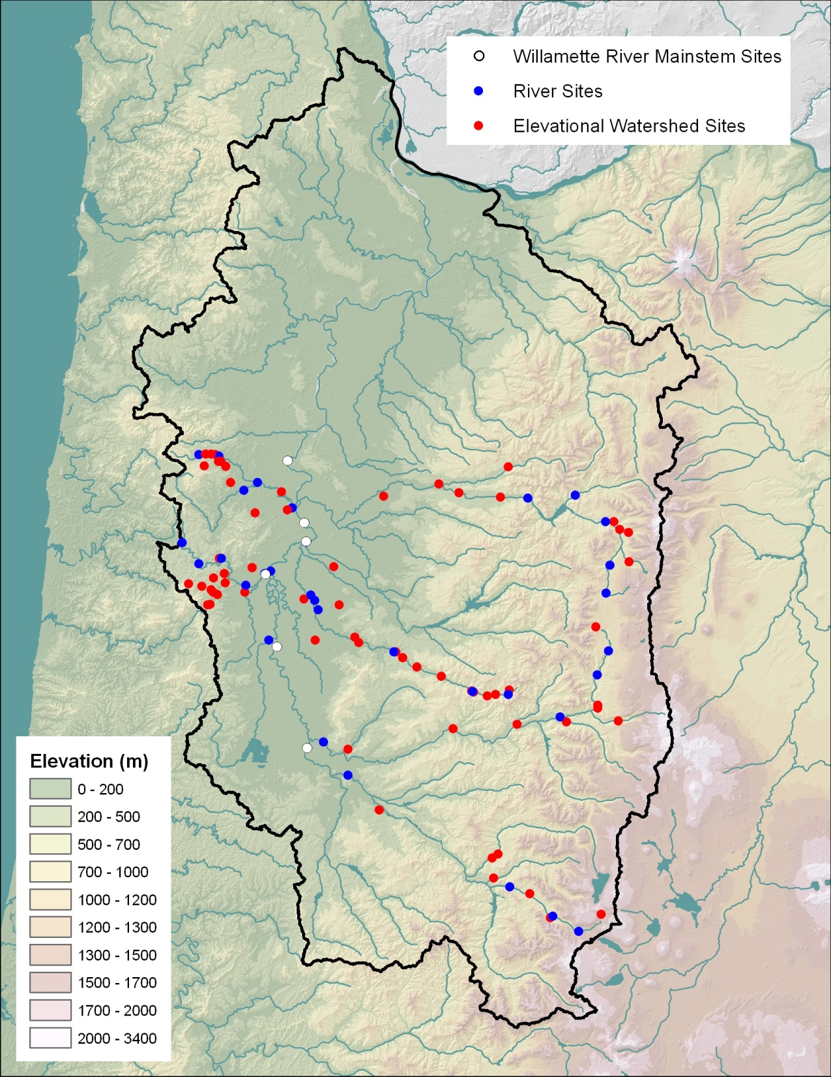
Samples are collected quarterly
Summer low flow (September)
Fall wet up (November)
Winter rains (February)
Spring snowmelt (May)

Slide 12
Temporally Intensive sampling
East-West Transect
3 Rivers:
Calapooia River
North Santiam River
Luckiamute River
Additional samples are collected in between the quarterly samples

Slide 13
Results
Characterizing variation of the
Small Elevational Watersheds

Slide 14
Isotopes in Corvallis Precipitation

Slide 15
Small Watershed Elevation Gradient
δ¹⁸O = -7.83 – 0.00304(Elevation)
δ²H = -54.7 – 0.0212(Elevation)

Slide 16
Rainout vs Elevation
Storm Trajectory
Storm Trajectory

Slide 17
Evaporation Effects

Slide 18
Small Watershed Seasonal Pattern

Slide 19
Small Watershed
Best Subset Regression Analysis
 | δ²H |  |  | δ¹⁸O
Variable | R²_{adj} | F | Variable | R²_{adj} | F
WS Elevation | 79.0% | 2108 | WS Elevation | 70.5% | 1339
+ Long | 81.3% | 1218 | + Evap | 87.3% | 1935
+ Evap | 84.1% | 986 | + Long | 89.5% | 1595
+WS Slope | 85.5% | 827 | +WS Slope | 90.5% | 1330
*Variables tried in model for small elevational watersheds:
WS Area, WS Elevation, WS Gradient, Flowpath Length, Topographic Index,
Mean WS Slope, Evap, Latitude, Longitude, Season and Water Temperature.

Slide 20
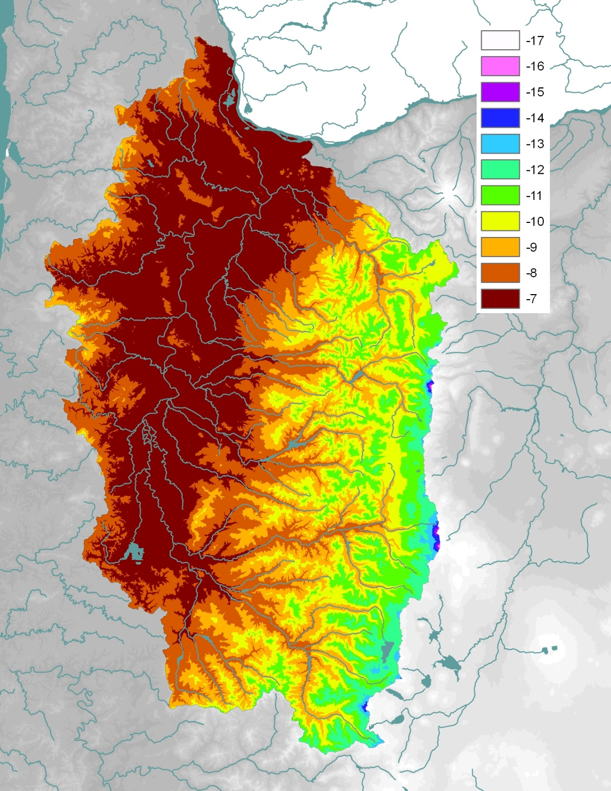
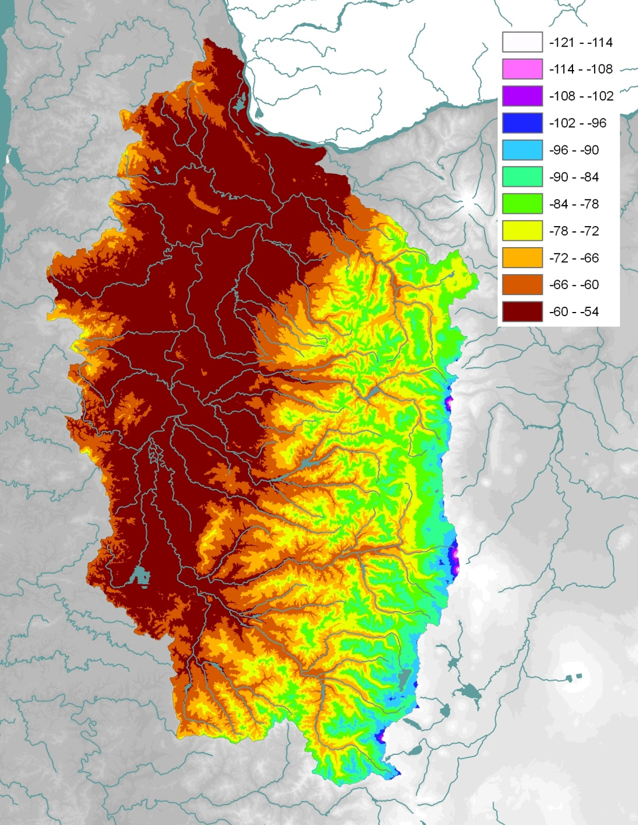
Isoscapes based on small watershed elevation
δ¹⁸O
δ²H

Slide 21
Small Watershed Elevation Gradient
R²_{adj} = 79%

Slide 24
Seasonal Patterns

Slide 25
Seasonal Changes in Source Water
Loc |  | Fall | Winter | Spring | Summer
Will-1 | δ²H (‰) | -73.0 | -70.5 | -73.1 | -79.2
668 | Elev (m) | 857 | 735 | 858 | 1,152
Will-6 | δ²H (‰) | -78.4 | -76.6 | -75.7 | -82.0
876 | Elev (m) | 1,114 | 1,026 | 986 | 1,286
δ²H = -54.7 – 0.0212(Elevation)

Slide 26
Simple Willamette Mixing Model
Average Valley δ²H = -62.0 (<800 m)
Average Mountain δ²H = -79.3 (>800 m)
Winter
Summer
49%
51%
+
99%
+
1%

Slide 27
Simple Willamette Mixing Model

Slide 28
Summary
Variation in small watershed streams:
Elevation effect caused by rainout of precipitation
No seasonal variation in small streams
Minor evaporation effects
Willamette River and Large Tributaries
Water sources skewed to higher elevation
Water sources shift seasonally
Increasing 400 m during the summer low flows
Willamette summer low flows are highly dependent on mountain water

Slide 29
Useful tool for characterizing linkages between water bodies.
Continue monitoring Willamette River water isotopes.
How do Willamette water sources change with climate?
What is the impact of changing snowpack?
Elevation pattern specific to West Coast
Characterization technique can be used in many locations.

