Slide 1
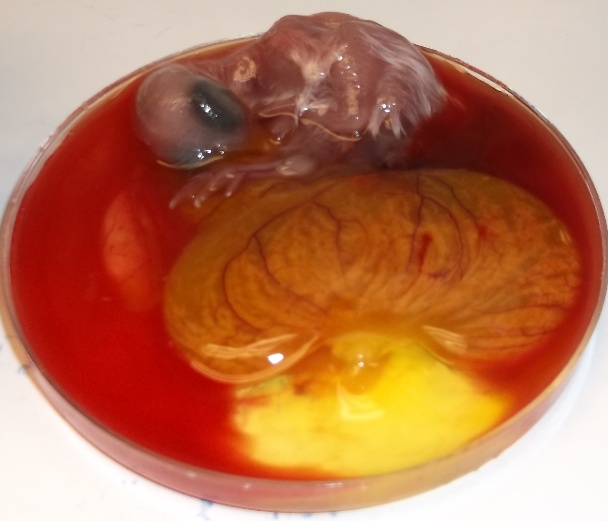
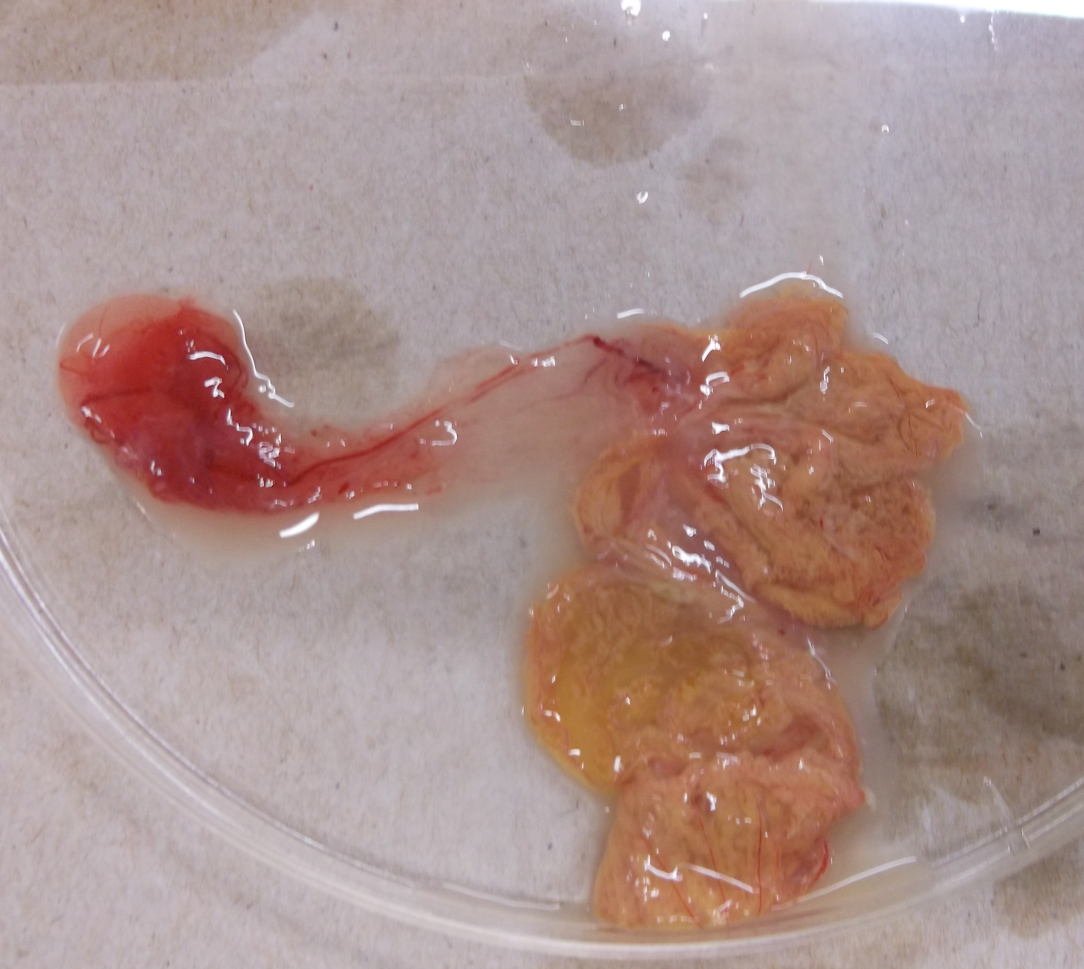
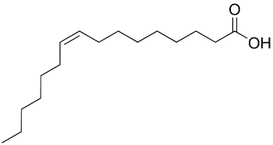
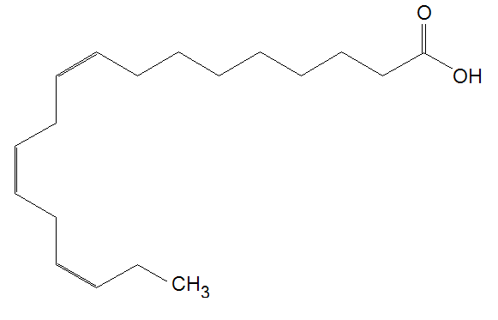
Fatty Acid Composition of the Yolk Sac Membrane in the Chicken Embryo Persia Neumannª, Fracine Vercese^{ab}, Gita Cherianª, Michelle Kutzlerª ªDepartment of Animal and Rangeland Sciences, Oregon State University ^{b}Department de Melhoramento e Nutricato Animal, UNESP, Botucatu, Brasil
Introduction
Similar to the mammalian placenta with the chorioallantois and amnion, the avian yolk sac membrane (YSM) is comprised of the area vitellina (AVI) and area vasculosa (AVA), respectively. Understanding incorporation and delivery of nutrients (especially fatty acids) between these membranes and the developing embryo is important for improving hatchability and survival of chicks during early life. Due to its relative proximity to the yolk, we hypothesized that the AVI would be higher in fatty acid composition compared to the AVA.
Methods: Total Lipid Extraction
AV
Results
Samples
 | AVI day 16 | AVA day 16 | AVI day 19 | AVA day 19
SFA¹ | 41.2 ± 1.3* | 39.2 ± 0.7 | 39.6 ± 1.3 | 39.3 ± 1.0
MUFA² | 34.5 ± 1.6 | 39.4 ± 1.3* | 36.6 ± 4.3 | 40.1 ± 2.4
PUFA³ | 24.3 ± 0.9* | 21.4 ± 1.1 | 23.8 ± 3.7 | 20.6 ± 1.8
AVA
AVI
Figure 1: Embryo and intact yolk sac membrane during sample collection.
Figure 2: Dissected yolk sac membrane. area vasculosa (AVA) and area vitellina (AVI) are labelled.
Figure 3: concentrations of ¹ Saturated Fatty Acids, ² Mono Unsaturated Fatty Acids, ³ Poly Unsaturated Fatty Acids in the area vitellina and the area vasculosa during embryonic days 16 and 19 of development. *p<0.05
Fertilized Eggs from Ross broiler hens were incubated until embryonic day 16 (n=5) or day 19 (n=6).
18 mL of Folch solution (600 mL chloroform and 300 mL methanol) was added to 2 grams of homogenized membrane sample, vortexed, and held at 4˚C overnight.
4 mL of sodium chloride solution 0.88% was added to the samples, and then the samples were centrifuged at 1800 RPM for 10 minutes.
The upper aqueous layer was aspirated and discarded as waste, 1 mL of he chloroform layer was dried under nitrogen gas.
2 mL boron trifluoride solution (45% HPLC-Grade methanol, 35% boron trifluoride reagent, 20% HPLC-grade hexane) was added to each sample and the samples were vortexed and capped tightly.
All sample tubes were put in a boiling water bath for 60 minutes, and then 2 mL hexane were added.
The top hexane layer was transferred to 7 ml scintilliation vials for gas chromatography.
Figure 4: Saturated fatty acid
Figure 5: Monounsaturated fatty acid
Figure 6: Polyunsaturated fatty acid
On day 16, the area vitellina had higher saturated fatty acids and polyunsaturated fatty acids, but lower monounsaturated fatty acids when compared to the area vasculosa (*p<0.05). There were no differences found between fatty acid composition in area vasculosa and area vitellina on day 19.
Conclusions
This is the first study performed aimed at beginning to determine specific functions of each individual membrane.
Successful development of the chick relies on adequate nutrient uptake from the deposited yolk.
Understanding the physiology of each portion of the yolk sac membrane can lead to targeted studies aimed to improve chick hatchability.
These data suggest that the area vitellina is the primary membrane for providing essential polyunsaturated fatty acids for cellular signaling and saturated fatty acids to meet the high energy requirements for embryogenesis.
The role of monounsaturated fatty acids in the area vasculosa on embryo development requires further investigation.
Acknowledgements
Oregon State University Department of Animal and Rangeland Sciences

