Slide 1
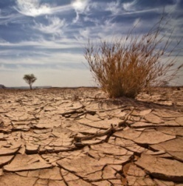

Assessment of Climate Change Impacts on Drought Return Periods Using Copula
Shahrbanou Madadgar, PhD Student
Hamid Moradkhani, Associate Professor, P.E., D.WRE
The Oregon Water Conference 2011: Evaluating and Managing Water Resources in a Climate of Uncertainty
Oregon State University
May 24-25, 2011
Department of Civil and Environmental Engineering

Slide 2
Introduction
Drought is a recurrent extreme climate event that strongly affects every specter of the natural environment and human lives.
$ 6-8 billion
Drought Types
Meteorological Drought
$ 10 billion
USA annual drought losses
Agricultural Drought
Western USA drought in 2002
Hydrological Drought
Socioeconomic Drought
National Drought Mitigation Center (NDMC)

Slide 3

Drought Indices
CMI
SWSI
SRI
PDSI
SMDI
RDI
JDI
VCI
SPI
RDSI
Each drought type is characterized by a certain drought index.
Drought indices are inherently correlated to each other.
Streamflow Drought Index (SDI; Nalbantis, 2008):

Slide 4
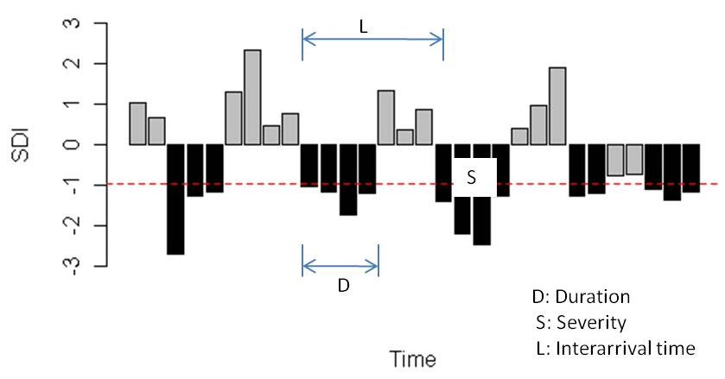

Drought Characteristics
Duration: the length of period in which the index values are less than truncation level.
Severity: the absolute cumulative index values based on the duration time.
Intensity: severity divided by duration.

Slide 5
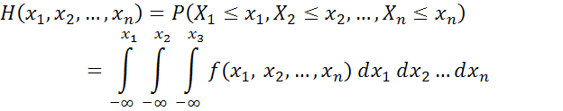

Drought Analysis and Copula
Drought duration, severity, and intensity are correlated to each other.
Joint behavior of drought variables should be analyzed by multivariate
probability distributions.
Copula is a multivariate distribution with uniform marginal distributions over (0,1). An n-dimensional Copula (C) is the joint probability of univariate marginal distribution F₁,…,F_{n} as follows:

Slide 6


Copula Family
Elliptical : Normal and t
Archimedean: Clayton, Gumbel, Frank, and Ali-Mikhail-Haq
Extreme value: Gumbel, Husler-Reiss, Galambos, Tawn, and t-EV
Other: Plackett and Farlie-Gumbel-Morgensterm
Trivariate GH copula:
t-copula:

Slide 7
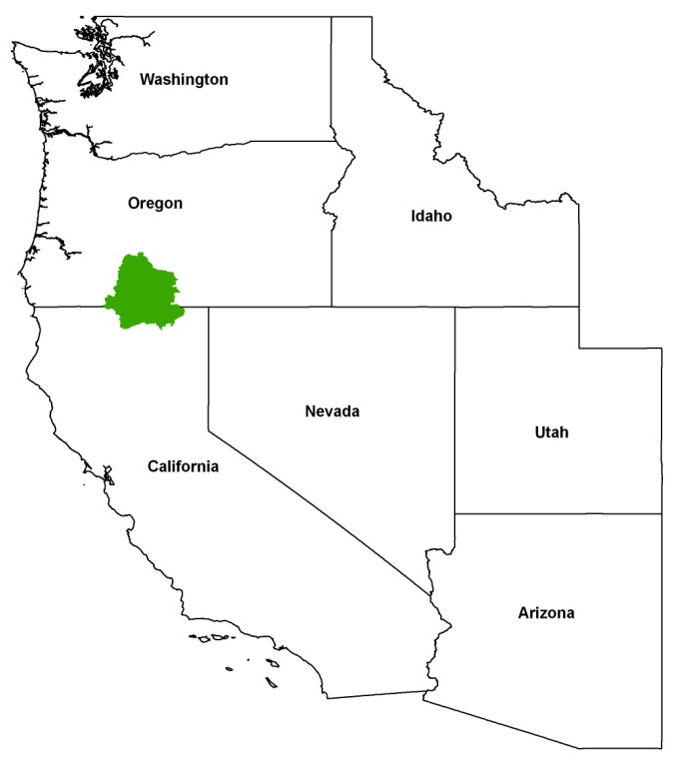
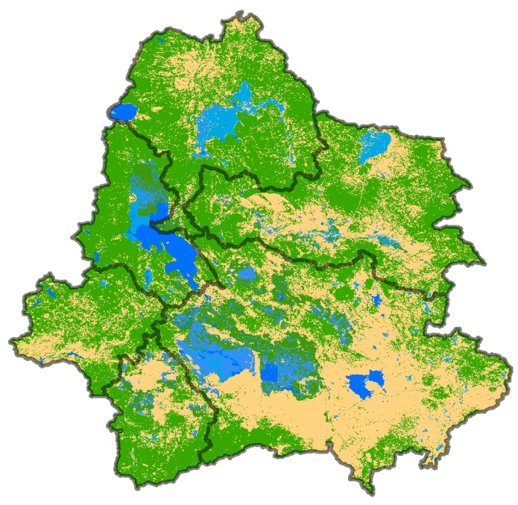
Study Area and Data
Upper Klamath River Basin in Western U.S.
On the border of OR/CA
Consists of six sub-basins
Drainage area: 21,000 km²
Drought analysis is conducted for historical and future time periods.
Monthly observed streamflow data from 1920 to 2009 for historical drought analysis. National Weather Service gage station: KLAO3/CNRFC.
Climate change impacts on drought events in the time period of 2020-2090.
Hydrological drought index: Streamflow Drought Index (SDI)

Slide 8
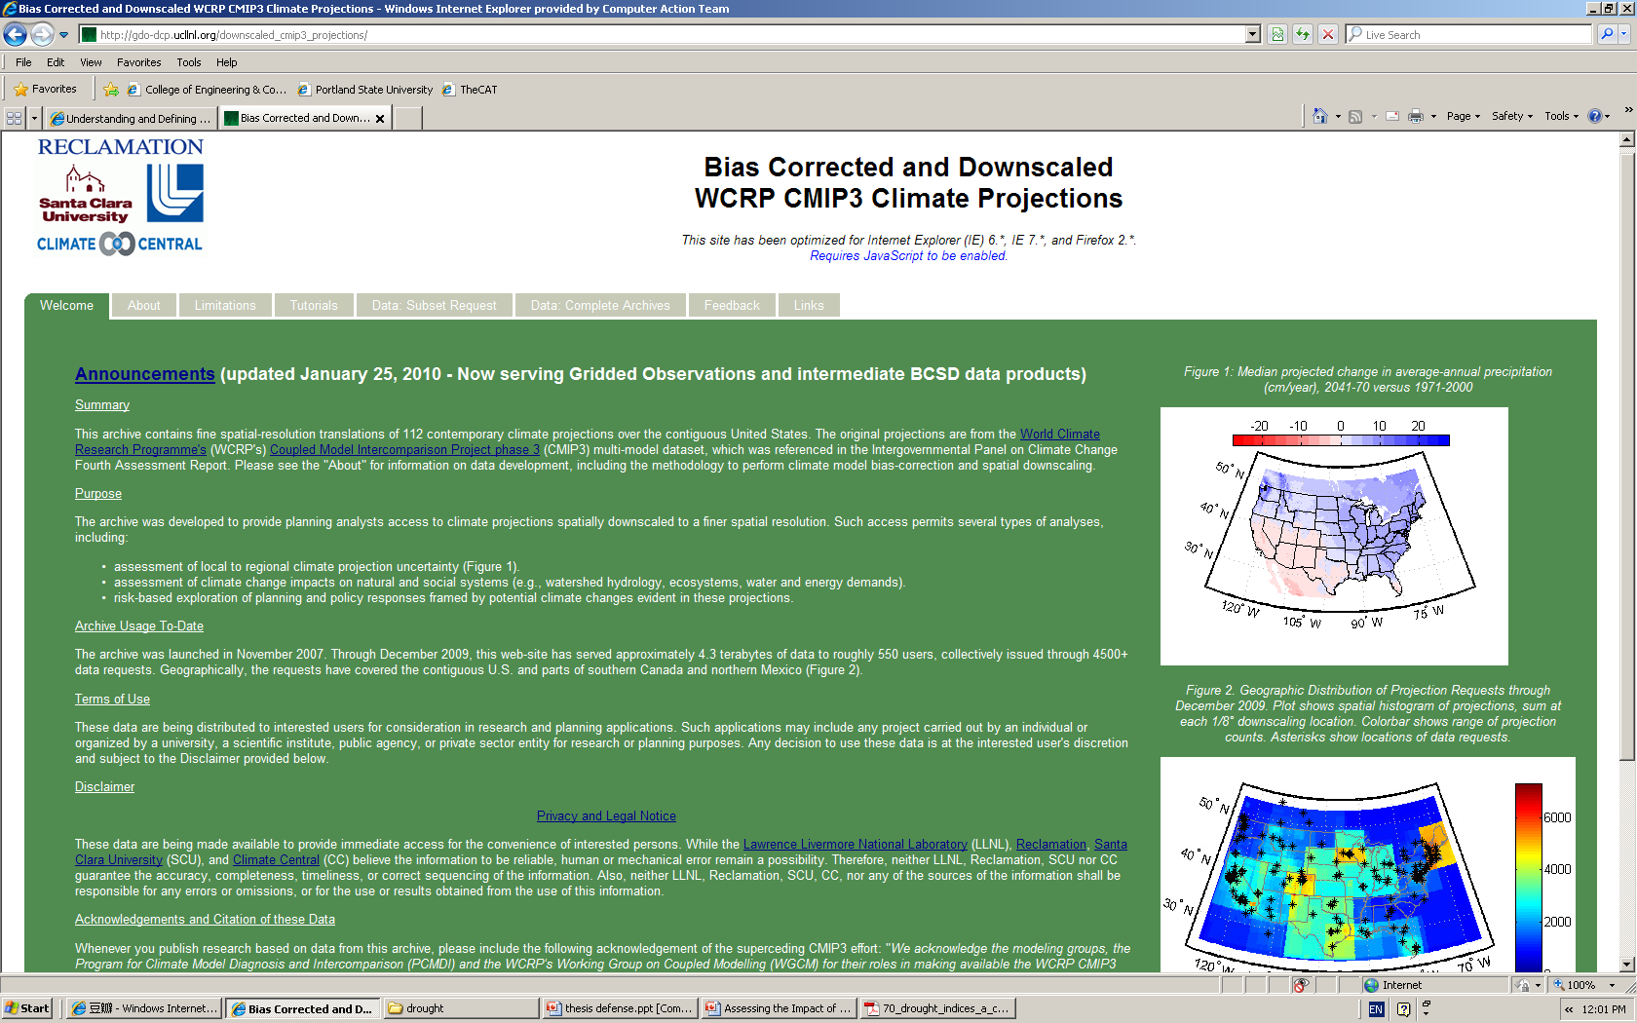
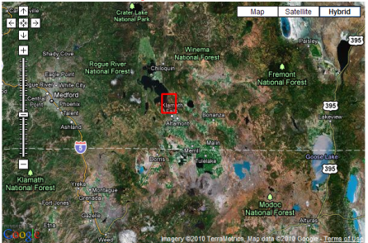
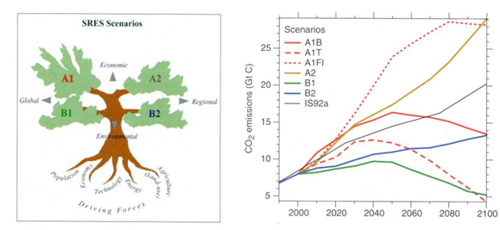
Data (cont’d)
Bias Corrected and Downscaled WCRP CMIP3 Climate Projections
precipitation, mm/day
  surface air temperature, °C
Resolution: 1/8 latitude-longitude (~12km by 12 km)
Location:42.3125 N, 121,8125 W
GCM Modeling Group, Country | Model Abbreviations
Bjerknes Centre for Climate Research | bccr_bcm2_0
Meteo-France/Centre National de Recherches Meteorologiques, France | cnrm_cm3
CSIRO Atmospheric Research, Australia | csiro-mk3_0
US Dept. of Commerce/NOAA/Geophysical Fluid Dynamics Laboratory, USA | gfdl_cm2_1
Hadley Centre for Climate Prediction and Research / Met Office, UK | ukmo_hadcm3

Slide 9
Marginal Distributions (1920-2009)
Droughts
Up to 8-month duration
Monthly variation of 6-month SDI
Best fitted marginal distributions to drought duration, severity, and intensity

Slide 10
Bivariate PDF Contours (1920-2009)
Gumbel copula and t-copula are employed to join the marginal distributions of duration, severity, and intensity.
Evidently, high correlation between duration and severity is supported by narrow stretching contour plots of marginal bivariate density functions in both copulas.

Slide 11
Marginal Distributions (2020-2090)
Wide range of severity
Small range of severity

Slide 12
Drought Durations (2020-2090)
≤ 5-month duration
Notes:
Duration of future droughts associated with different GCMs paired with A1B emission scenario for the time period of 2020-2090

Slide 13
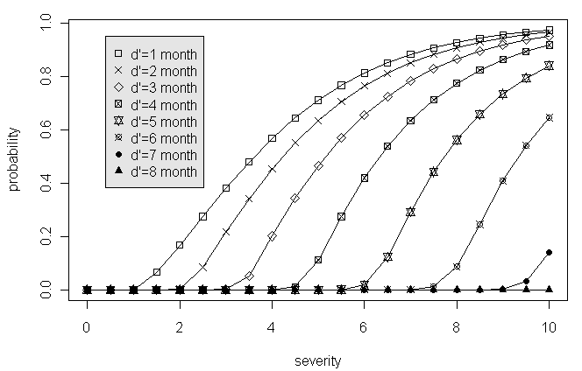
Conditional Probability (1920-2009)
-- Shiau(2006)
Conditional non-exceedance probability of drought severity given drought duration exceeding “d” months by applying Gumbel copula

Slide 14
Conditional Probability (2020-2090)
For the same given duration, future droughts are less severe than historical events.
CSIRO-MK3.0 pertains to the most severe 1-month droughts among all five GCMs
GFDL-CM2.1 results in the least severe events or the wettest conditions in the basin.
Given duration = 1 month

Slide 15



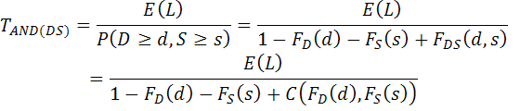
Return Periods
Single Variable
--Shiau(2003)
D>=d
AND
S>=s
Bivariate Return Periods
D>=d
OR
S>=s
--Shiau(2003)

Slide 16
Bivariate Return Periods
2020-2090
D>=d
AND
S>=s
D>=d
OR
S>=s
1920-2009
Notes:
The shaded areas correspond to 3, 10, and 100 years of joint return periods in either “AND” or “OR” case, and other mid-years return periods (e.g. 20 yrs, 50 yrs) are not shown. The reason is the close distance between shaded areas given the scales of either plot implying the existence of overlapped uncertainties if mid-return periods are also added to the figure. This fact actually indicates the high uncertainty for the joint return periods.
The other finding from this figure is that the historical droughts are quite longer and more severe than future droughts, and large distance between the contours of historical droughts in comparison with that of future droughts indicate that an increase in return period significantly changes the duration and severity of historical droughts. However, the characteristics of future droughts are not highly sensitive to the return periods.
Drought events in future would become less severe than the historical drought events, and the possibility of duration longer than 5.5 months is less than 0.01 for the “AND” case. For example, (d=3.5 and s=4) results in of 5.2 years for historical period while it is projected as over 10-yr future drought.

Slide 17
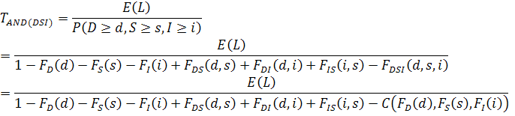

Trivariate Return Periods
D>=d
AND
S>=s
AND
I>=i
Trivariate Return Periods
D>=d
OR
S>=s
OR
I>=i
Notes:
Developing the bivariate return period formulation to 3 dimensions, trivariate return periods are obtained for either “AND” or “OR” case.

Slide 18
Trivariate Return Periods
“AND”
“OR”
Notes:
Joint return period for AND case is longer than “OR” case. In other words, in situations that all variables exceed the certain thresholds simultaneously, less frequent droughts are expected in comparison with the case that either variable exceeds the threshold.
T”AND” and T”OR” are respectively greater and smaller than the univariate return periods for future time period.
Evidently, droughts resulted from the GFDL-CM2.1 climate scenario gives greater return period of T”AND” as compared with other GCMs. Moreover, all the GCMs perform relatively close to each other while the GFDL-CM2.1 projection does pretty different than others in “AND” case. Comparing to historical droughts, the future events are less frequent in T”AND” and more frequent in T”OR” indicating that under climate change impacts Upper Klamath River basin will experience wetter conditions than the past.

Slide 19
Conclusion
Future droughts associated with 5 GCMs under A1B emission scenario have less duration and severity than the past.
Projected droughts are expected to persist less than 3 months and rarely prolong to 5 months.
Based on the conditional probability analysis using Copula, given 1-month drought duration, CNRM-CM3 and GFDL-CM2.1 are seen as the wettest climate scenarios resulting in the least drought severity among other GCM outputs; whereas CSIRO-MK3.0 output show the most severe droughts.
Joint return periods of future events are expected to increase in comparison with the historical events while a high uncertainty is estimated arising from different GCMs.
The return period analysis based on either bivariate or trivariate copulas showed that climate change makes an overall decline in drought severity and duration in the Upper Klamath River basin.

Slide 20
References
Han, P., Wang, P. X., Zhang, S. Y., Zhu, D. H., 2010. Drought forecasting based on the remote sensing data using ARIMA models. Mathematical and Computer Modelling, 51, 1398-1403.
Maurer, E. P., Brekke, L., Pruitt, T., and Duffy, P. B., 2007. Fine-resolution climate projections enhance regional climate change impact studies, Eos Trans. AGU, 88(47), 504.
Mishra, A. K., and V. P. Singh, 2010. A Review of Drought Concepts. J of Hydrology, 391: 202-216
Nalbantis, I., 2008. Evaluation of a Hydrological Drought Index. European Water 23/24: 67-77.
Salvadori, G., and C. De Michele (2010), Multivariate multiparameter extreme value models and return periods: A copula approach, Water Resour. Res., 46, W10501, doi:10.1029/2009WR009040.
Sheffield, J., and Wood, E. F., 2008. Projected changes in drought occurrence under future global warming from multi-model, multi-scenario, IPCC AR4 simulations. Climate Dynamics, 31(1), 79-105.
Shiau, J. T., 2006. Fitting drought duration and severity with two-dimensional copulas. Water Resources Management, 20(5), 795-815.
Sklar, K., 1959. Fonctions de repartition `a n Dimensions et Leura Marges. Publ. Inst. Stat. Univ. Paris, 8, 229–231.
Wong, G., Lambert, M. F., Leonard, M., and Metcalfe, A. V., 2010. Drought Analysis Using Trivariate Copulas Conditional on Climatic States. J. Hydrologic Engineering, 15(2), 129-141.

Slide 21
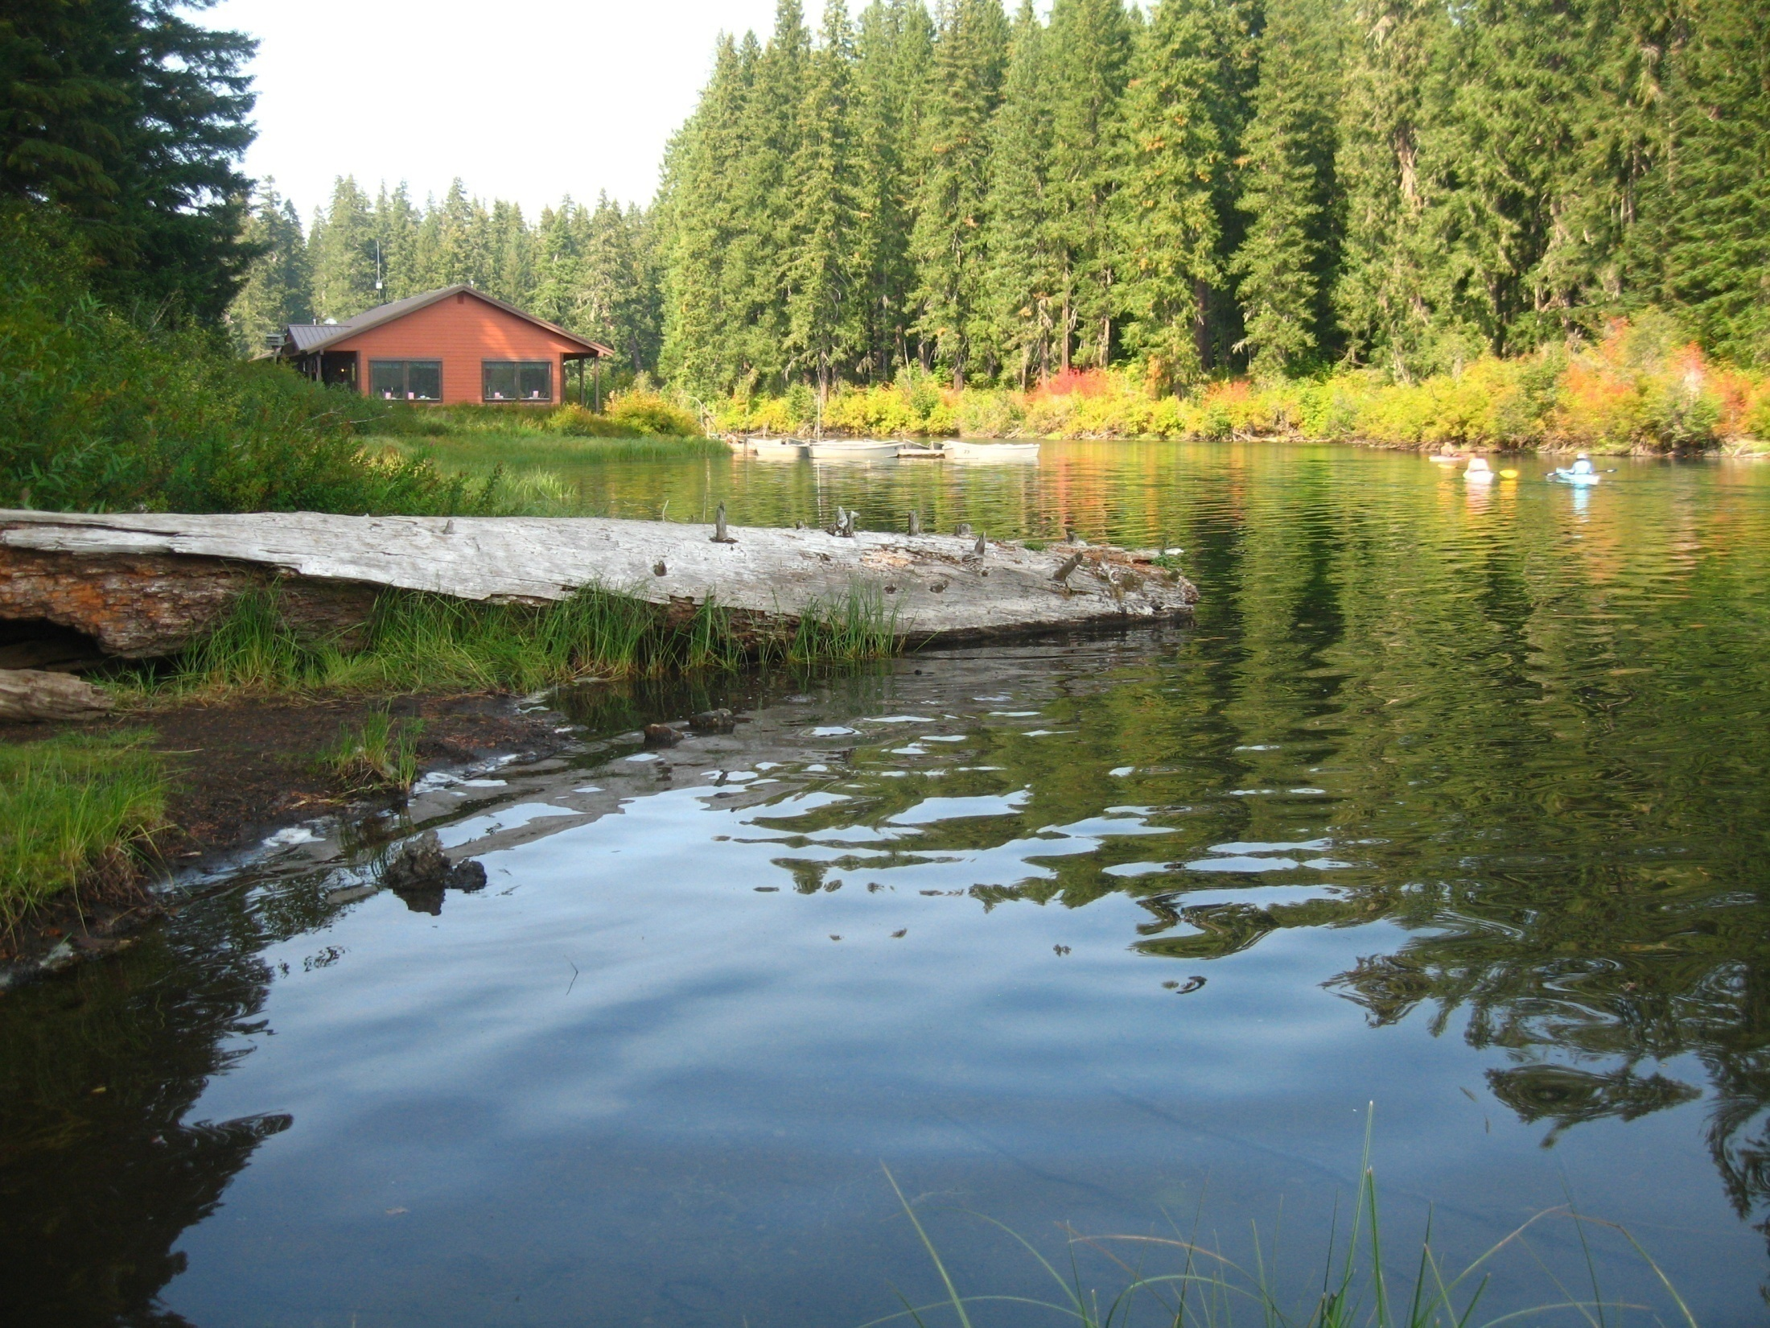
Thank you!

